Slide 1
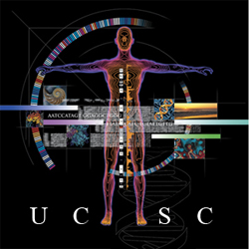

GTEx in the UCSC Genome Browser
Kate Rosenbloom
UCSC Genome Browser Group
December 2015

Slide 2
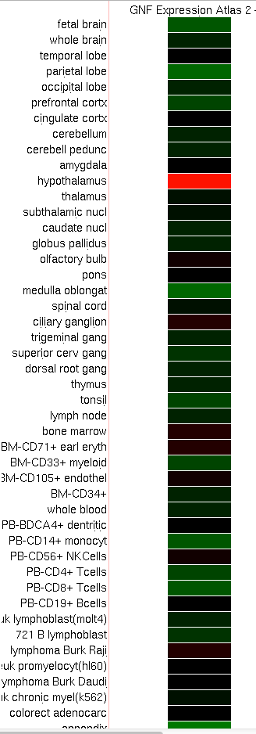
Motivation
Incorporate newer gene expression data sets and explore new ways of displaying tissue-specific gene expression in the browser.
Current tissue expression tracks:
GNF Atlas 2 (2009)
ENCODE transcription signal (2008-2012)
➔
Browser supplement funding to integrate GTEx into the genome browser database and develop visualizations
OXT: Oxytocin precursor
Expression from GNF Atlas2

Slide 3
Aims
Integrate gene expression data and metadata into the browser database
Develop new track display with more compact layout for higher on-screen annotation density
Create browser tracks for GTEx gene-level expression and allele-specific expression

Slide 4

Progress
✔
Integrate gene expression data and metadata into the browser database
Develop new bar-graph track display
Create browser track for GTEx gene-level expression
Create browser track for GTEx allele-specific expression
✔
✔
  Try the GTEx gene expression track on the UCSC preview browser:
  http://tinyurl.com/gtexUcsc

Slide 5
GTEx Gene Expression track
LCAP gene locus, showing highest expression in heart and skeletal muscle. Mouseover on
bars shows tissue type and median score. Click-through shows boxplot with score ranges.

Slide 6
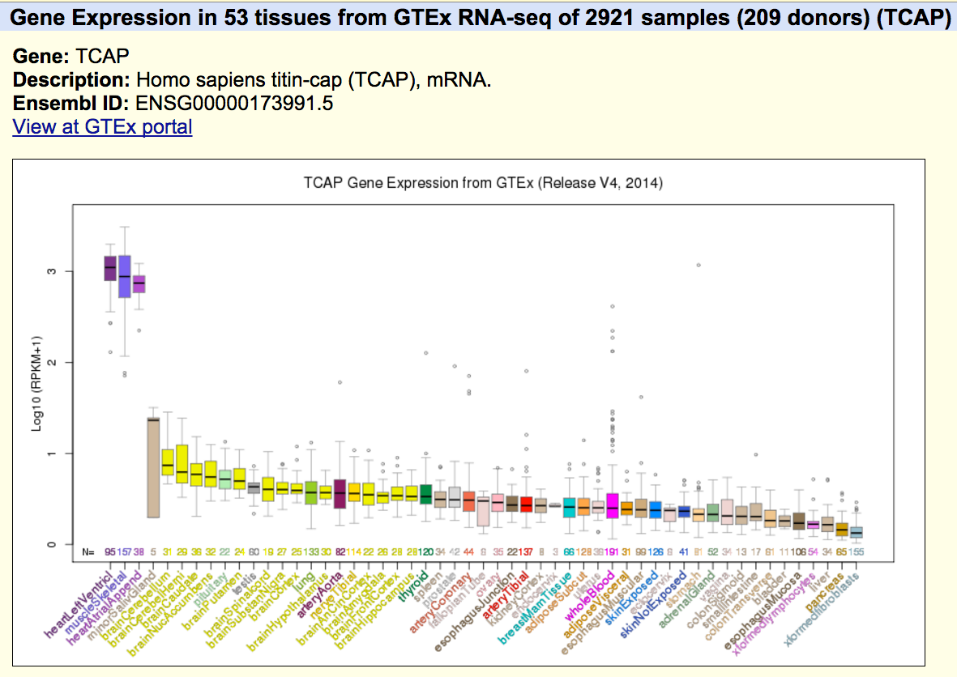
Gene expression details page

Slide 7
Multi-gene view
200 Kbp region of chromosome 17

Slide 8
Multi-megabase view
2.7 Mbp region of chromosome 17

Slide 9
Track features
Displays bar graph height as median RPKM raw score (with configurable range) or log transform. Mouseovers on gene shows description; on bars show tissue and score.
Shows sample quartiles and outliers on details page.
Allows filtering by tissue.
Provides comparison function to subset samples (currently, Male/Female).
Displays comparisons as difference graph or mirror graphs.

Slide 10
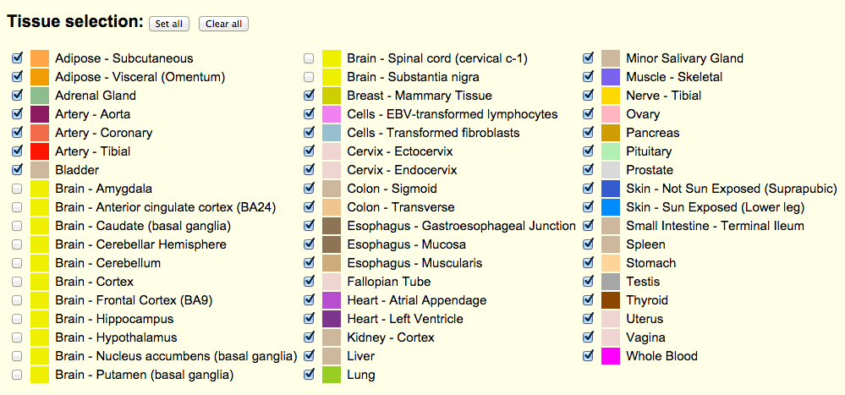
Tissue selection
Track configuration supports user choice of tissues to display

Slide 11
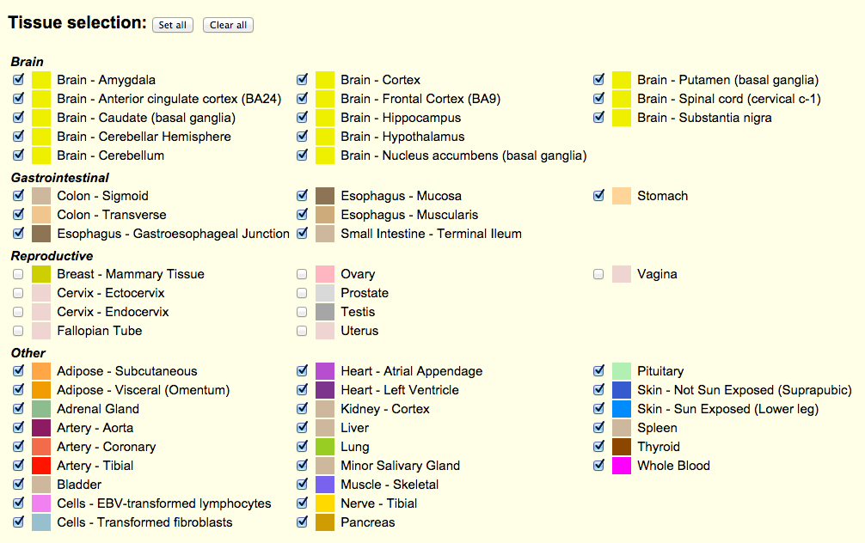
Tissue selection, cont.
Alternative configuration panel, with tissues grouped by system

Slide 12
Comparisons
Gender expression differences graph. The tissue filter was applied here to exclude
gender-specific tissues.

Slide 13
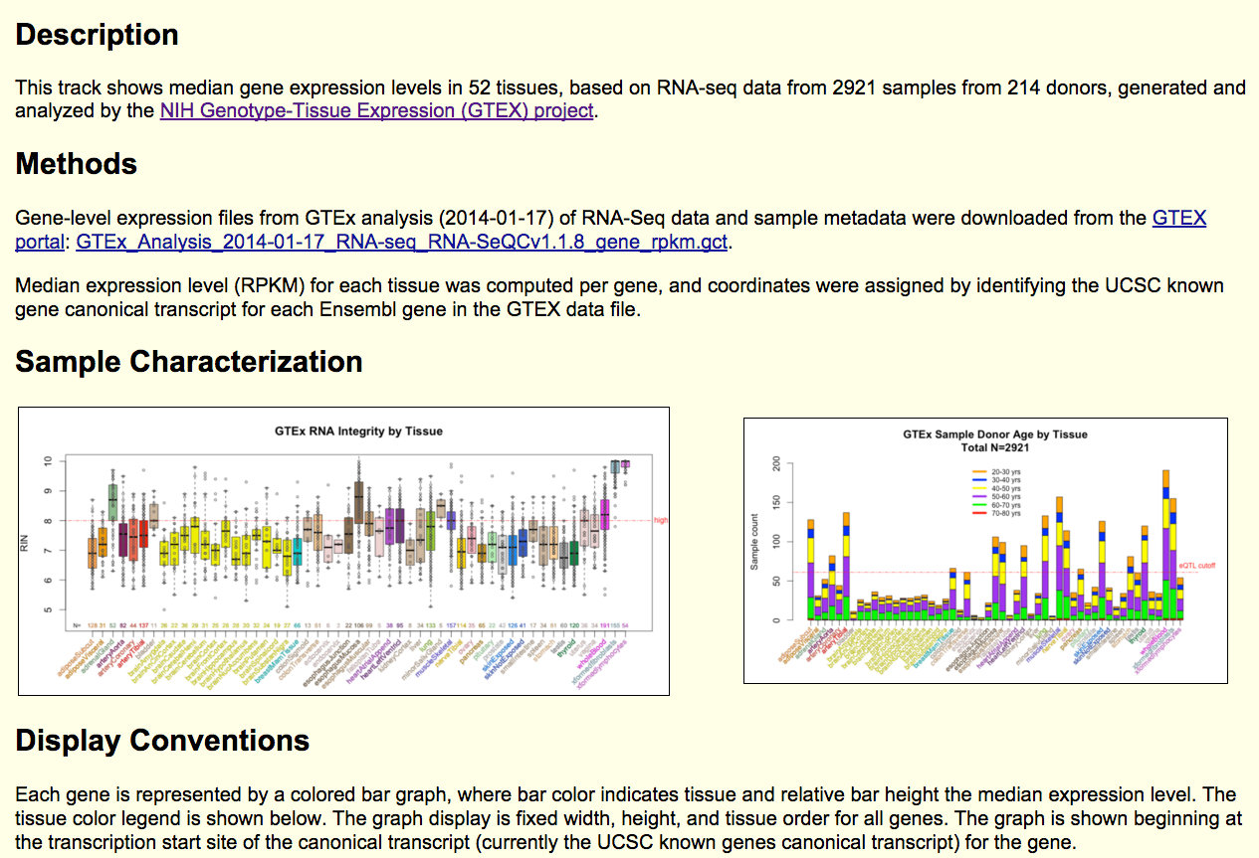
Track description
Track Description Page

Slide 14
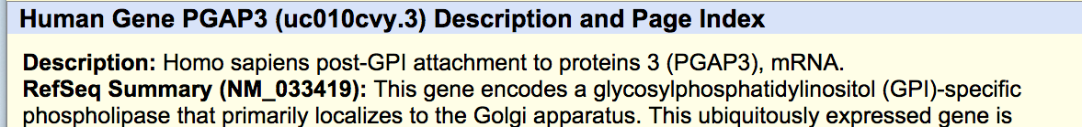
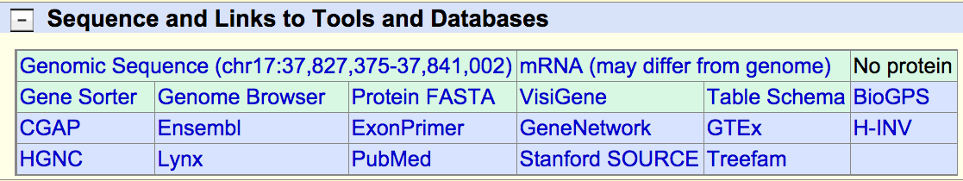
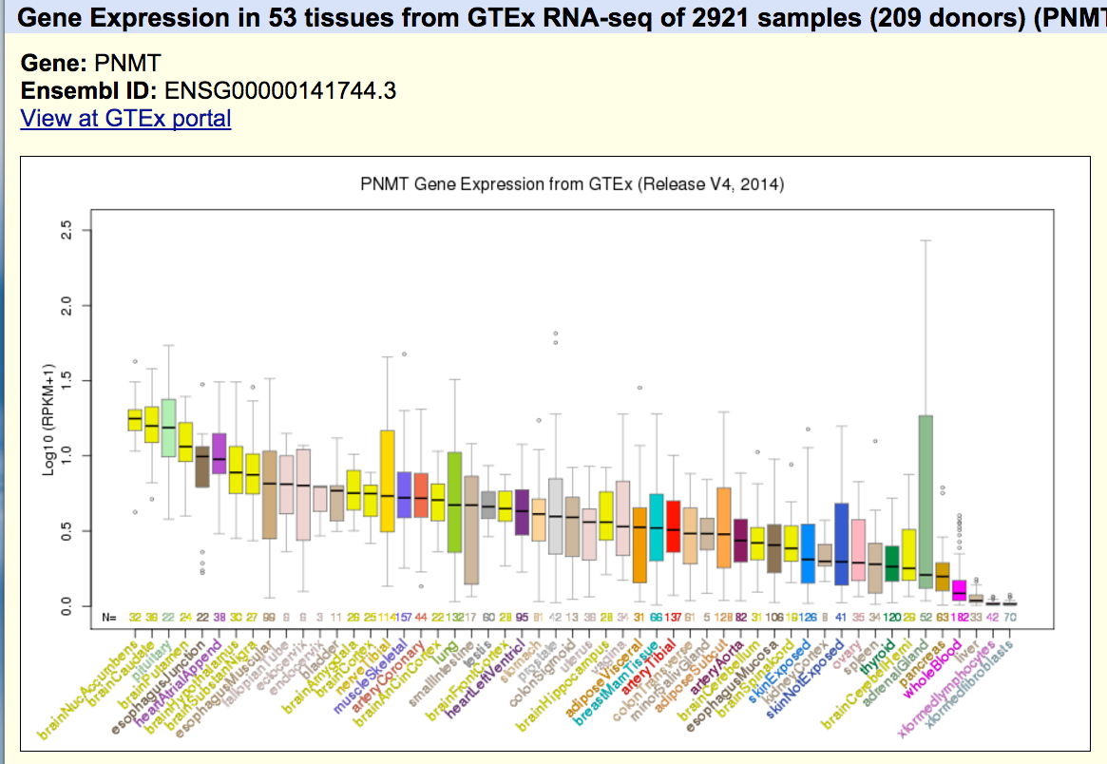
Linkouts to GTEx portal
UCSC/GENCODE genes detail page
GTEx gene expression details page

Slide 15
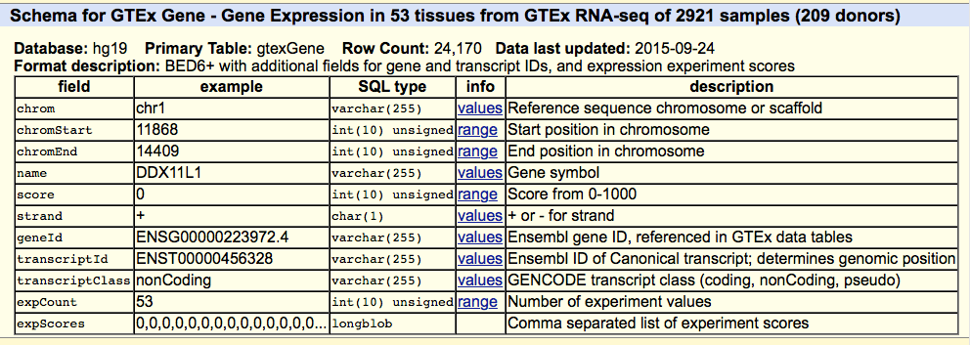
Under the covers:
GTEx Database tables
Primary table for GTEx Gene Expression track. This is a summary table of tissue medians
Per gene, anchored to the genomic location of the GTEx union transcript for the gene.
Related tables:
Data: gtexSampleData (RPKM scores for each gene by sample)
Metadata: gtexTissue, gtexSample, gtexDonor

Slide 16
Data mining & analysis:
UCSC public MySQL server
$ mysql –user=genome –host=genome-mysql.cse.ucsc.edu –A \
hgFixed -e ‘select sampleId, tissue, gender, age,\ deathClass, ischemicTime, autolysisScore, rin,\ collectionSites, batchId, isolationDate from \ gtexSample, gtexDonor where \ gtexSample.donor=gtexDonor.name' | \
sed -e 's/ //' > sampleDf.txt
$ R
>sampleDf <- read.table("sampleDf.txt", sep="\t", header=TRUE)
Example: Query GTEx metadata tables to create an R dataframe

Slide 17
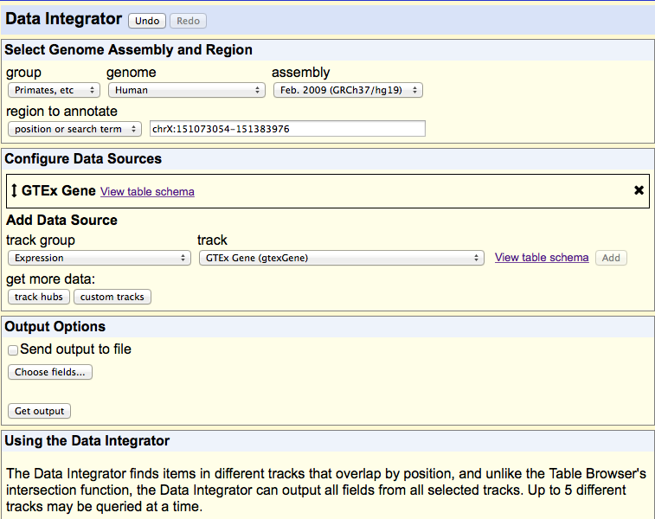
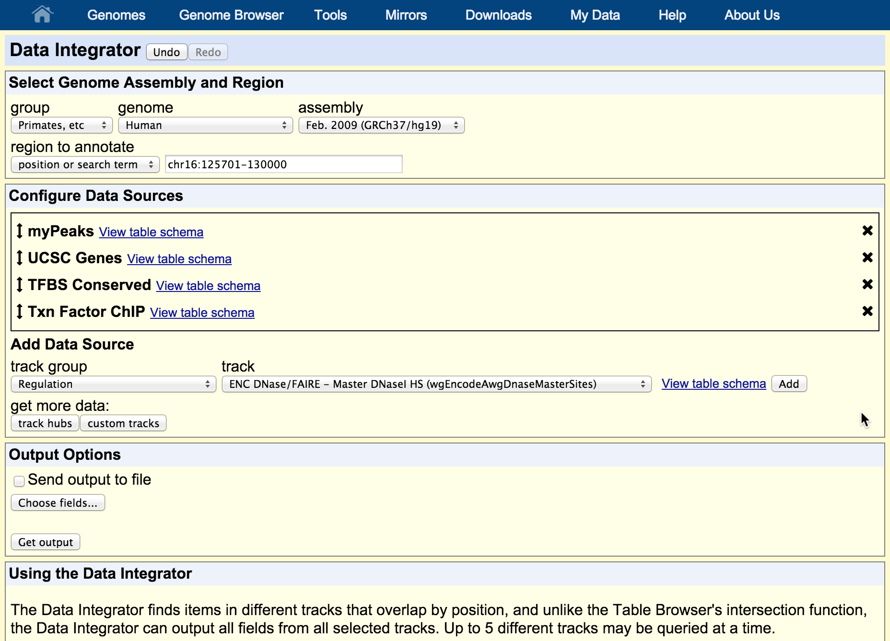
Data mining & analysis:
New tool for database queries/intersections

Slide 18
Plans
Release GTEx gene expression tracks on hg19 and hg38 (V4, then V6)
Implement GTEx allele-specific expression track:
  Display will be based on difference bar graph, as in gene expression track
  Initial design will locate graph at eQTL SNP’s
  Your input welcome!

Slide 19
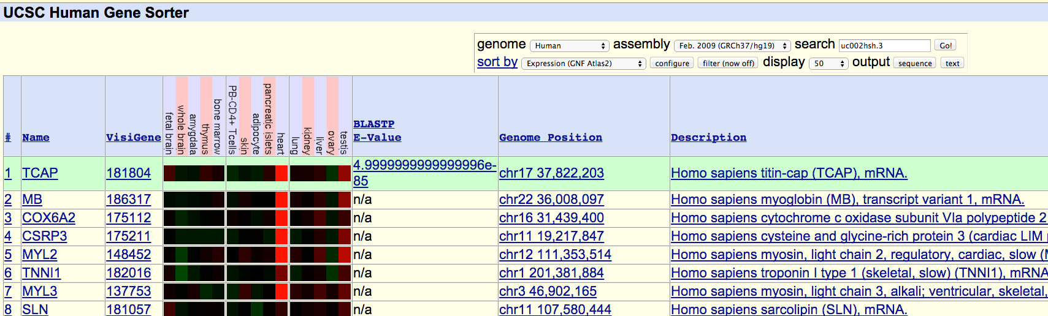
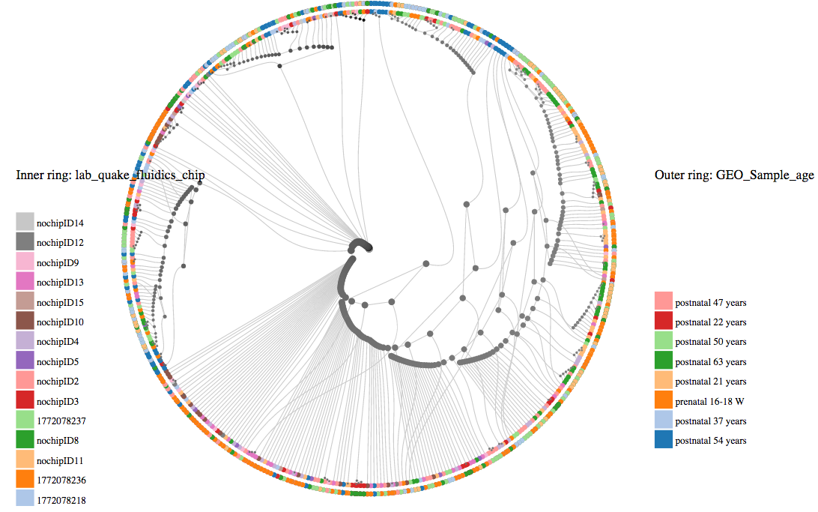
Other plans
Gene sorter
Tree of cells visualization

Slide 20
Community data: GTEx data hub ?
RNA-seq signal tracks for all samples
Exon-level expression
Transcript-level expression
Proteomics ?
-> Can display on UCSC or Ensembl (and later, NCBI sequence viewer)
-> Can view and intersect eQtl’s with regulatory data from ENCODE, Epigenomics Roadmap, etc.
-> Can view and intersect with variant and medical annotations, comparative genomics

Slide 21
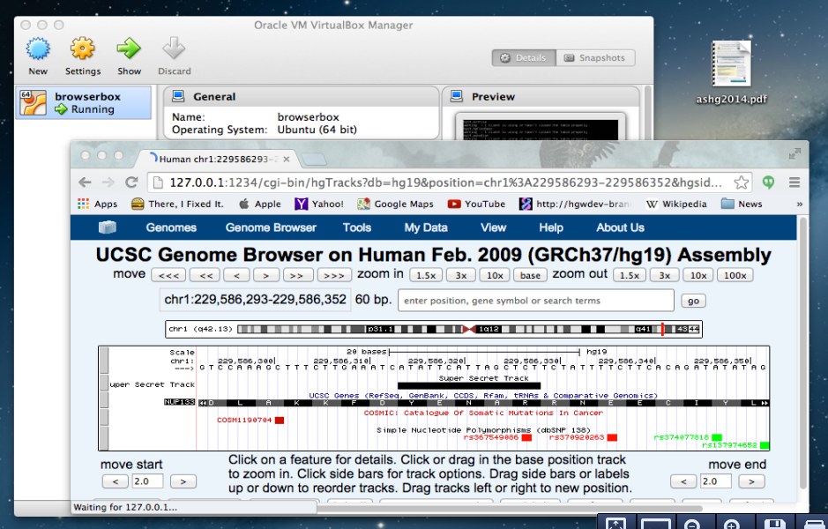
GTEx + private data:
Genome Browser in a Box (GBiB)
GBiB running on a Macbook, with private data loaded as a custom track. The GBiB
preinstalled image is run in a virtual machine so data can be kept local. UCSC tracks can
be mirrored locally or retrieved from the UCSC public MySQL server.

Slide 22
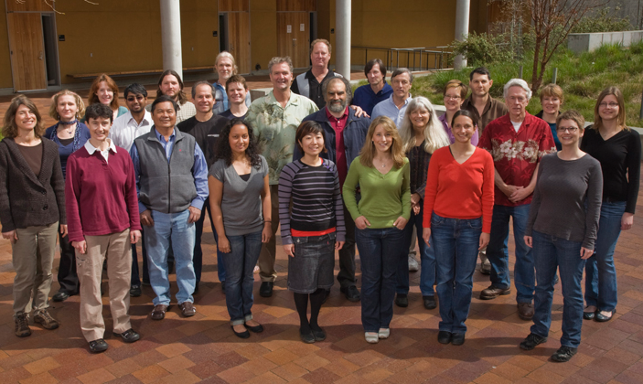
Acknowledgements
Colleagues: UCSC Genome Browser group
PI: Jim Kent
Collaborators: GTEx Consortium
Funding: NHGRI (5 U41 HG002371 to UCSC Center for Genomic Science)

Slide 23


UCSC Browser help
Send us a message to our public mailing list:
genome@soe.ucsc.edu
View training info, videos, and user’s guides:
http://genome.ucsc.edu/training/
Find us on: Genome Browser
@GenomeBrowser
UCSC Genome Browser
More information:
Send us a message on our public mailing list:
genome@soe.ucsc.edu
View training info, videos, and user’s guides:
http://genome.ucsc.edu/training/
Find us on:
GenomeBrowser
@GenomeBrowser
UCSC Genome Browser
More information:
Send us a message on our public mailing list:
genome@soe.ucsc.edu
View training info, videos, and user’s guides:
http://genome.ucsc.edu/training/
Find us on:
GenomeBrowser
@GenomeBrowser
UCSC Genome Browser
More information:
Send us a message on our public mailing list:
genome@soe.ucsc.edu
View training info, videos, and user’s guides:
http://genome.ucsc.edu/training/
Find us on:
GenomeBrowser
@GenomeBrowser
UCSC Genome Browser

