Slide 1
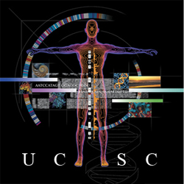

GTEx in the UCSC Genome Browser
Kate Rosenbloom
UCSC Genome Browser Group
February 2016

Slide 2

The GTEx project
https://commonfund.nih.gov/GTEx
NIH Common Fund sponsored initiative launched in September 2010 to create a biobank and database resources for studies on the relationship between genetic variation and gene expression in multiple human tissues. Aim: 50+ tissues in 1000 individuals.
NIH leads: Jeff Streuwing and Simona Volpi (NHGRI)

Slide 3
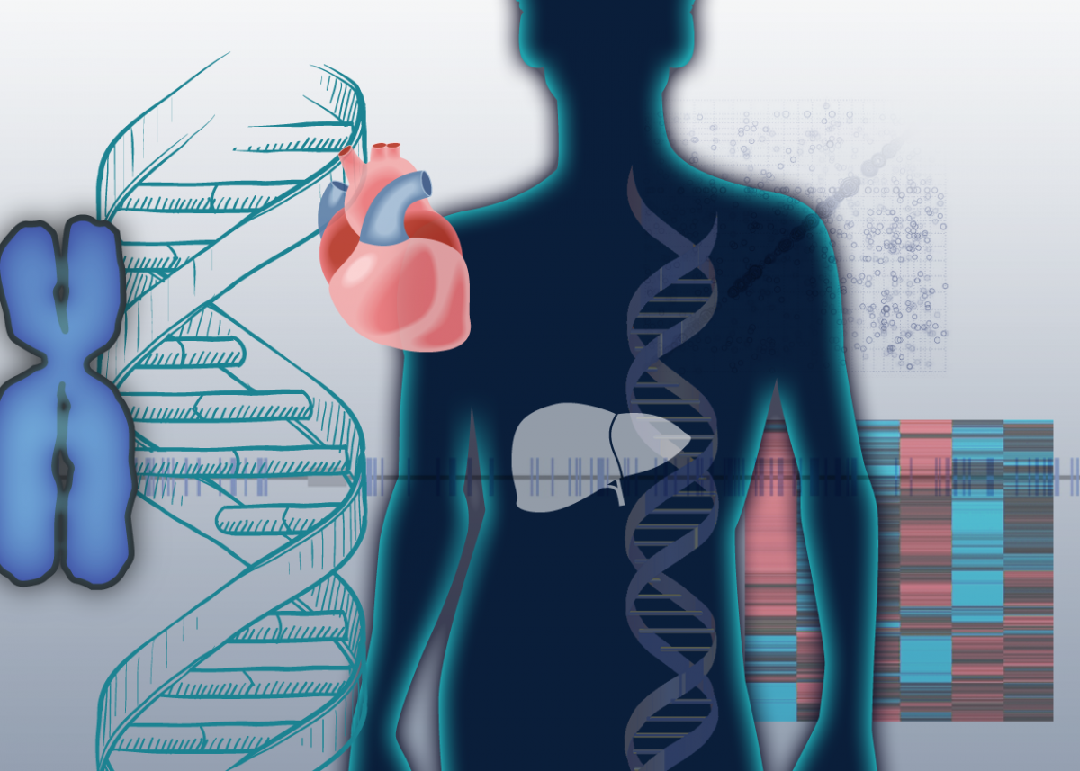
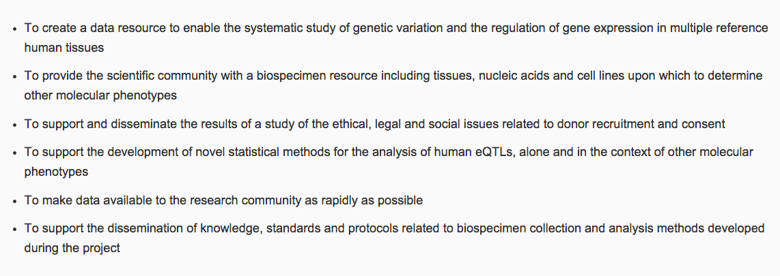

The Genotype-Tissue Expression (GTEx) project
The GTEx Consortium.
Nat Genet. 2013 May 29;45(6):580-5. doi: 10.1038/ng.2653.
PMID: 23715323
Goals
Status
Notes:
The project kicked off a 2-year pilot in 2010. First partial data releases in 2012 were followed by a 2013 Marker paper describing the project goals in detail. Establish a tissue biobank and data resource from 900 post-mortum individuals. Collect genotypes and a broad range of tissue samples, running RNA-seq and analyzing for expression levels and quantitative trait loci.

Slide 4
Data: GTEx analysis releases
Jun 2013: Freeze: Pilot dataset (9 tissues, 1641 samples, 178 donors) -> First round of publications
Jun 2014: Gene and transcript expression levels for 53 tissues, 2921 samples, 214 donors (V4)
Jan 2015: eQTL’s for 9 tissues
Oct 2015: Freeze: Midpoint (~7300 samples, 550 donors) (V6) ->
-> Second round of publications
Mid 2016: Freeze: Full dataset (15-20,000 samples, 900 donors)
V4 and V6 data are available on UCSC dev/preview servers. V6 will be public.
Notes:
Here you can see the timeline of GTEX data release. We are currently working with the 2014 data release, the first to include a broad range of tissues. We have loaded all the gene expression data, much of the metadata, derived tissue median levels, and created annotation tracks of for the hg19 and hg38 assemblies. We also have an iniital implementation for a new track display showing per-tissue expression via a color spectrum bar graph per gene.

Slide 5

GTEX Sample Metadata
60 variables reported
From pathology reports
  autolysis score
  ischemic time
  tissue quality
11 from sample processing and sequencing
45 metrics from analysis pipeline
Notes:
I mentioned we want to capture the full sample metadata

Slide 6
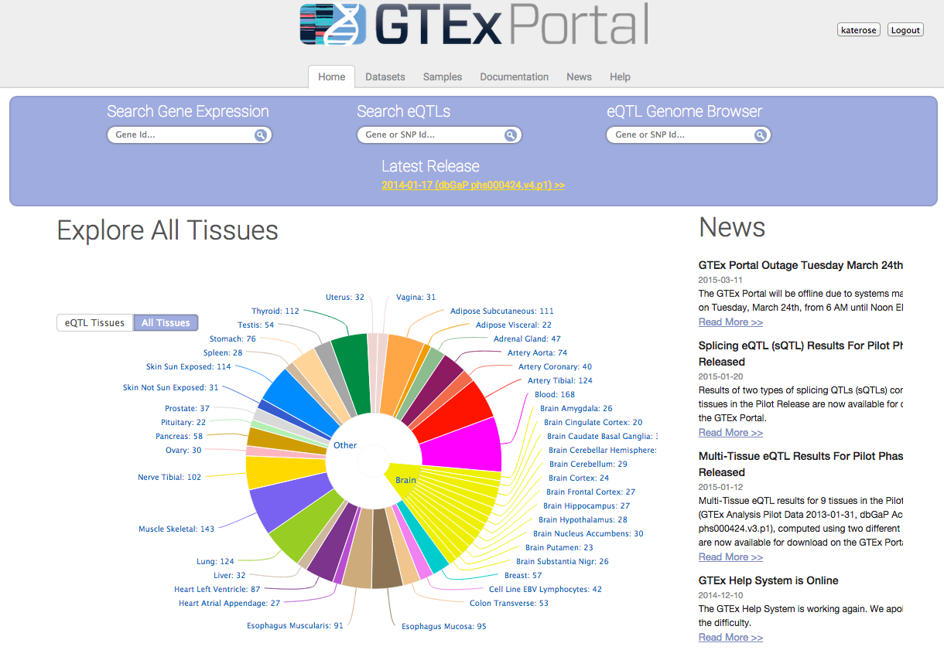
Data and visualization site at the Broad LDACC,
PI’s: Gad Getz, Kristin Ardlie
http://gtexportal.org
* Gene and transcript expression levels, eQTL’s are hosted at GTEX portal
* RNA-seq reads and genotypes hosted at dbGAP
Notes:
GTEX data are released at this portal, managed by the project Data coordination and analysis group at the Broad.

Slide 7
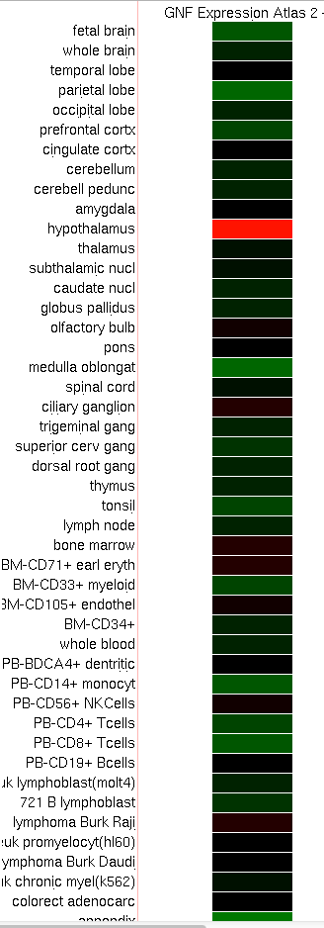
UCSC Motivation
Incorporate newer gene expression data sets and explore new ways of displaying tissue-specific gene expression in the browser.
Current tissue expression tracks:
GNF Atlas 2 (2009)
ENCODE transcription signal (2008-2012)
➔
Browser supplement funding to integrate GTEx into the genome browser database and develop visualizations
OXT: Oxytocin precursor
Expression from GNF Atlas2

Slide 8
UCSC GTEx Grant Aims
The NIH Common Fund's Genotype-Tissue Expression (GTEx) program measures genotype and gene expression in multiple tissues for many human donors.
UCSC will integrate GTEx data into the Genome Browser. The integration will include at least two new tracks in the Genome Browser, one that shows the tissue-by-tissue expression data associated with each gene, and another that shows significant allele-specific differences in expression. We will also add new columns for the GTEx data to the Gene Sorter, and new panels to the existing gene details display.
UCSC will update the GTEx data in the Genome Browser at least once yearly, and will synchronize new releases to match major data releases from GTEx when possible. UCSC will collaborate with the GTEx analysis team, integrating new analyses as well as new data, and advising on analysis methods when useful.
Notes:
So what is our role ? UCSC aims to incorporate GTEX data into the browser databases, develop new track displays to facilitate interpretation, as well as use the data to expand some of our existing gene tracks and tools.
Specifically, we are developing a new GTEX gene-tissue expression track, and an allele-specific expression track. We will also show GTEX expression from our main gene track detrails page, and in the Gene Sorter tool.
As new data becomes available, we’ll be updating our databases and tracks.

Slide 9
Aims
Integrate gene expression data and metadata into the browser database
Develop new track display with more compact layout for higher on-screen annotation density
Create browser tracks for GTEx gene-level expression and allele-specific expression
Integrate GTEx expression into browser gene details
Add GTEx expression columns to the Gene Sorter

Slide 10

Progress
✔
Integrate gene expression data and metadata into the browser database
Develop new bar-graph track display
Create browser track for GTEx gene-level expression
Create browser track for GTEx allele-specific expression
Integrate GTEx expression into browser gene details
Add GTEx expression columns to the Gene Sorter
✔
✔
  -> Try the GTEx gene expression track on the UCSC preview browser:
  http://tinyurl.com/gtexUcsc

Slide 11
GTEx Gene Expression track
LCAP gene locus, showing highest expression in heart and skeletal muscle. Mouseover on
bars shows tissue type and median score. Click-through shows boxplot with score ranges.

Slide 12
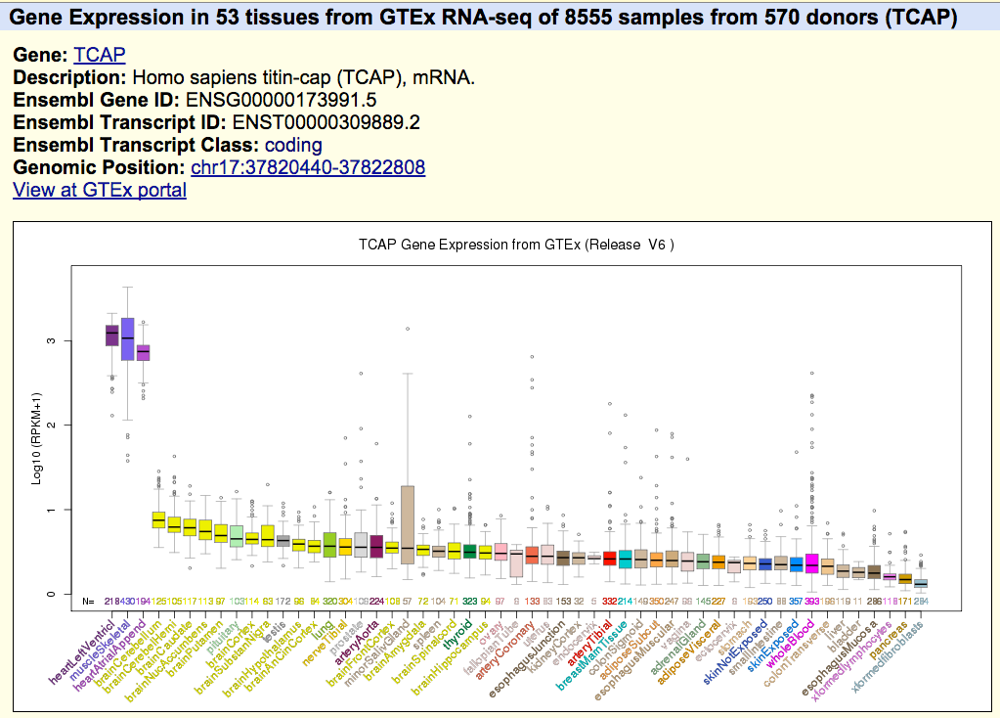
Gene expression details page

Slide 13
Multi-gene view
200 Kbp region of chromosome 17

Slide 14
Multi-megabase view
2.7 Mbp region of chromosome 17

Slide 15
Track features
Main browser displays a bargraph per gene, with bar height for each tissue based on the median expression level (RPKM)
Mouseovers on gene shows description; on bars show tissue and score.
Graph is configurable to draw bar heights based on raw score (with max limit selectable) or log transform
Supports tissue selection via sortable table
Provides comparison function to subset samples (currently, Male/Female). Comparisons are shown as a difference graph or mirror graphs.
Details page shows boxplot of gene expression, including quartiles and outliers, on details page.

Slide 16
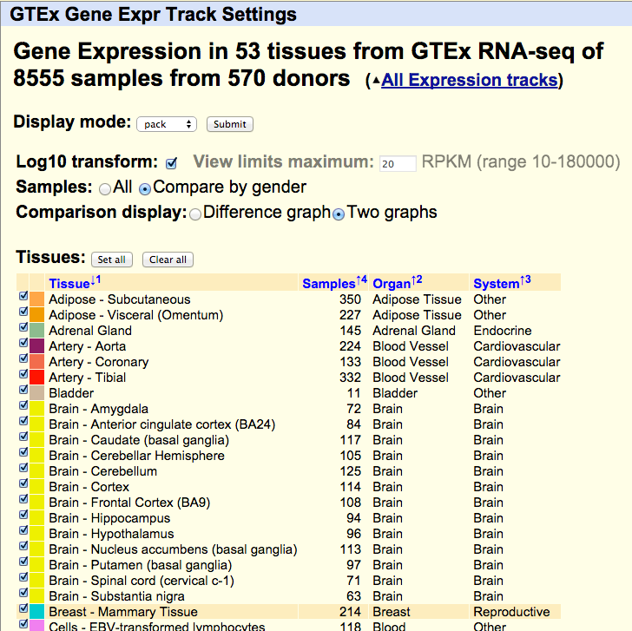
Track Configuration
Sample comparison
Tissue selection

Slide 17
Comparisons
Gender expression differences graph. The tissue filter was applied here to exclude
gender-specific tissues.

Slide 18
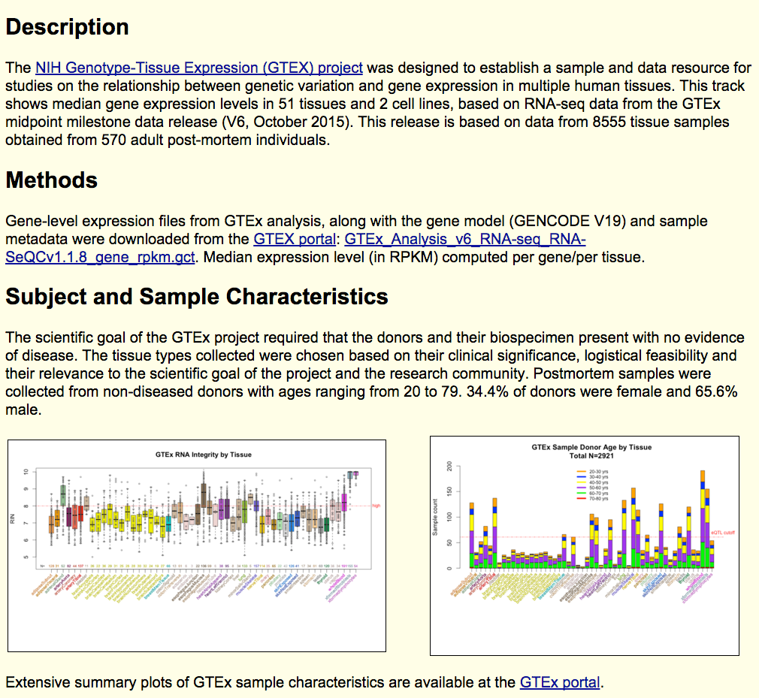
Track Description Page

Slide 19
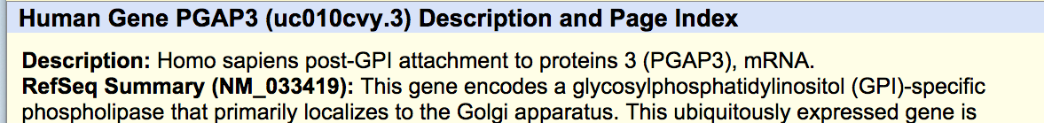
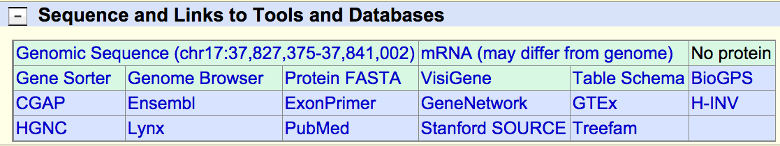
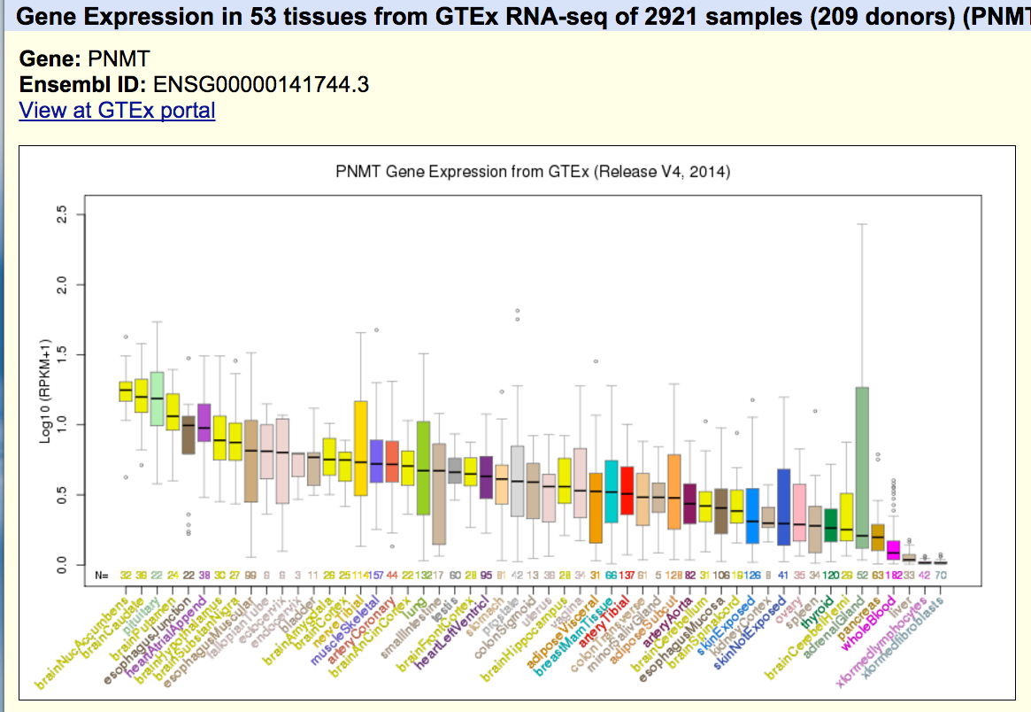
Linkouts to GTEx portal
UCSC/GENCODE genes detail page
GTEx gene expression details page

Slide 20
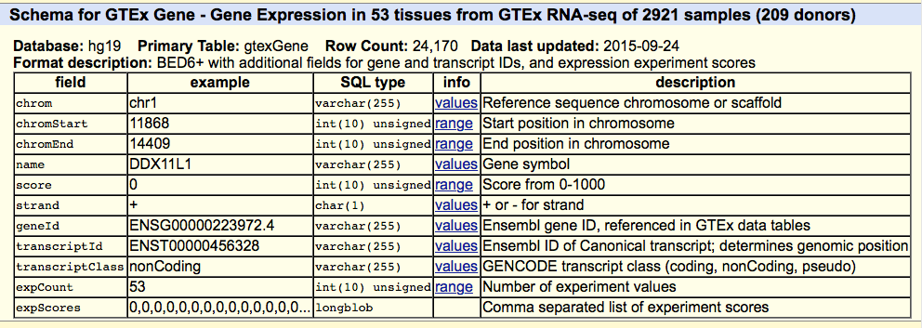
Under the covers:
GTEx Database tables
Primary table for GTEx Gene Expression track. This is a summary table of tissue medians
Per gene, anchored to the genomic location of the GTEx union transcript for the gene.
Related tables:
Data: gtexSampleData (RPKM scores for each gene by sample)
Metadata: gtexTissue, gtexSample, gtexDonor

Slide 21
Data mining & analysis:
UCSC public MySQL server
$ mysql –user=genome –host=genome-mysql.cse.ucsc.edu –A \
hgFixed -e ‘select sampleId, tissue, gender, age,\ deathClass, ischemicTime, autolysisScore, rin,\ collectionSites, batchId, isolationDate from \ gtexSample, gtexDonor where \ gtexSample.donor=gtexDonor.name' | \
sed -e 's/ //' > sampleDf.txt
$ R
>sampleDf <- read.table("sampleDf.txt", sep="\t", header=TRUE)
Example: Query GTEx metadata tables to create an R dataframe

Slide 22
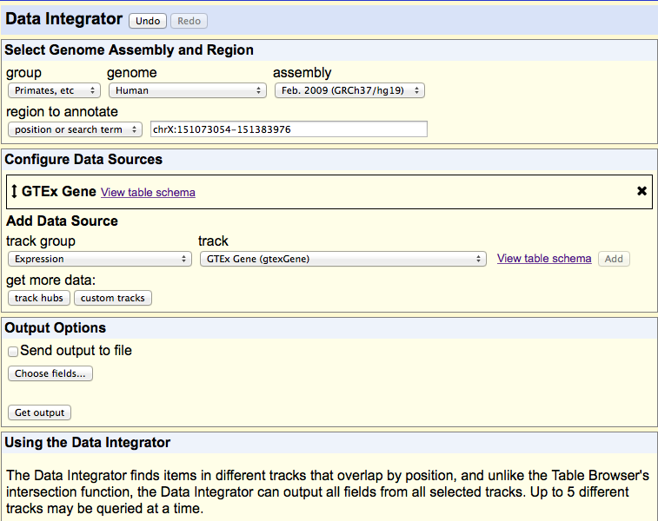
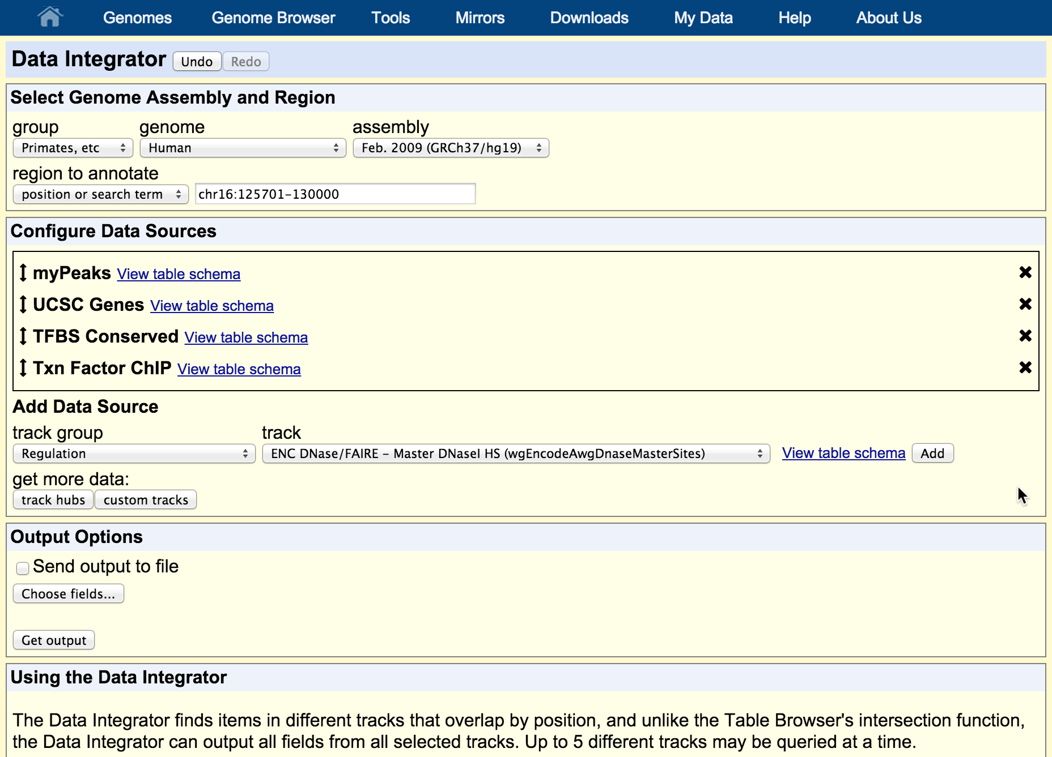
Data mining & analysis:
New tool for database queries/intersections

Slide 23
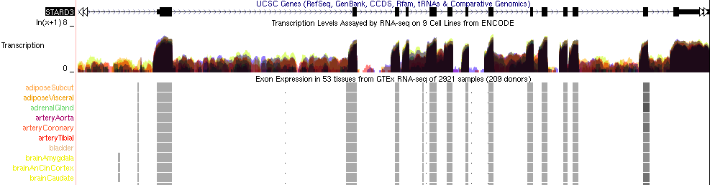
Community data: GTEx data hub
RNA-seq signal tracks for all samples
Exon-level expression
Transcript-level expression
Proteomics ?

Slide 24
Plans
Release GTEx V6 gene expression track on hg19 and hg38 (in pushQ week of Feb 15)
Integrate GTEx V6 gene expression graph into hgGene page (replace microarray heatmap)
Build public track hub of GTEx RNA-seq signal from all V6 samples (~8000), organized by tissue. (with Parisa Nejad, and in collaboration with Benedict Paten’s group).
Add GTEx gene expression columns to Gene Sorter
Implement GTEx eQTL or allele-specific expression track (TBD)
Work with GTEx portal team (Jared Nedzel) and EBI Ensembl groups (Daniel Zerbino) to support each others GTEx visualization efforts.

Slide 25
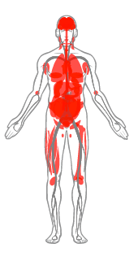
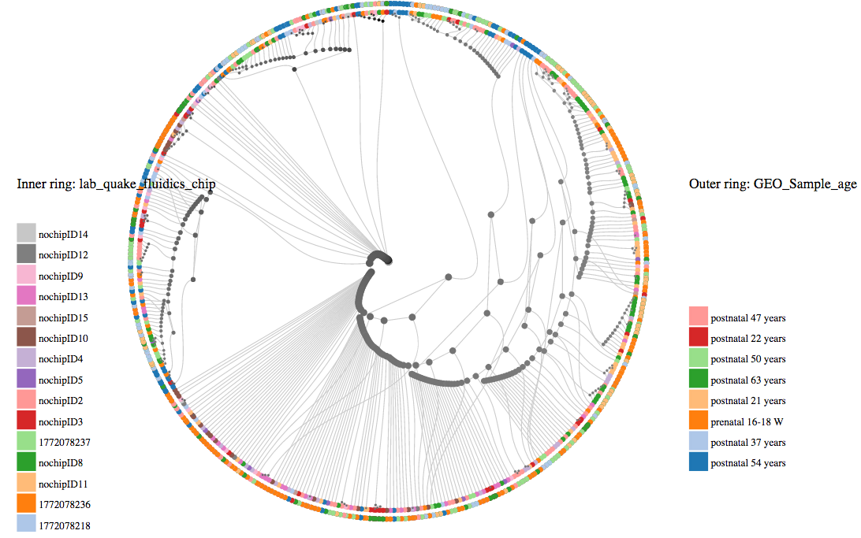
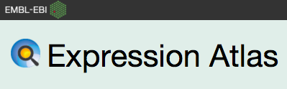
Further plans
Anatomogram
Tree of cells
Credit: Chris Eisenhart
Courtesy of Robert Petryszak

Slide 26
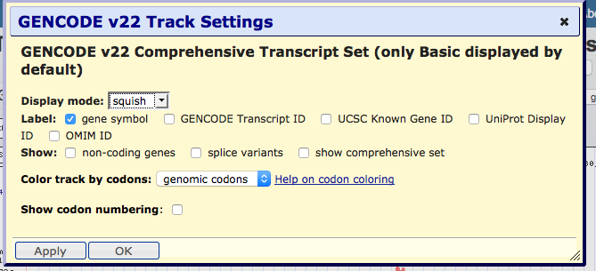
Bonus feature (inspired by GTEx data): Apply button

Slide 27
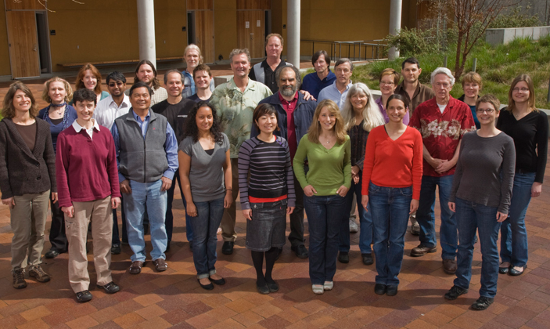
Acknowledgements
Colleagues: UCSC Genome Browser group
PI: Jim Kent
Collaborators: GTEx Consortium
Funding: NHGRI (5 U41 HG002371 to UCSC Center for Genomic Science)

