Slide 1


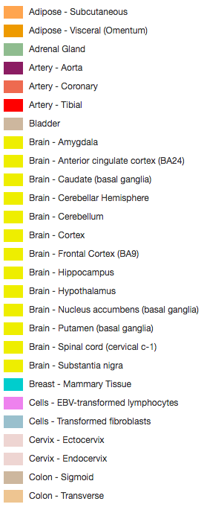
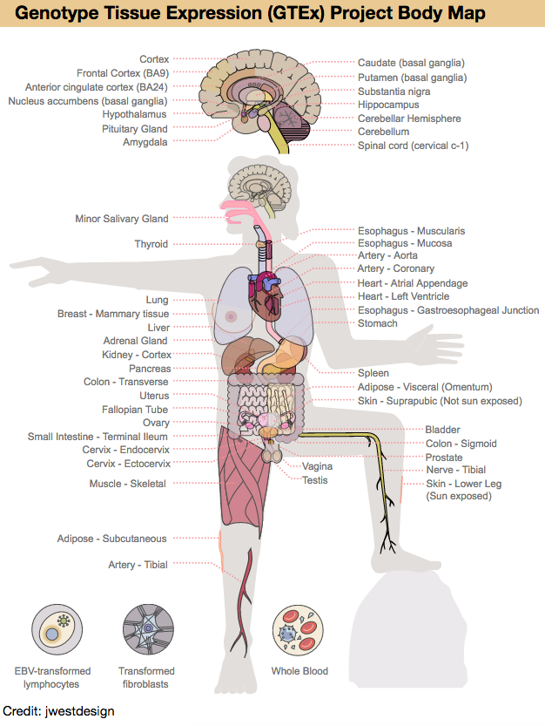


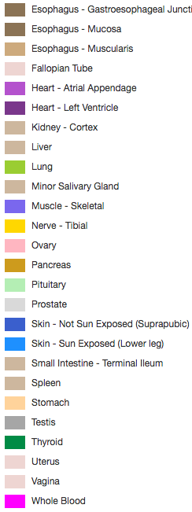


Genome Browser
GTEx resources and new ‘barChart’ and ‘interaction’ track displays inspired by GTEx
Kate Rosenbloom, Galt Barber, Jonathan Caspar, Hiram Clawson, Max Haeussler, Angie Hinrichs, Christopher Lee, Jairo Navarro,
Brian Raney, John Vivian, Brian Lee, Ann Zweig, David Haussler, Robert M Kuhn, and Jim Kent
UCSC Genome Browser Group, UC Santa Cruz Genomics Institute, University of California Santa Cruz
https://genome.ucsc.edu
Inspired by the comprehensive and high-quality gene expression and variant datasets released by the NIH Genotype-Tissue Expression (GTEx) project, we have created new visualization and data mining resources in the UCSC Genome Browser based on the GTEx midpoint release (V6). Recognizing that the new displays developed for GTEx would be useful for user community display of their own data, we generalized the data management and display to create two new track types – barChart and interact.
GTEx Body Map
Tissue colors
GTEx tracks
Gene and transcript expression in 53 tissues
from GTEx RNA-seq of 8555 samples (570 donors)
Expression QTLs in 44 tissues from GTEx
Intronic region of the PHACTR1 locus, where GTEx eQTL analysis reported in Nature October 2017 identifies two SNP’s affecting gene expression levels in artery -- one upregulating (colored red), and the other down-regulating (colored blue). The color intensity displayed reflects the effect strength.
Public GTEx track hubs
Distant SNP-gene interactions
Allele-specific expression
RNA-seq read coverage from GTEx/UCSC Toil
https://genome.ucsc.edu/gtexBodyMap.html
12 Mbp region where GTEx trans-eQTL analysis identifies one interchromosomal interaction, 4 with both SNP and gene in the region (curved display), and multiple longer interactions. These tracks, featuring the new paired region interaction display, are under development for release in spring 2018.
ASE annotation from GTEx analysts at the NY Genome Center showing allelic imbalance at the H19 locus, a known imprinted gene.
Genomic region with 6 transcriptionally active regions demonstrating tissue-specific expression, indicated by the gene-level annotation from the GTEx LDACC as well as the individual donor RNA-seq signal computed independently at UCSC, using the Toil pipeline.
As a companion to the GTEx data resources, we developed an interactive human anatomy graphic of the 52 GTEx tissues. This graphic provides a user-friendly tissue legend for GTEx . It is available for tissue selection on the configuration page of several GTEx tracks, and will be released as an independent page available for linking by outside resources.
barChart track type
Interact track type
The barChart track format displays a graph of category values over genomic regions. This format is useful for displaying gene expression and other datasets comparing a set of variables. The main display is designed to present summary data from large sample sets, An optional data matrix file with sample values will enable display of the data distribution as a boxplot on a details page.
The interact track type was designed to display functional element interactions (e.g. SNP-Gene), but is also suitable for low-density chromatin interaction data (e.g. ChiaPet)
track type=interact visibility=full
# Interaction Source Target
# chrom start end name score value exp color chrom start end name strand chrom start end name strand
chr6 99790007 99798261 inter1 233 4.0 brain 255,0.0 chr6 99790007 99793559 rs1 . chr6 99794572 99798261 gene1 +
chr6 99797231 99875440 inter2 175 3.2 blood 0,255,0 chr6 99797231 99801068 rs2 . chr6 99873105 99875440 gene2 +
chr6 99834530 99843149 inter3 175 3.1 liver 0,0,255 chr6 99834530 99837680 rs3 . chr6 99839323 99843149 gene3 -
chr6 99848067 99857519 inter4 175 3.5 kidney 0 chr6 99848067 99852034 rs4 . chr6 99855098 99857519 gene4 +
track type=barChart barChartBars="blood lung liver heart muscle" visibility=pack
# chrom start end name score strand name2 expcount expscores
chr14 9508627 95158010 DICER1 900 - ENSG000005100697 5 30.5,11.6,80.2,4.9,120.5
Acknowledgements
Interactions on the same chromosome are displayed as arcs or half-rectangles connecting the interaction endpoints (arcs are drawn if both endpoints are in the display window). The height of the arc/rectangle is based on the length of the interaction. Interchromosomal interactions are indicated by a single endpoint with a vertical extension.
Thank you to the GTEx investigators, analysts, and the GTEx Laboratory, Data Analysis and Coordinating Center, for guidance during development of these resources. In particular, thanks to Tuuli Lappalainen and Stephane Castel (NY Genome Center), Christopher Brown (University of Pennsylvania), Farhad Hormozdiari (Harvard), Barbara Engelhart (Princeton), Alexis Battle (Johns Hopkins), and Ayelet Segre, Francois Aguet and Jared Nedzel (LDACC and GTEx portal teams, Broad Institute). This work was funded by NHGRI award 4U41HG002371 to the UCSC Center for Genomic Science.
More information
Genome Browser public mailing list: genome@soe.ucsc.edu
Genome Browser tutorials and videos:
https://genome.ucsc.edu/training/index.html

