Slide 1
Software engineering and testing

Slide 2
Why is software hard?
Compared to other engineering:
Generally don’t need to understand calculus, statistics, or other hard math.
Generally don’t have to worry about defects killing anybody.
Don’t have to wait for cement to dry, weld, or even solder.
Don’t have to design for manufacturability.
Turn around time between changes in design and testing new implementation is measured in seconds
What makes it hard is that we try to do very complicated things, and there are so many ways to do it.
Complexity and entropy are the enemy
In many ways the size of software is limited by the learning curve of those working on it.

Slide 3
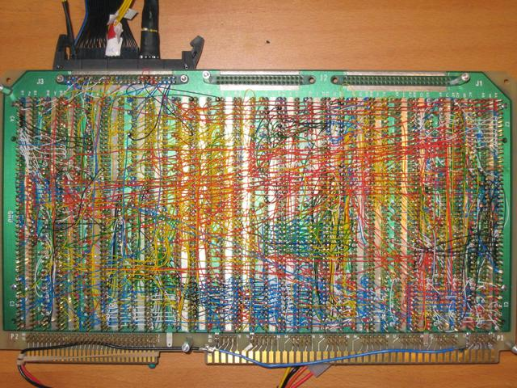

Slide 4
Software Engineering
Don’t try to do everything
But execute what you choose to do well.
Test as you go
Easier to build if the foundation is reliable
Keep it consistent
100 ways to do things == 100 ways to remember things
Locality and modularity
Only needing to understand what you’re working on
Readability
Whitespace, paragraphing, naming, commenting.

Slide 5
Software Engineering
Don’t try to do everything
But design and execute what you choose to do well.
Test as you go
Easier to build if the foundation is reliable
Keep it consistent
100 ways to do things == 100 ways to remember things
Locality and modularity
Only needing to understand what you’re working on
Readability
Whitespace, paragraphing, naming, commenting.

Slide 6
Test as You Go
It’s much easier to debug software if you have confidence that the bug is in the small piece of code you just wrote rather than somewhere in the large amount of code previously written.
In the bad old days we used to sometimes get compiler bugs, where the compiler would generate incorrect code.
Productivity would go down for weeks after a compiler bug as you would tend to suspect and make test cases for the compiler every time there was a problem.
There’s also a “broken window” effect where if there are more than a few rare bugs, people will stop caring about the code and it will rapidly get infested with more bugs.
Bugs have unpredictable effects, and often manifest many places.

Slide 7
Testing Software
To fully test a program usually requires substantially more work than writing the program.
Testing must be selective:
Make sure that the most important stuff works
Test stuff that is especially error prone or fragile
Randomly check parts of system
In general good if programmers spend about 1/3 of their time testing
In general good if have a dedicated testing staff about ½ the size of programming staff.

Slide 8
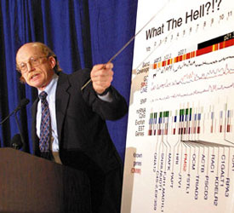
Testing important stuff
Here you are using the tool to do its job.
It helps to pretend you’re a bio grad student (not PI)

Slide 9
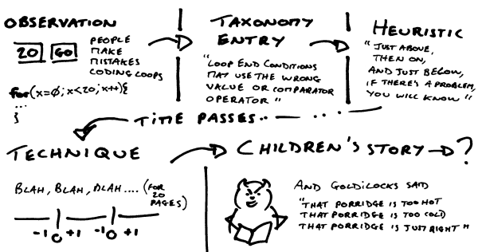
Testing Fragile Stuff
Helps to know project history, what broke in the past, what is new and still perhaps half baked
Helps to be a little evil in a sense.

Slide 10
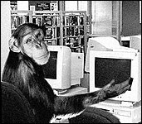
Testing Randomly
Apple uses “test monkey” scripts that give program random messages in its main event loop.
Exercise different parts of program when manual testing.
Different people have different usage patterns, so having a wide range of testers helps.
Typically stop when have gone an hour without finding a bug, or when have three bugs.
Challenge sometime can be reproducing the bugs one finds, recording can help sometimes.

Slide 11
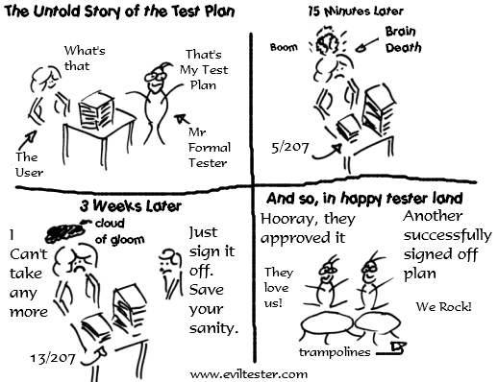
The alternative

Slide 12
Range of Software Testing
Test scaffolding – temporary stuff as you’re building
Internal sanity checks – asserts and other cheap tests
Unit tests – permanent tests of at module level
Code review – finds different classes of bugs
Quality assurance – tests by separate paid group
Alpha and beta test – test by selected users
User support – 100,000 people will find things 10 won’t.
Code for testability – limit branches, fail fast and hard

Slide 13
Software Scaffolding
Not a permanent test fixture.
Holds pieces together in early stages
May morph into a permanent functional framework.
May morph into unit tests.
In general good to do a barrage of test runs inside of scaffold while code is instrumented (in debugger and/or with copious debugging prints).
Putting something into a unit test is more time consuming, so there is a place for early one time tests

Slide 14
Internal Sanity Checks
Unless code is super time critical, you can include a few tests of form: if (someTestFails) internalErr(); or errAbort(“useful info”);
assert(someTestPasses)
/* Write out the slots that are used one by one, and do sanity check. */
int slotsUsed = 0;
int endIx = i + nodeSizePer;
if (endIx > itemCount)
endIx = itemCount;
for (j=i; j<endIx; j += slotSizePer)
{
void *item = items + j*itemSize;
memset(keyBuf, 0, keySize);
(*fetchKey)(item, keyBuf);
mustWrite(f, keyBuf, keySize);
writeOne(f, nextChild);
nextChild += bytesInNextLevelBlock;
++slotsUsed;
}
assert(slotsUsed == slotsAllocated);
Sample assert from bPlusTree.c,
Checks that precomputed allocated area for index agrees with index
size.

Slide 15
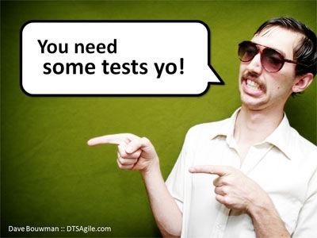
Unit Tests
Idea is to develop tests that can be quickly run every time software is built or changed.
For us, hooked up to “make test”
Almost a religion for agile development.
Partly a reaction to lack of compile time tests in interpreted languages.
Useful especially for code that is in many hands or is fragile.
Limits:
Tests that require huge data sets not practical.
As usual complete testing not feasible.
Common stuff usually apparent elsewhere
Tests really aren’t random
Sweet spot is on fragile stuff, but maybe module isn’t fragile…..
In general I think worth maybe 20% of time you spend on a module.

Slide 16
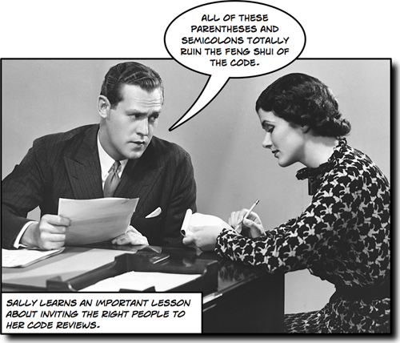
Code Review

Slide 17
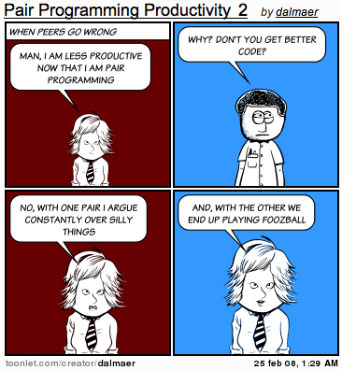
Pair Programming

Slide 18
Seriously Code Review
It’s curious but what bugs are obvious reading the code are very often different than those obvious from running the code. Bug in last line is pretty obvious to reader, but may require rare input to manifest at run time.
/* And now we move onto the next part */
int dx = xEnd – xStart;
int dy = yEnd – yStart;
xTotal += dx;
yTotal += dx;
There’s many other good reasons for code review too including spreading knowledge about the code around to other people so they won’t reinvent it, and making sure that standards we agree to are followed.

Slide 19
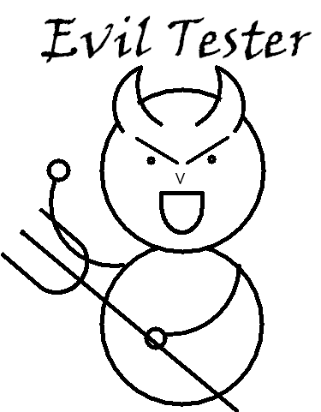
Separate QA Group
Not really evil, but often misunderstood. Look up IBM’s black team in 1960’s.
Get happy, not sad when they find a bug.
Need especially to focus on important, new, fragile, or random places since job is endless.
At UCSC does a lot of _staging_ as well as testing, also user support, docs, and design feedback.
Recommend staging work go to engineers for automation
Design feedback should happen as early as possible, often well before testing.

Slide 20
Testing part of QA job
Tests main functionality of site very often.
Sad but true that fixes to obscure bugs can cause major bugs.
Last minute, “this couldn’t break anything so I don’t need to test it” changes by programmers sometimes do break things.
Stuff that is peculiar to production rather than development environment sometimes breaks things.
Test fragile stuff
New stuff tends to be fragile, we try to test it all.
Once a few bugs found in a fragile area give it back to engineers, no need to find lots of examples.
Engineers consistently producing fragile code need retraining or maybe just to slow down and be more careful.
Save time for random tests as well, something you’ve never done before, or following a new user.

Slide 21
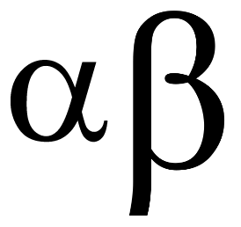
Alpha/beta testing
Alpha – testing primarily oriented for feedback on features.
Beta – testing primarily oriented for making sure code is reliable.
Both involve people outside of the development team, can be quite wide, but for us often:
Alpha – management, peers, power users, sometimes QA
Beta – QA group.
When/if we do major new products, would be appropriate to seek alpha/beta input outside of UCSC.

Slide 22
Testing and User Support
It’s crucial that feedback from users, particularly about bugs, be gathered and fed back into the product.
User support and testing go well together since good testing eliminates a lot of user support.
On the other hand good docs also eliminate a lot of user support.
On the other hand good design eliminates need for a lot of docs.
It’s good for everyone to participate to a degree in user support, but these days it’s organized to make sure no double responses or lack of response.
Some users do abuse support to do their homework, or just out of perpetual cluelessness. Just be terse with them.

Slide 23
Design for testability
Five things to avoid
Things that can only be tested in a production setting
Code that behaves differently each time you use it
Code with lots of branches, particularly rarely used ones
Code duplication & divergence (sometimes necessary)
Soft error modes.
Five things to embrace
Things that can be checked by compiler
Code generators
Functional programming – explicit inputs and outputs with no side effects.
Breaking things into independently verifiable passes
Use of library code

Slide 24
Do we have to blow up something to test your code? Perhaps it needs a simulator to try to wring out issues before deployment.

Slide 25
Do we need to follow a specific path through the code to get things to happen?
Perhaps the interface could be simplified and made stateless.
Reduce use of globals.
Define “write once” variables that are read-only after initialization.

Slide 26
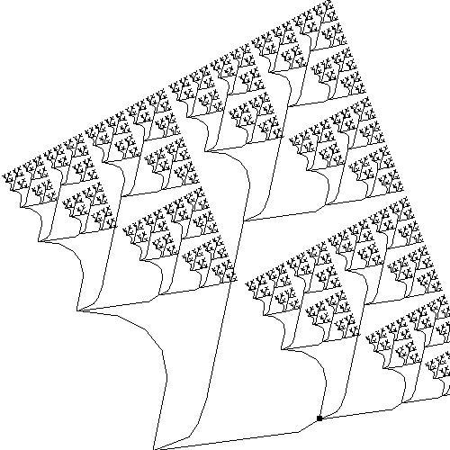
Avoid creating numerous or rarely used branches.
Code that is rarely executed is rarely reliable.

Slide 27
Code duplication & divergence Is best avoided. Post-duplication the code
usually has some places where the two copies will need to be kept in sync. Try to
make code a parameterized subroutine. Consider creating a polymorphic object with a few small but variable methods, where these methods encapsulate the
divergence.

Slide 28
Soft error modes – where code continues in spite of an error condition often
just result in a lot of code so the application can fail crypically a little later.
Generally it’s best to fail quickly and cleanly with an errAbort.

Slide 29
Design for testability continued….
Use the compiler to validate things for you
Prefer constants over literal strings.
When refactoring, changing name of a field ensures you at least visit very place the field is used.

Slide 30
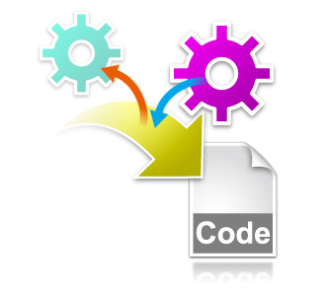
Code generators
In those occasions where coding gets repetitious.
Used for i/o with files and tables and xml at UCSC.
autoSql, autoXml,

Slide 31
Functional Programming
A function that does not change the state of the program except as reflected in its output is:
Can be used recursively
Is thread safe, parallelizable
Yields the same result when called repeatedly
Generally easier to understand and debug
The functional style can lead to problems
Functions with huge numbers of parameters – can avoid with objects.
Where to stash initialization and cleanup – can treat as object construction/destruction.
Prefer to mix a little oo w/functional. In C, both OO and functional programming have to be done stylistically.

Slide 32
Breaking things into passes
Many processes can be broken into separate passes that can either be done simultaneously or one after the other.
In software if this can be done in such a way that the passes need not be done in the same program it is usually good:
Allows passes to be developed and tested separately, helping reduce a problem into simpler components.
Examining intermediate passes often very helpful for debugging.
Breaking things up not always feasible. If passes or layers have to know too much about each other, the break up can be worse than useless, generating dependencies and sync points, inviting code duplication.

Slide 33
Using library code
In general the more library code gets exercised the better code that will be.
Try adopting a 1,2 library approach:
1st time code is used just write it
2nd time it’s used write it better, then take the better version and put it in a library, replacing both usages with the library call.
It’s rare that if you wrote the library with the first instance that you would get the interface right.
It’s rare that life becomes easier rather than more difficult if you defer librarification past the second use.
Part of librarification should be removal of dependencies/globals, and expansion of method names to include object prefix.
Spend some time learning our libraries, you may not need to write that routine at all!

Slide 34
In Conclusion
You can’t “test in” quality, but testing sure tends to let you know if quality is there in a hurry.
Preventing idiotic nuisances actually prevents most nuisances.
Test
the important stuff
the new stuff
the fragile stuff
some random stuff
Testability should be part of the design

