Slide 1
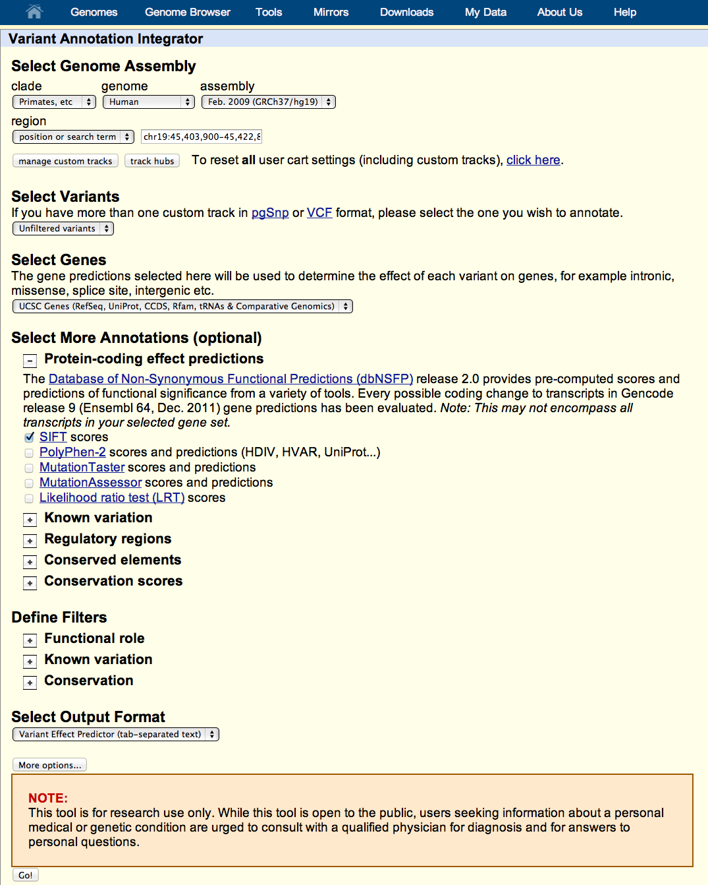
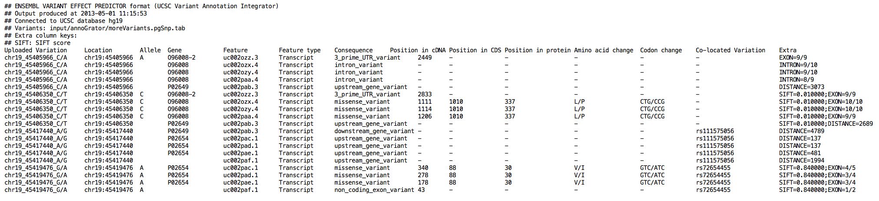
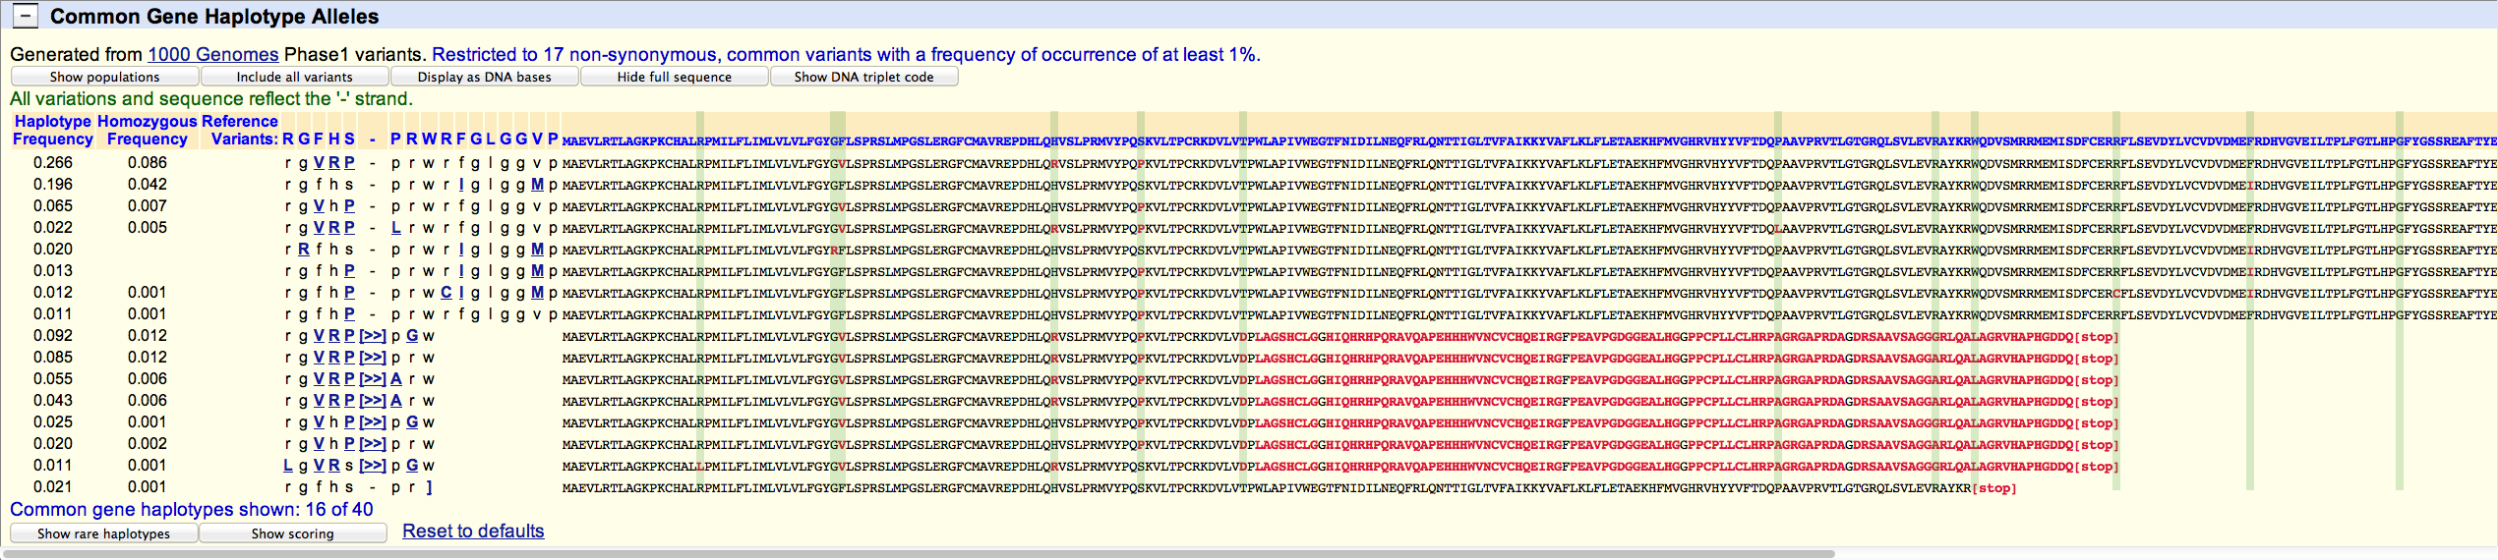


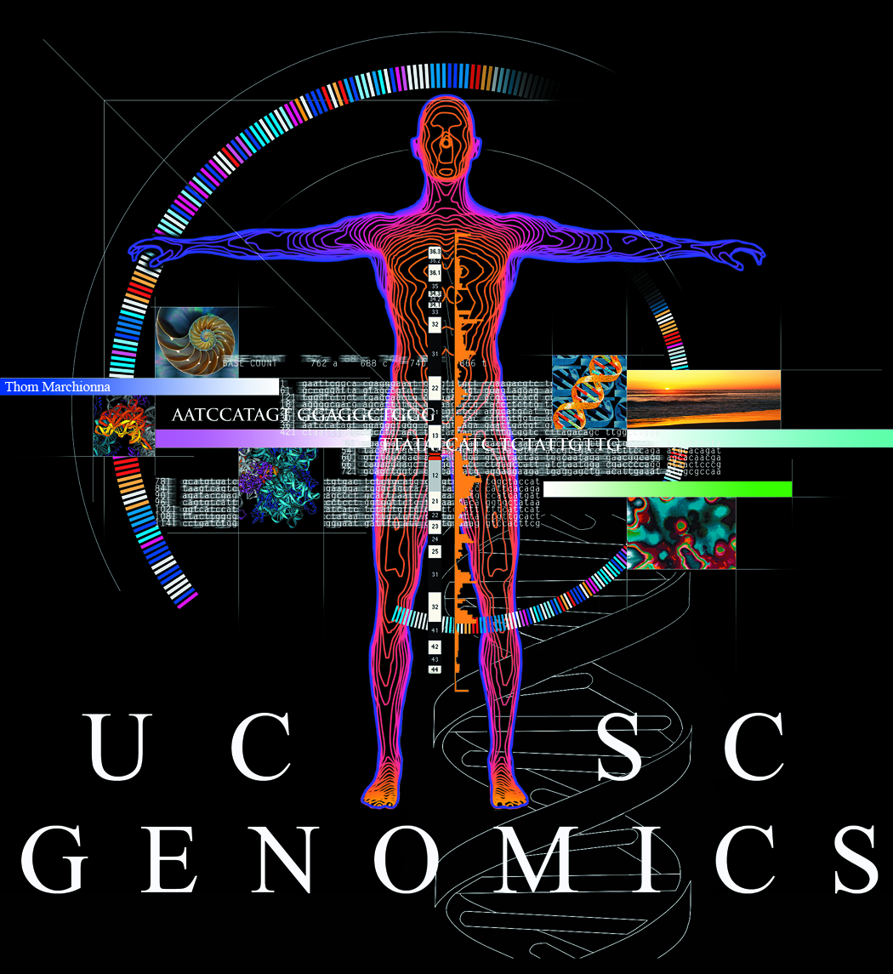
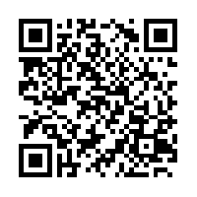
New variation resources at the UCSC Genome Browser
Brooke Rhead, Angie S. Hinrichs, Timothy R. Dreszer, Brian J. Raney, Robert M. Kuhn, Ann S. Zweig, Donna Karolchik, W. James Kent
Annotate your variants:
Upload variants:
track type=pgSnp visibility=pack db=hg19 name=myVariants description="Unfiltered variants"
browser position chr19:45403900-45422800
chr19 45405965 45405966 C/A 2 0,0 0,0
chr19 45406349 45406350 C/T 2 0,0 0,0
chr19 45417439 45417440 A/G 2 0,0 0,
chr19 45419475 45419476 G/A 2 0,0 0,0
Download variants with predicted functional effects and annotations from UCSC Genome Browser data tracks:
View gene alleles (haplotypes) from 1000 Genomes data:
Click on a gene in the UCSC Genes track:
Scroll to the Gene Alleles section:
Haplotype and homozygosity frequencies.
Summary of variants in each haplotype allele.
Sequences with predicted effects. Variants are highlighted by vertical lines, and changes to the predicted amino acid sequence are highlighted in red. This gene (ABO) shows a frameshift mutation in several haplotypes.
This work is funded by the National Human Genome Research Institute award U41HG002371 to the UCSC Center for Genomic Science.
See our wiki for more details:
http://genomewiki.ucsc.edu/index.php/BoG2013VariationPoster

