Slide 1
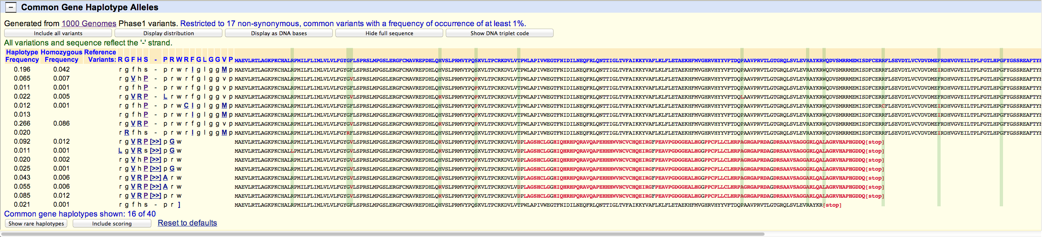


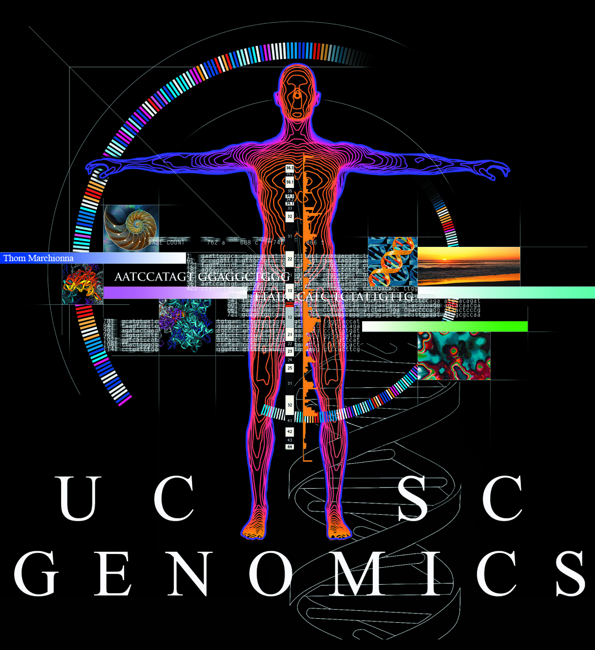
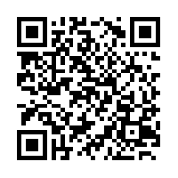

New variation resources at the UCSC Genome Browser
Brooke Rhead, Angie S. Hinrichs, Timothy R .Dreszer, Brian J. Raney, Robert M. Kuhn, Ann S. Zweig, Donna Karolchick, W. James Kent
Annotate your variants:
View gene alleles (haplotypes) from 1000 Genomes data:
Click on a gene in the UCSC Genes track:
Scroll to new section:
Haplotype and homozygosity frequencies.
Summary of variants in each haplotype allele.
Sequences from the 1000 Genomes Project, with variants highlighted by vertical lines and changes to the predicted amino acid sequence highlighted in red. This gene (ABO) shows a frameshift mutation in several haplotypes.
This work is funded by the National Human Genome Research Institute award U41HG002371 to the UCSC Center for Genomic Science.
See our wiki for more details:
http://genomewiki.ucsc.edu/index.php/BoG2013VariationPoster

