Slide 1
topic for today
Education resources with the U.C. Santa Cruz Genome Browser
Teaching biology and the genome browser together
Presenter: Hiram Clawson – U.C. Santa Cruz Genomics Institute
hclawson@ucsc.edu
our work is supported by a number of different grants:
National Human Genome Research Institute U41HG002371
National Human Genome Research Institute U24HG002371
Silicon Valley Community Foundation 2017-171531(5022)
National Institute of Allergy and Infectious Diseases
NIAID 75N93019C00076 AWD100477
Notes:
Topics in this presentation: 1. The U.C. Santa Cruz Genome Browser 2. GenArk collection of genome assemblies 3. Assembly hubs for your new genome assembly 4. REST API programmatic interface to extract data

Slide 2
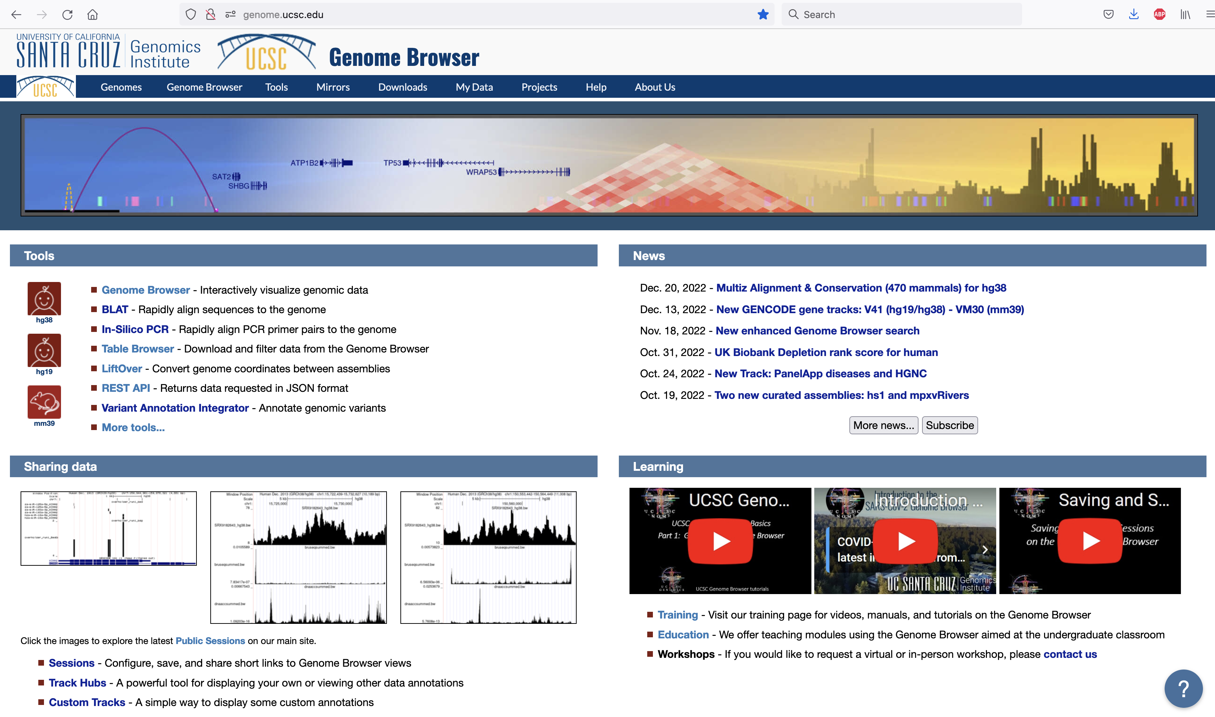
UCSC Genome Browser education/learning
https://genome.ucsc.edu/
Note the section of links
at the lower right of the
home page leading to
‘Training’ and ‘Education’
resources.
Notes:
U.C. Santa Cruz genome browser home page: https://genome.ucsc.edu/ -note section in lower right for training/education links

Slide 3
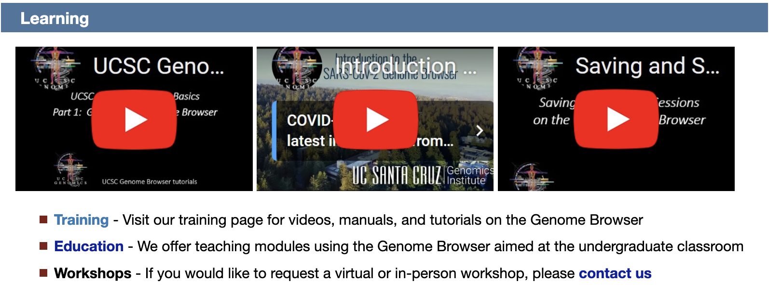
Browser + Education
Notes:
Training and education outreach are important services from the genome browser team.

Slide 4
contributors to this project
Robert Kuhn, browser staff (retired)
supervised undergraduate students:
Mateo Etcheveste, UCSC
Cally Lin, UCSC
Arturo Marquez, University of Sonora, Mexico
Zoë Shmidt, UCSC
Notes:
Robert Kuhn organized this project. The work was submitted by the students.

Slide 5
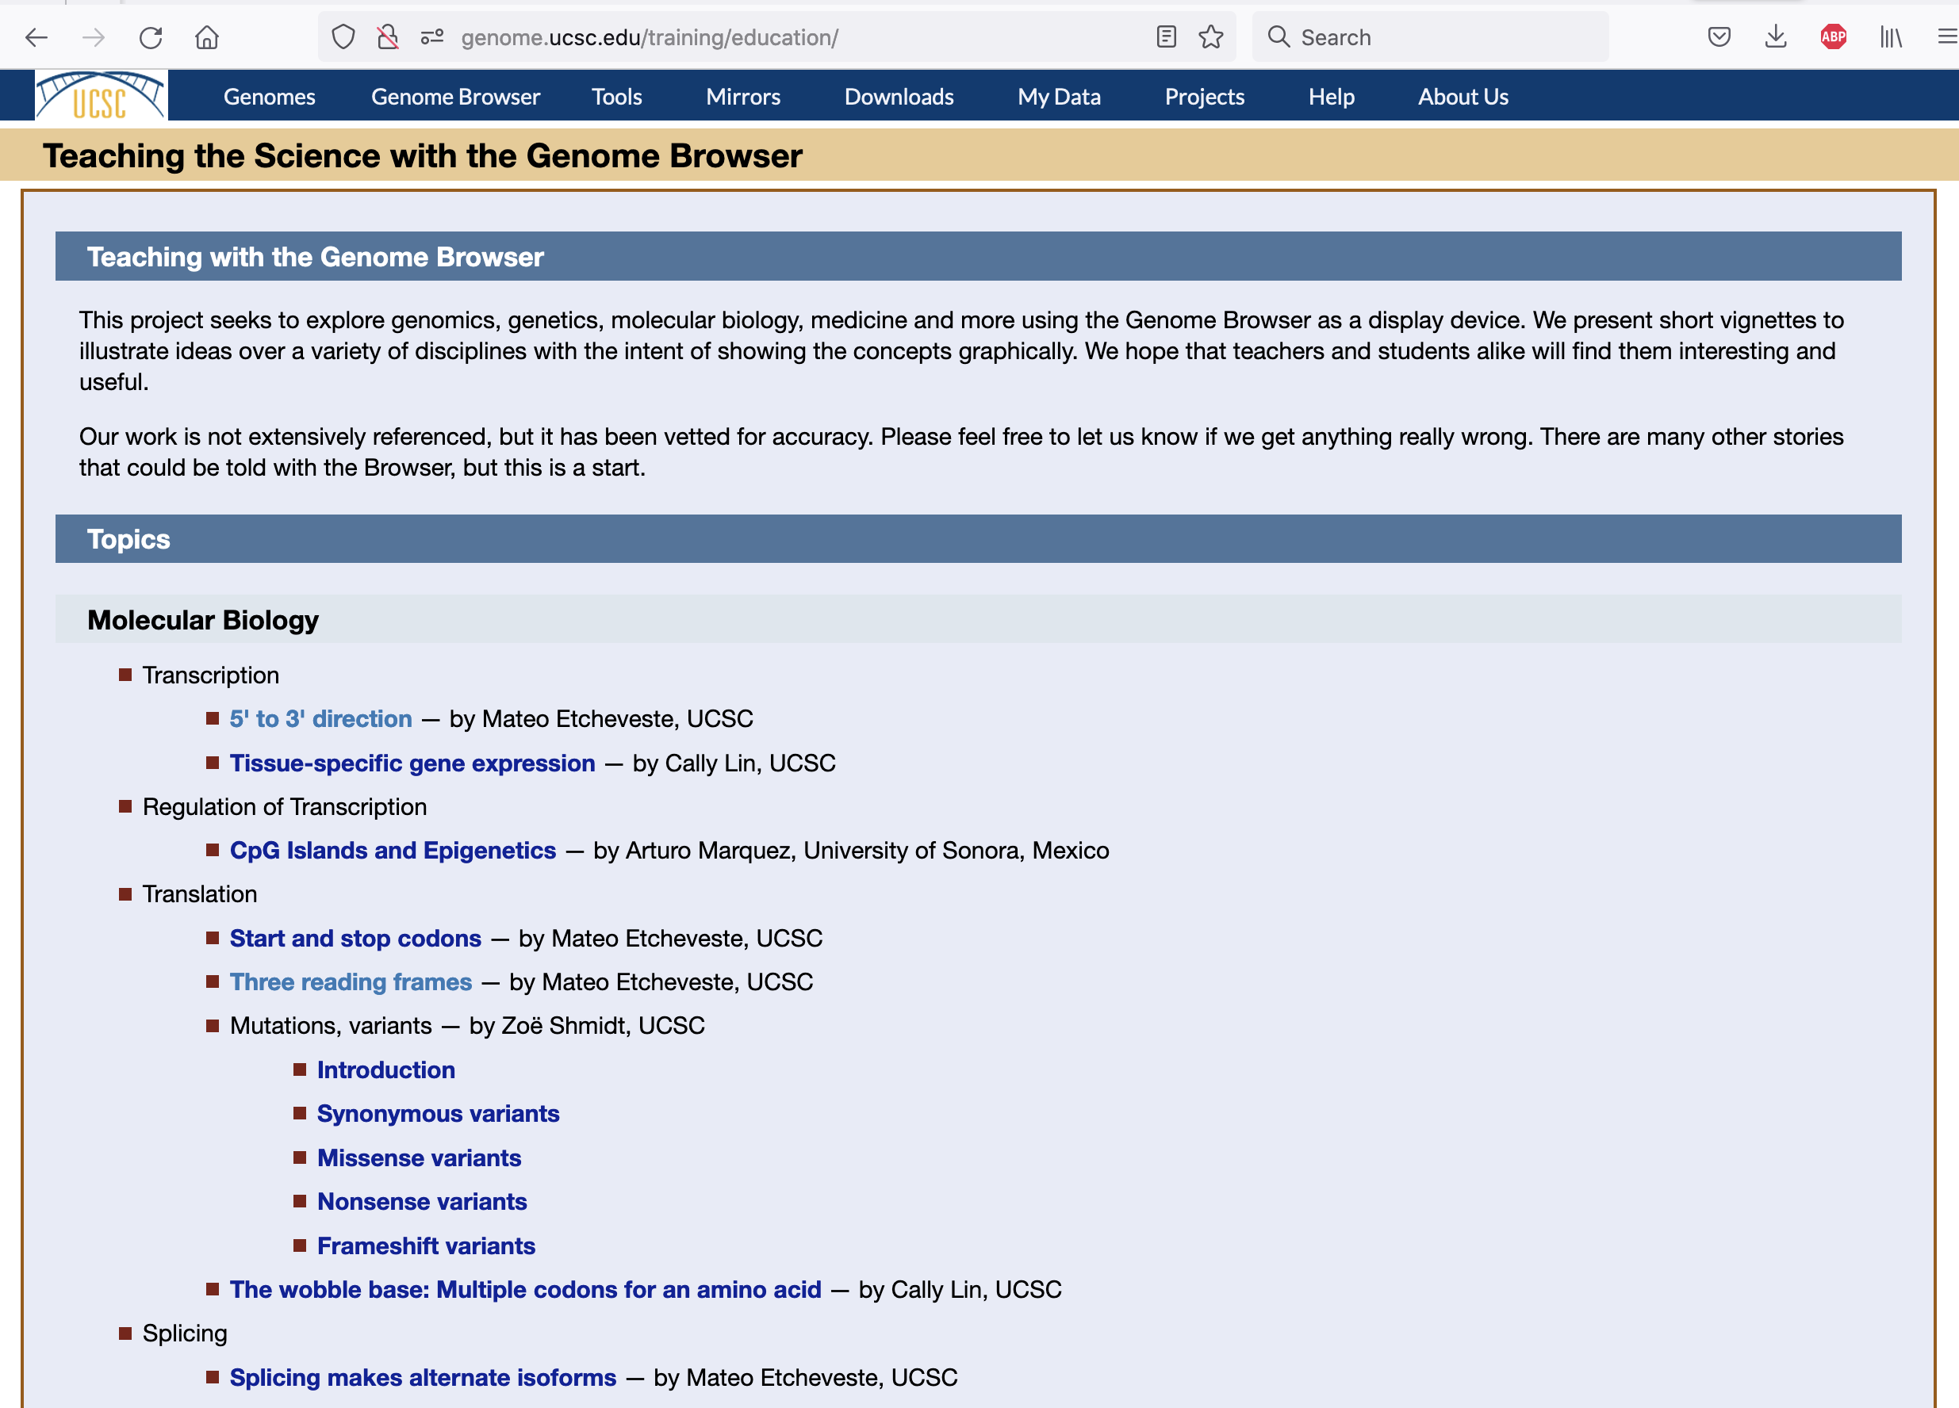
genome.ucsc.edu/training/education/
Prepared
scenarios link
to the genome
browser for
interactive
exploration
of the topic.
Example: three
reading frames
Notes:
The education gateway page leads to a number of prepared scenarios in the genome browser to illustrate biological concepts

Slide 6
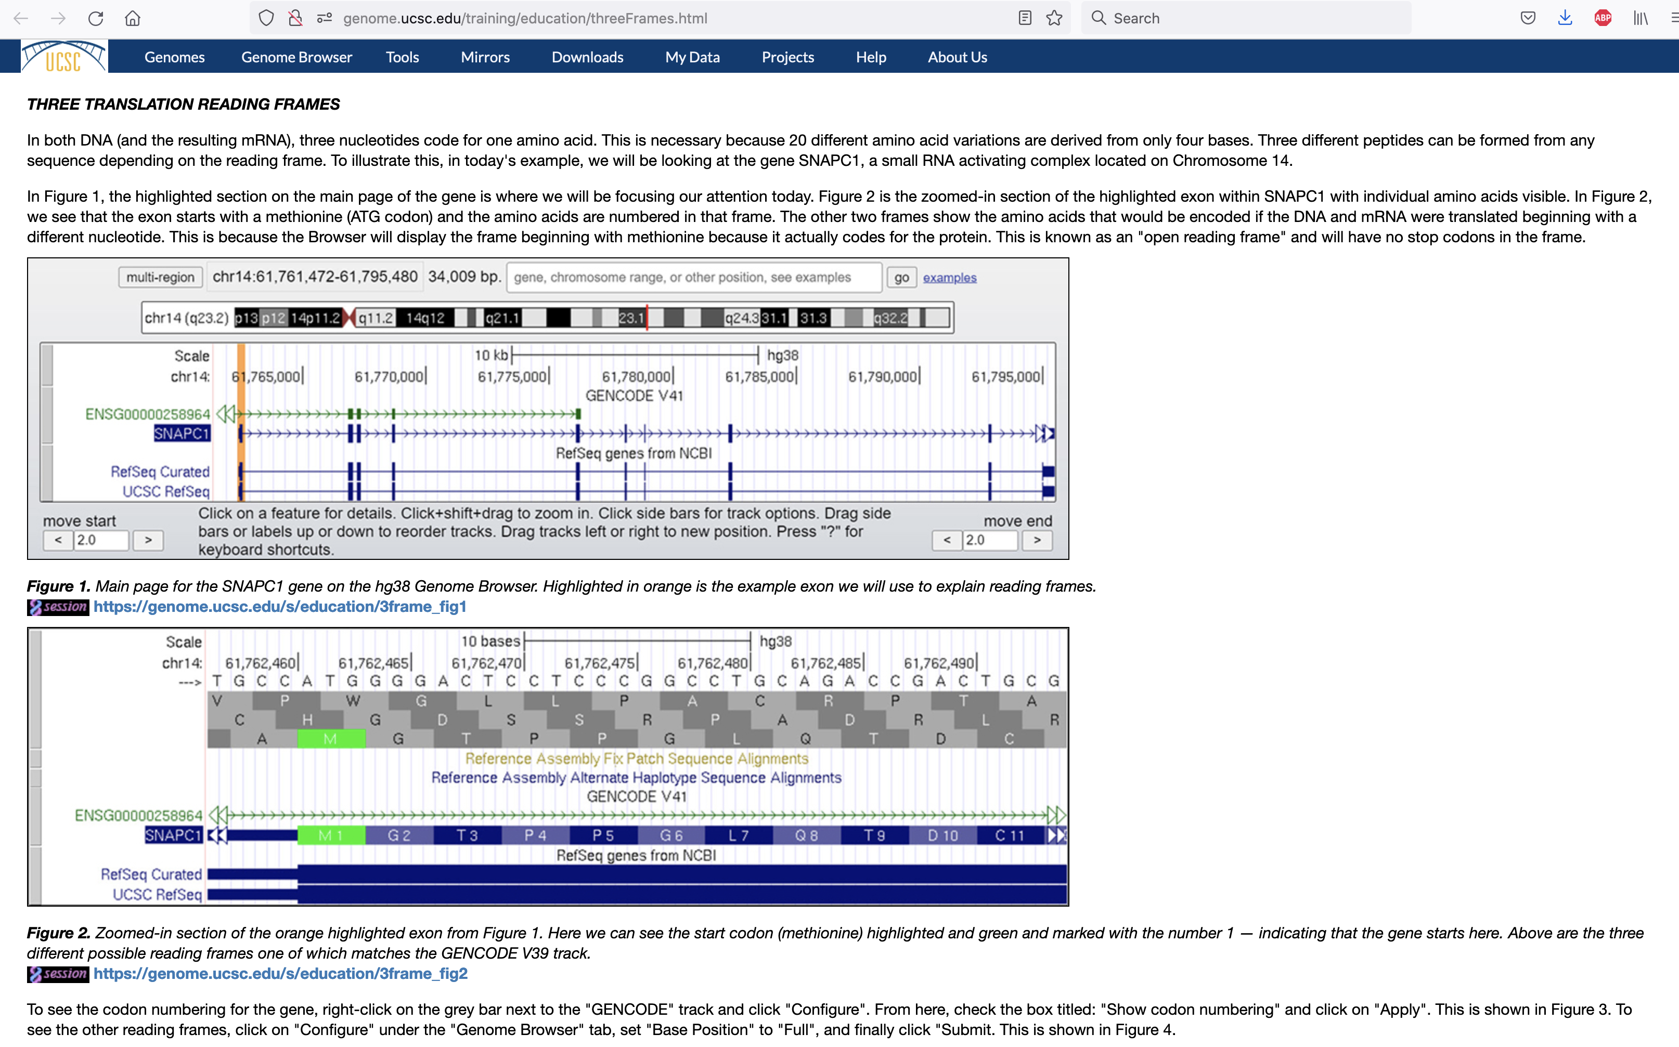
genome.ucsc.edu/training/education/threeFrames.html
‘Saved sessions’ are specific configurations of the genome browser view that can be used to direct anyone to that view. Any user can make saved sessions. All public sessions can be found in the session search system. Search for ‘education’ to find these sessions:
https://genome.ucsc.edu/cgi-bin/hgPublicSessions
Each scenario has a dedicated discussion page of the topic with links to browser ‘sessions’ for the student to interact with the browser with this prepared viewpoint.
Notes:
Each topic has a description page to explain the subject. The browser images have links to browser sessions to display the scenario in the genome browser.

Slide 7
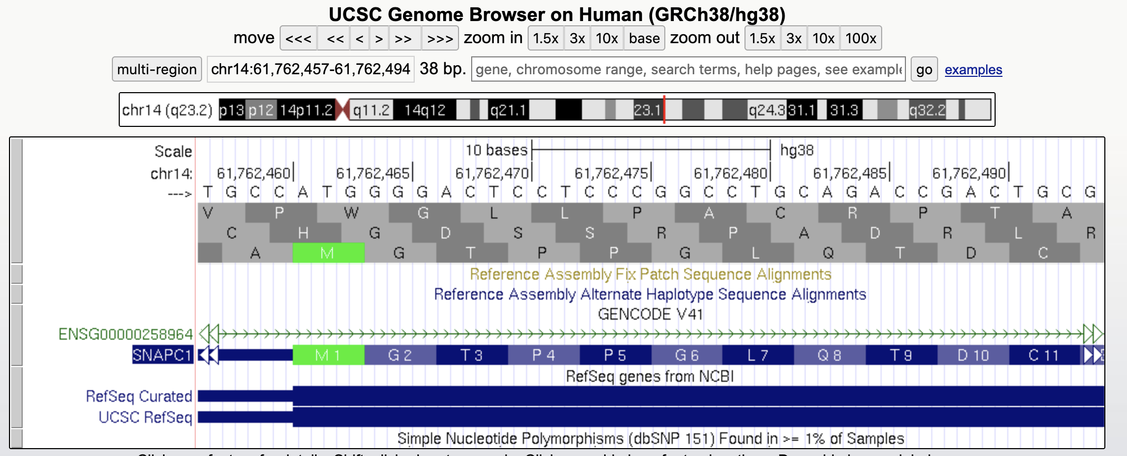
genome.ucsc.edu/s/education/3frame_fig2
The link from the discussion page goes to the genome browser at this position as
described in the text. The student can interact with the elements in this viewpoint.
Notes:
When the student clicks through to the browser session, they can interact with the browser to explore the subject in more depth. The is the browser session as linked to from the discussion page.

Slide 8
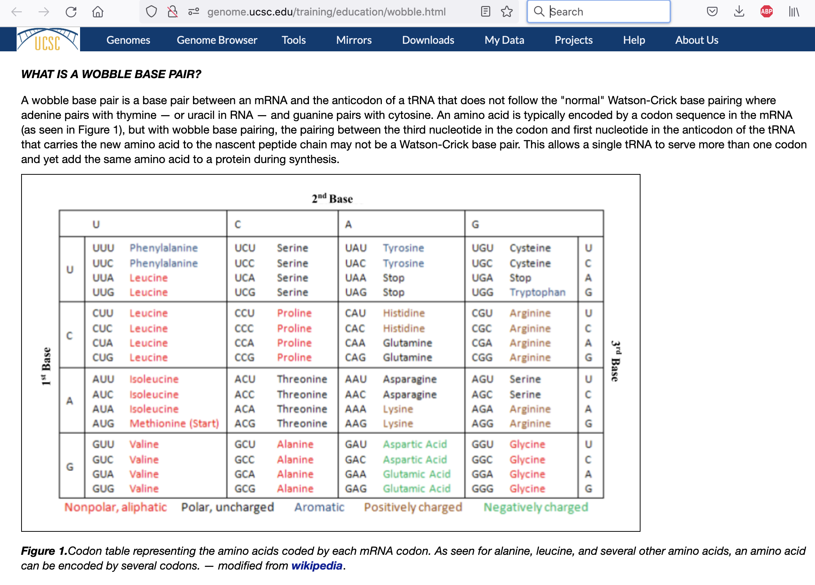
genome.ucsc.edu/training/education/wobble.html
A second example, the ‘wobble’ base. To be illustrated in the conservation track in the browser.
Notes:
A second example, the ‘wobble’ base to be illustrated in the genome browser conservation tracks.

Slide 9
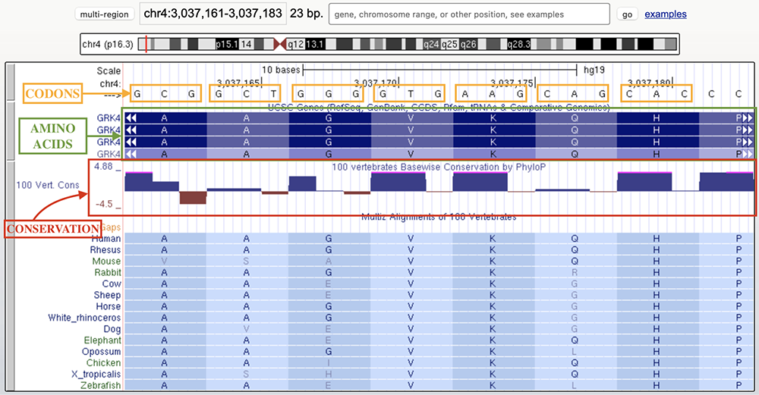
genome.ucsc.edu/training/education/wobble.html
Notes:
A second example, the ‘wobble’ base to be illustrated in the genome browser conservation tracks. This is figure 2 on the discussion page.

Slide 10
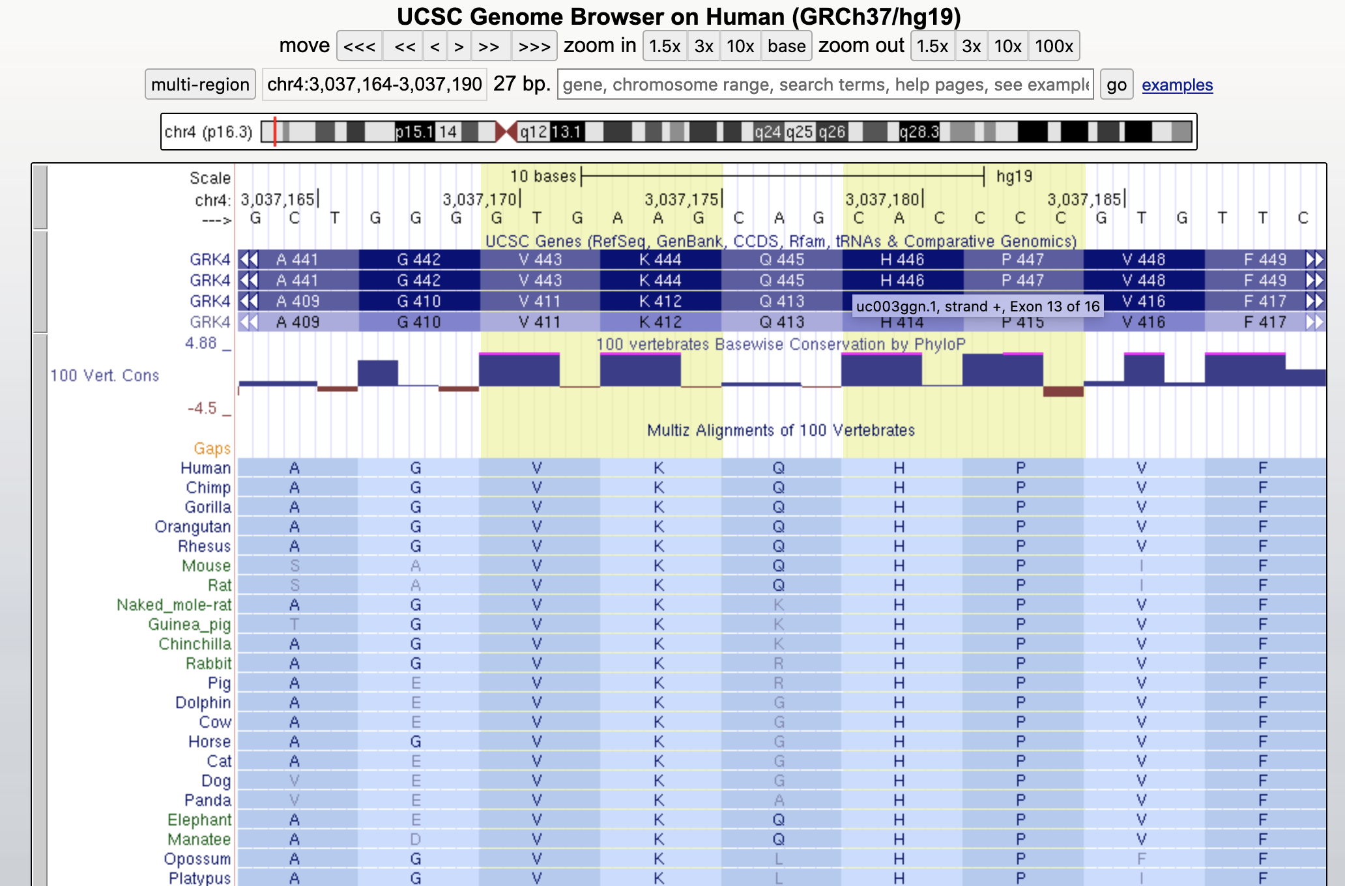
genome.ucsc.edu/s/education/hg19_wobble2
Third base is *not* conserved,
but same AA is produced
Notes:
The wobble discussion page links to this saved session in the genome browser.

