Slide 1


Utilizing the
UCSC Genome Browser in Classrooms
Presented by: Jairo Navarro Gonzalez

Slide 2
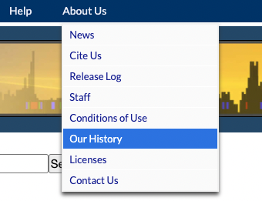
History of the UCSC Genome Browser
Developed at University of California, Santa Cruz
Providing a web browser view of the human genome since 2001, added mouse genome in 2002, today serving up a view of over 3,600 genome assemblies for over 2,500 species
2002 - https://pubmed.ncbi.nlm.nih.gov/19957273/

Slide 3

UC Santa Cruz campus

Slide 4
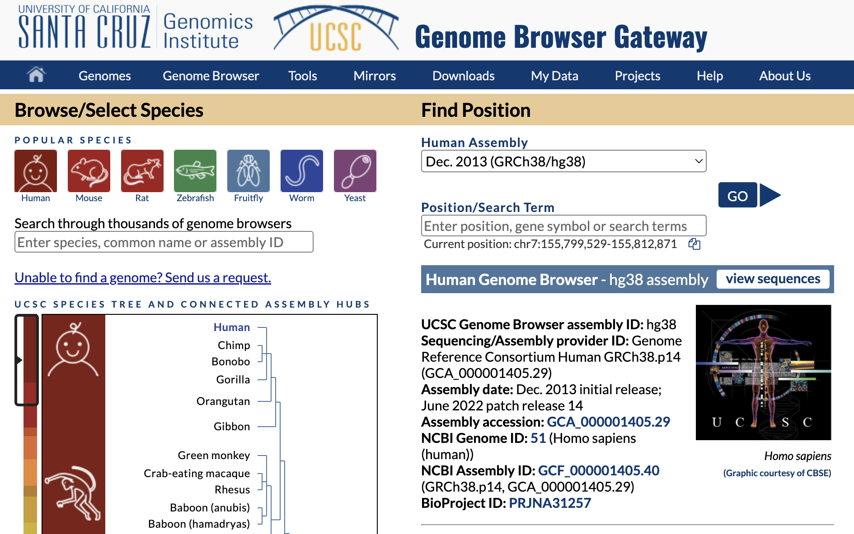
What is the UCSC Genome Browser?
Complex data visualization tool that displays annotations alongside a reference genome
220 genome assemblies
  3,779 assembly hubs in GenArk
https://genome.ucsc.edu/ browser ‘home’ page

Slide 5
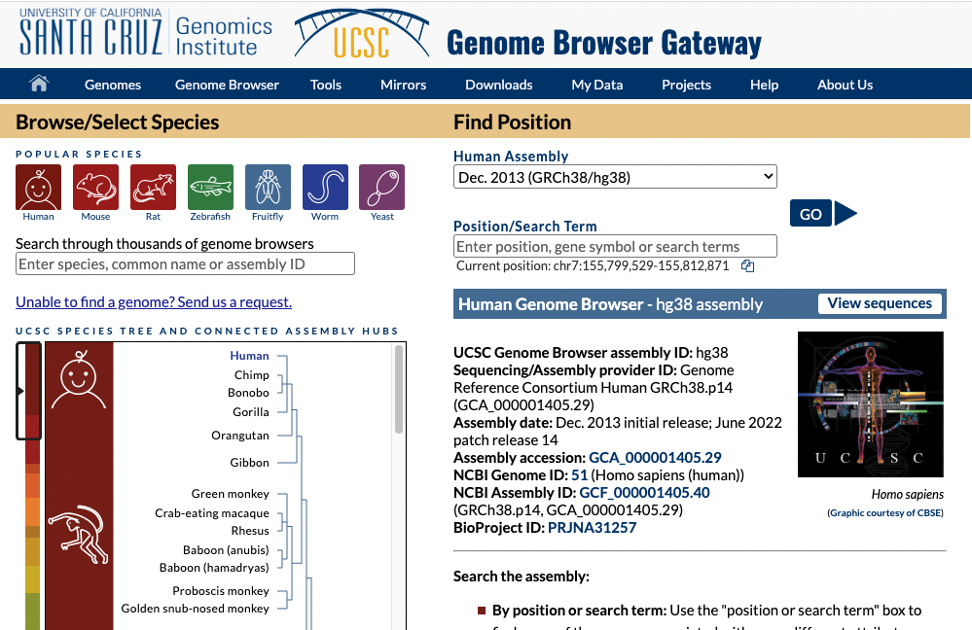

Slide 6


What is a genome?
The entire set of DNA instructions found inside a cell
A genome assembly is a digital representation of an organism’s genome
Can have many different genome assemblies for the same organism
  With new sequencing technologies, we get a better resolution of the actual genome

Slide 7

Understanding gene annotations
Usually cDNA obtained from sequencing the extracted mRNA from a cell.
Transcript sequence can differ from the reference genome
Annotations are updated with new supporting evidence over time

Slide 8
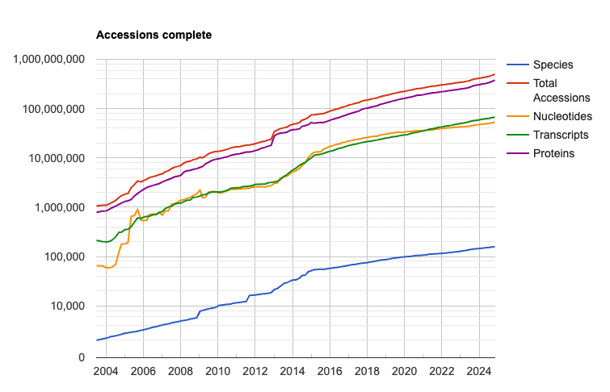
* obtained from https://www.ncbi.nlm.nih.gov/refseq/statistics/
on Jan 6th, 2024
Notes:
Shows the growth of NCBI RefSeq Accessions

Slide 9
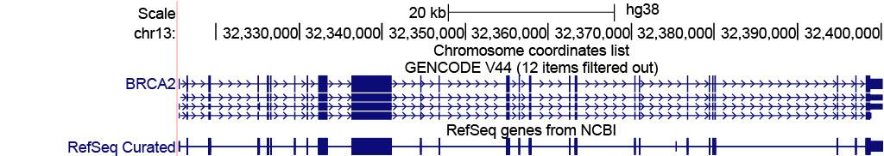
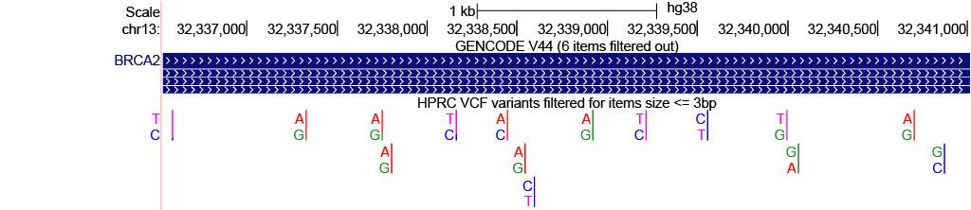
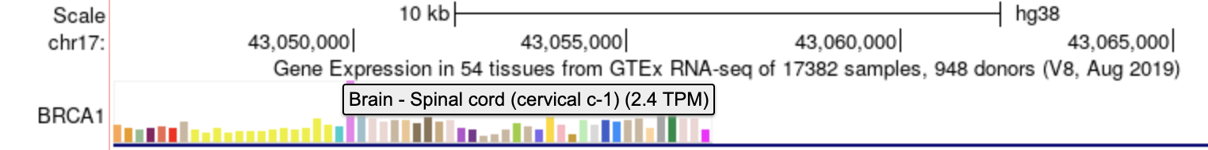
What type of data can I view?
Gene annotations
Variant annotations
Tissue Expression

Slide 10
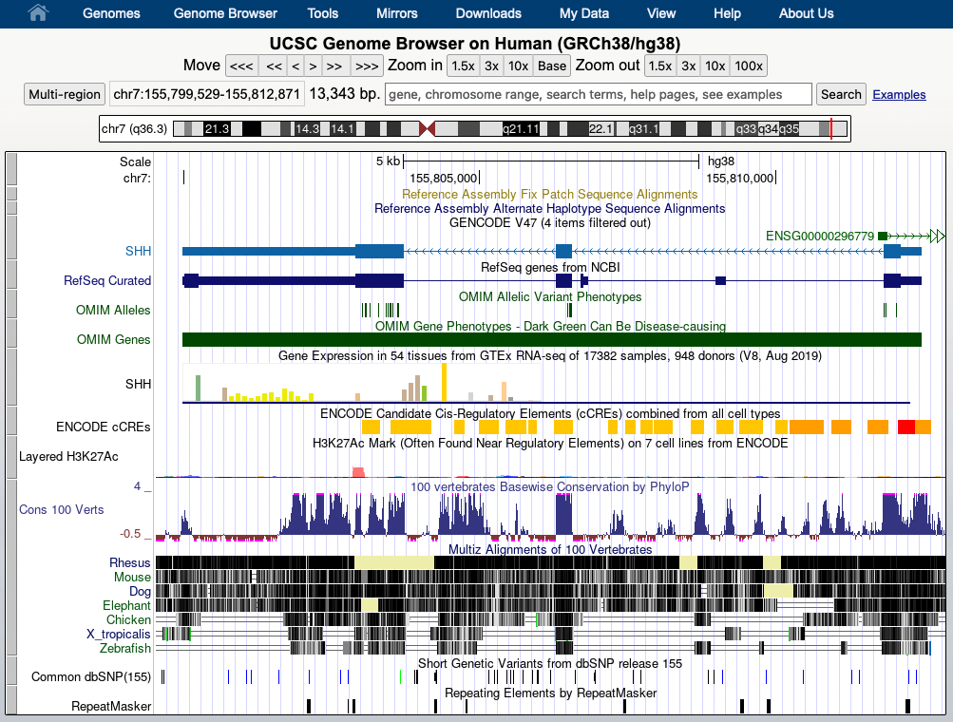
Genome Browser tracks display

Slide 11
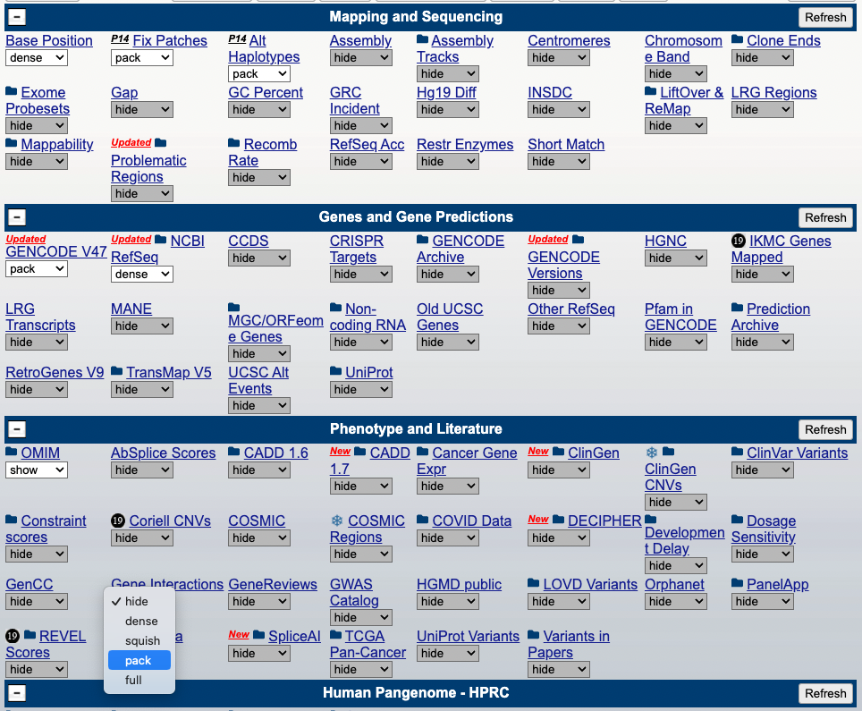
Track controls

Slide 12
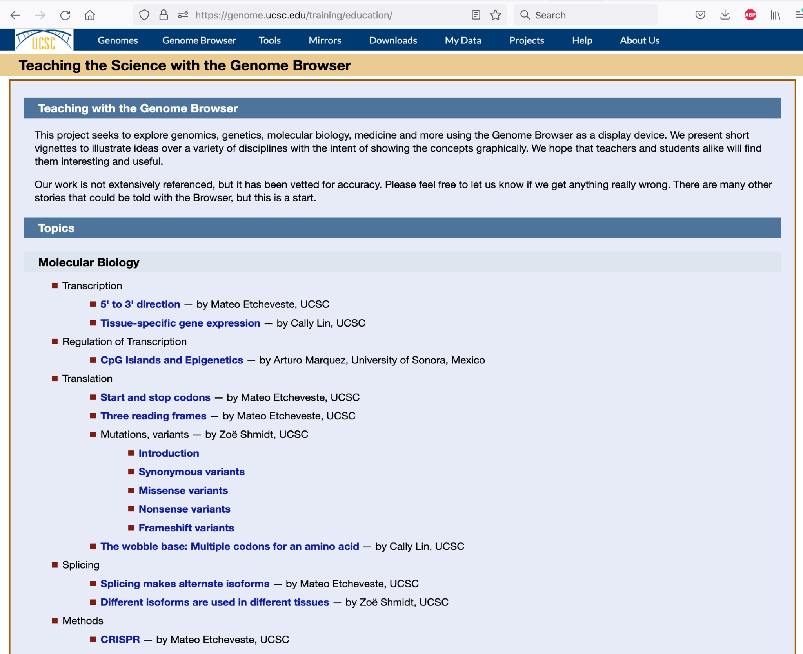
Education modules

Slide 13
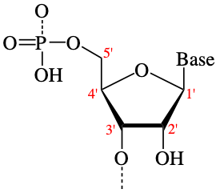
5' to 3' direction — by Mateo Etcheveste, UCSC
Overview of gene strands on the UCSC Genome Browser
  How to distinguish between the 5' end and 3' end for any given gene on the browser.
  The 5' and 3' ends of a DNA or RNA molecule refers to the carbon atom in a deoxyribose sugar molecule to which a phosphate group bonds.

Slide 14
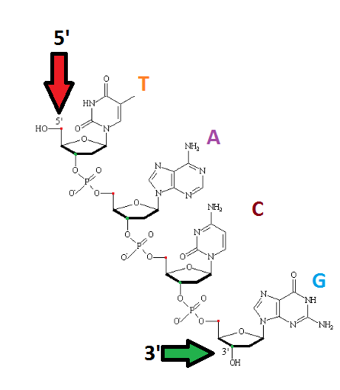
5’
3’
G
C
T
A
*
C
G
A
T
G
C
C
G
A
T
T
A
G
C
*
3’
Obtained from: https://qph.cf2.quoracdn.net/main-qimg-70047170ffd6ac5610c52e6a57d92957
5’

Slide 15
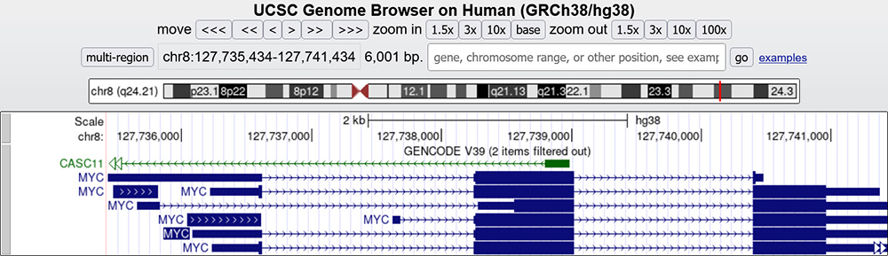
Alignment of MYC gene to hg38

Slide 16
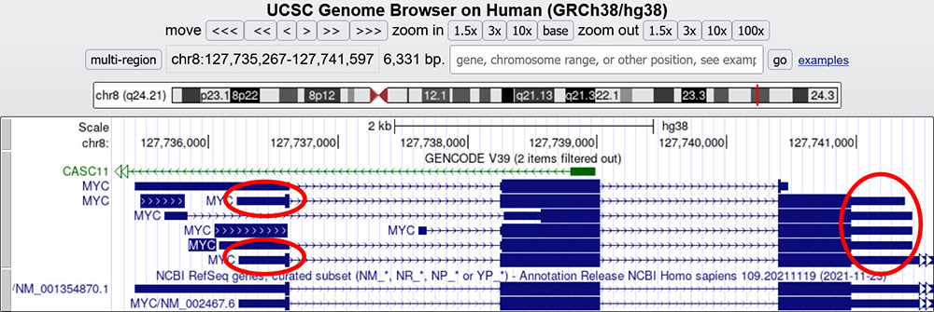
Untranslated regions

Slide 17
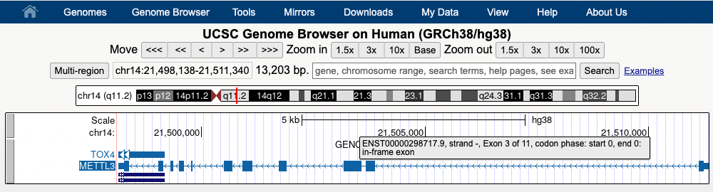
Hover over items for more information

Slide 18
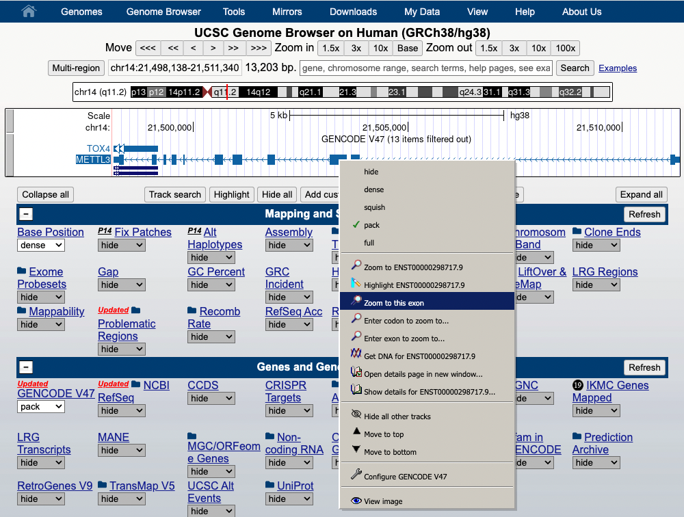
Right-click to zoom to an exon

Slide 19
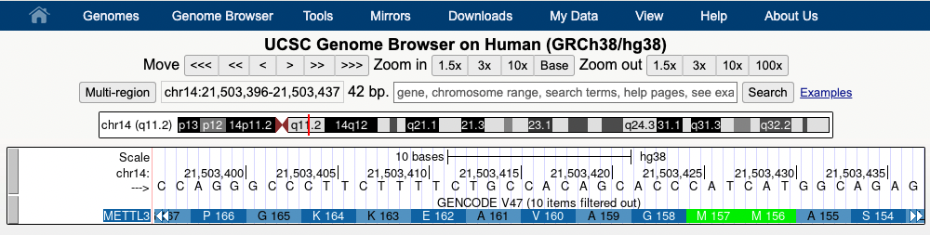
Base-level view of the transcript
Codons are “wrong” because the the transcript is on the negative strand

Slide 20
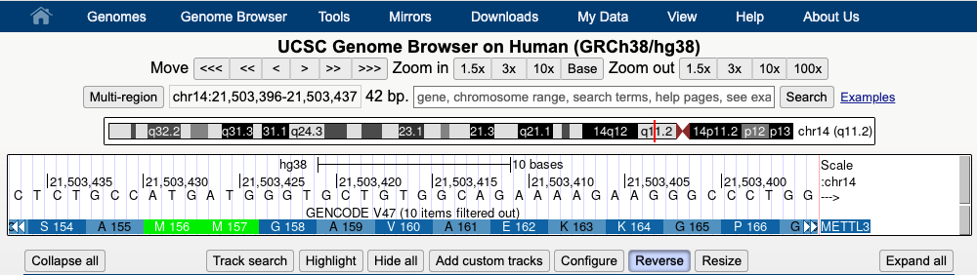
Reverse the strand to view the correct codons

Slide 21
Many other education modules

Slide 22
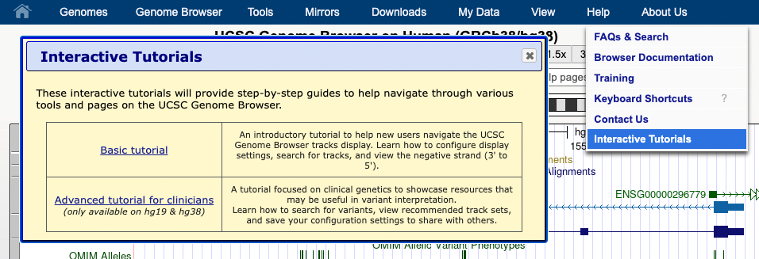
Tutorials available!

Slide 23
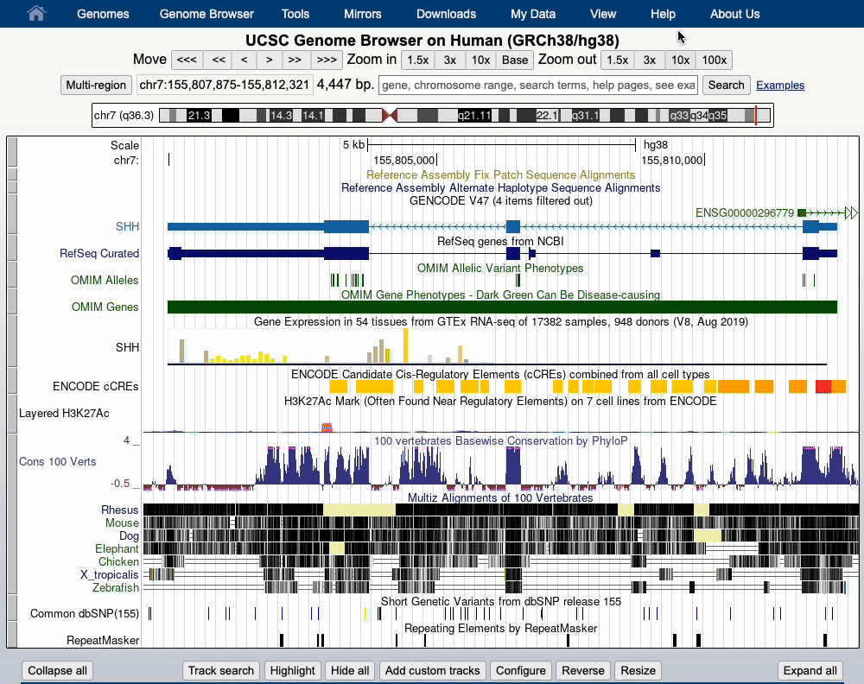

Slide 24
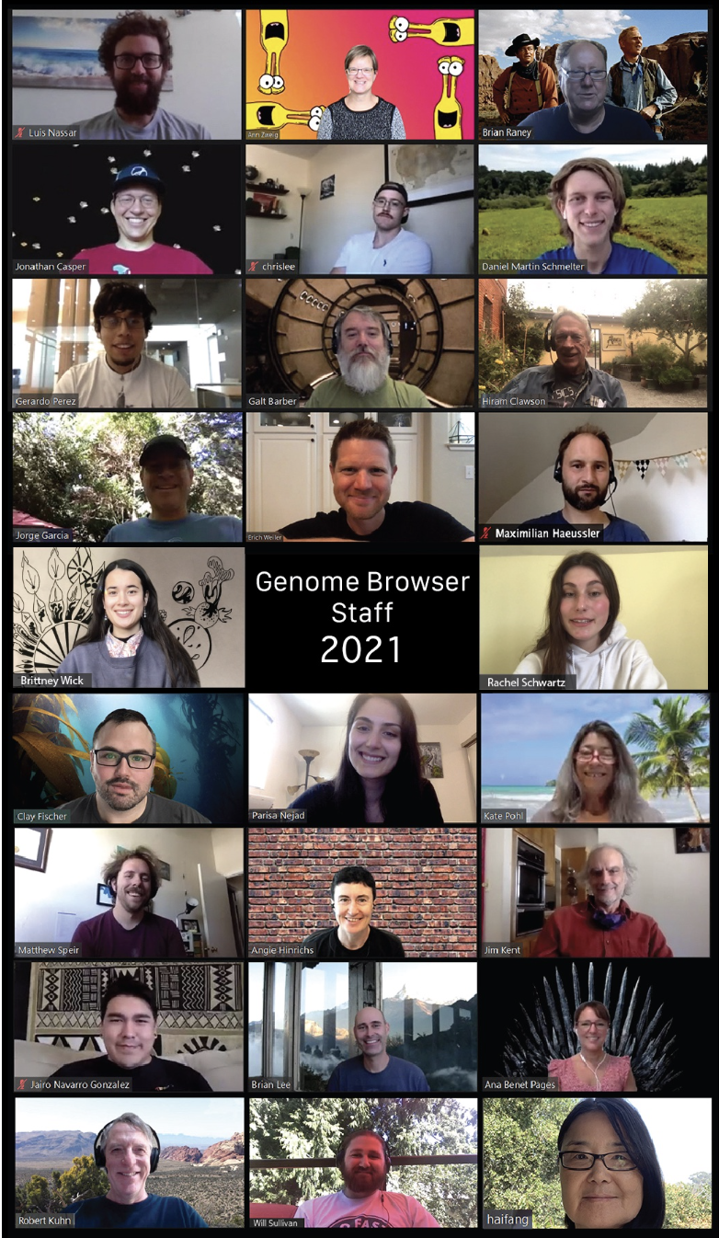
Thanks!
Contact us with your questions:
genome@soe.ucsc.edu
Sensitive data: genome-www@soe.ucsc.edu

