Slide 1


Display Your Custom Assembly
in the UCSC Genome Browser
Presented by: Jairo Navarro Gonzalez

Slide 2
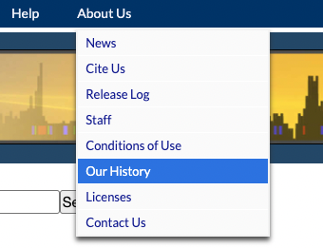
What is the UCSC Genome Browser?
Developed at University of California, Santa Cruz
Data visualization tool
Displays annotations alongside a reference genome
Hosting 220 genome assemblies
  Over 3,779 assembly hubs in GenArk

Slide 3
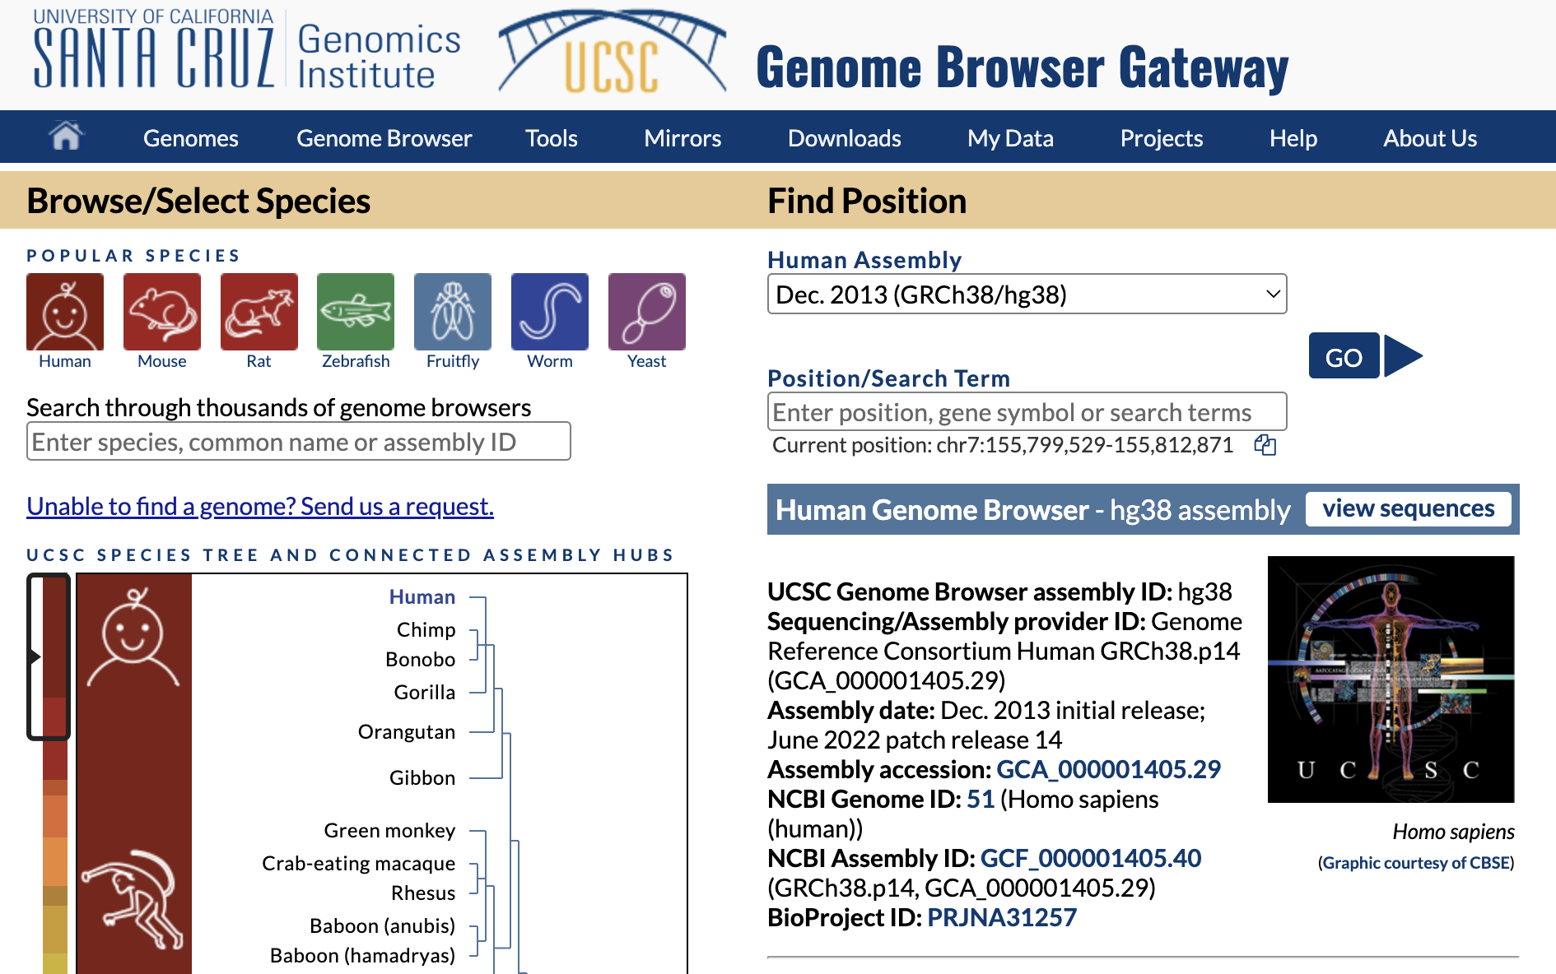
What is the UCSC Genome Browser?
https://genome.ucsc.edu/ browser ‘home’ page

Slide 4
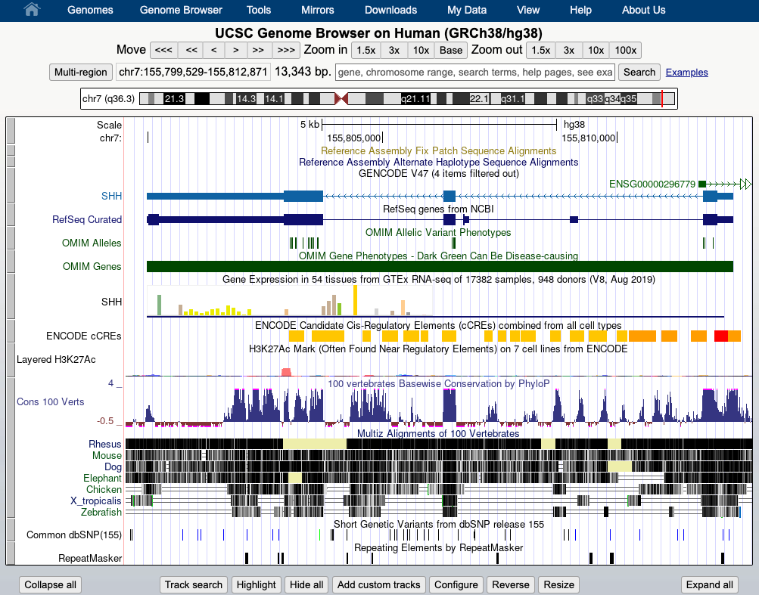

Slide 5
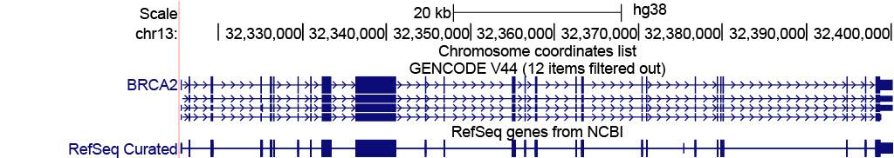
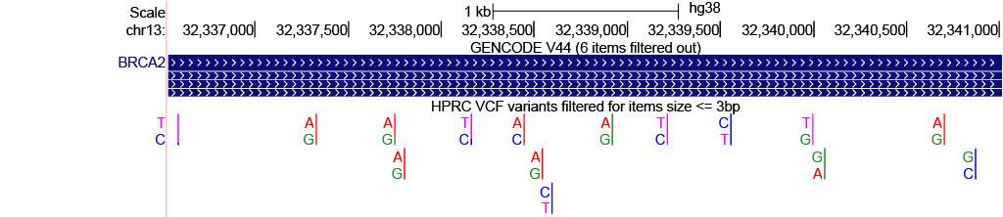
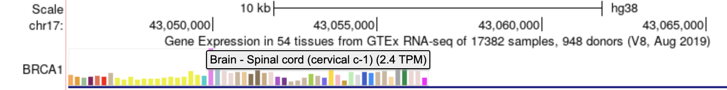
What type of data can I view?
Sequencing Data
  BAM
  WIG
Gene annotations
  BED
  genePred
  GFF/GTF
Variant annotations
  VCF
Tissue Expression
  barChart

Slide 6
Supported Data Formats
Text-based:
Binary indexed:
BED
genePred
WIG
barChart
bigBed
bigGenePred
bigWig
BAM
HIC
And much more!

Slide 7
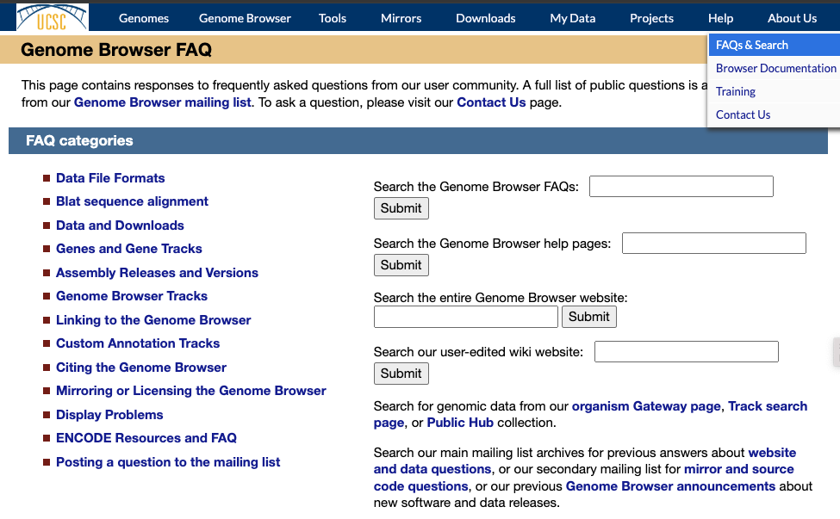

Slide 8
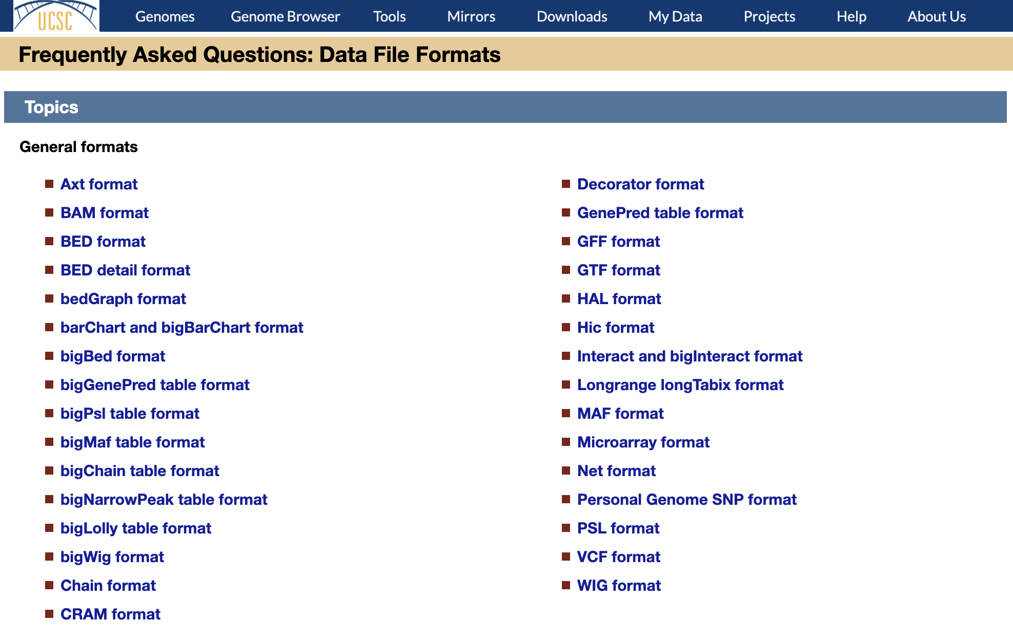

Slide 9
How do I view the data?
Some terms used by the UCSC Genome Browser:
Custom Track
Track Hub
Assembly Hub
Gene annotations
Custom genome assembly

Slide 10
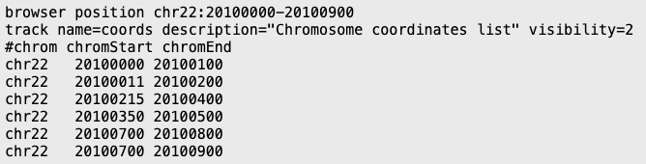
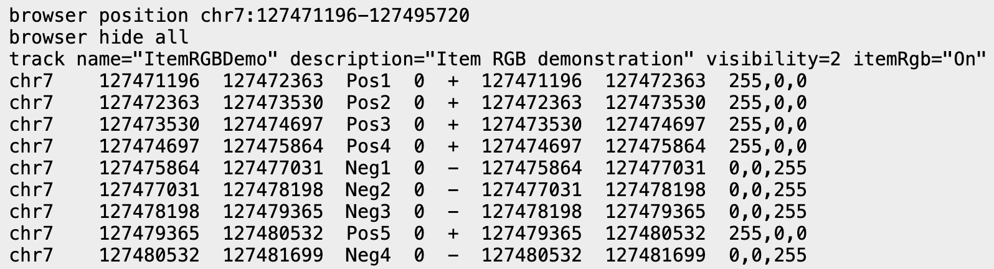
What are ‘Custom Tracks’?
Your own annotations on the Genome Browser
Benefits:
Useful to quickly view a small sample of the data
Temporary way to display the data
Text based data is human readable
Uploaded directly to UCSC
Examples of BED custom tracks:
Limitations:
Are removed 48 hours since the last time they were accessed (unless saved in a Session)
Cannot upload binary index files directly to UCSC (big*)

Slide 11
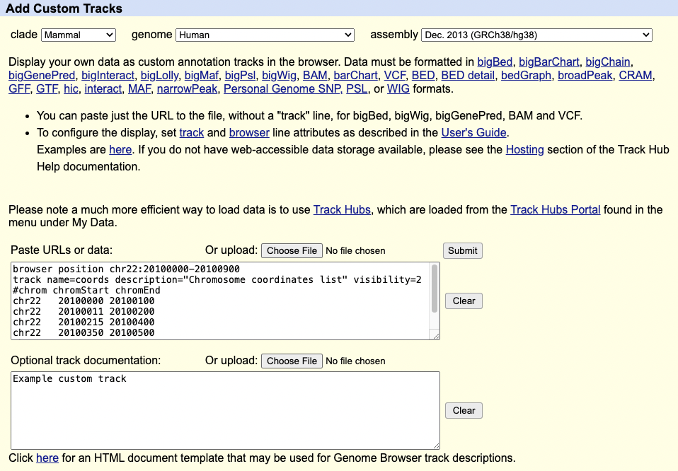
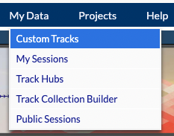
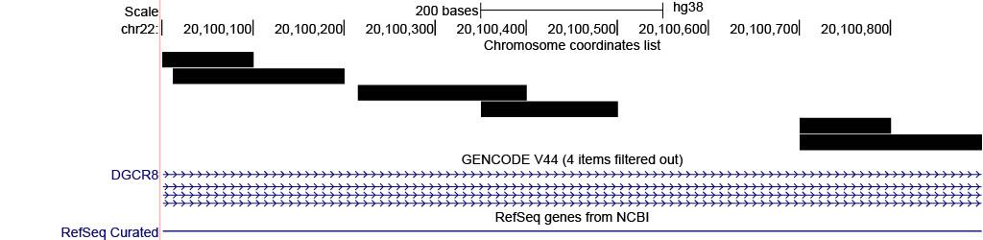
Using
Custom Tracks
Visualization is defined in “track” and “browser” lines
Upload via the Custom Tracks page:
https://genome.ucsc.edu/cgi-bin/hgCustom

Slide 12
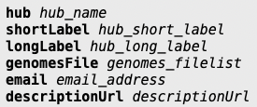


What are ‘Track Hubs’?
Three text files that define how to visualize the data
Example:
-- hub.txt
-- genomes.txt
-- trackDb.txt
Benefits:
Allows for greater control of the data
Various configuration options that are not available for custom tracks
You are always in control of the data
Limitations:
Data must be hosted remotely
Server must support byte-range requests (won’t work with OneDrive, DropBox, etc)

Slide 13
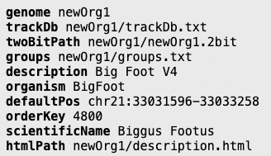
What is an ‘Assembly Hub’?
Similar to track hubs but you define your own genome
Benefits:
Can use your own reference genome
Create your own track groupings on the Genome Browser
Add other tracks via track hubs
Example:
-- genomes.txt:
Limitations:
May require you to have a large amount of storage capacity

Slide 14
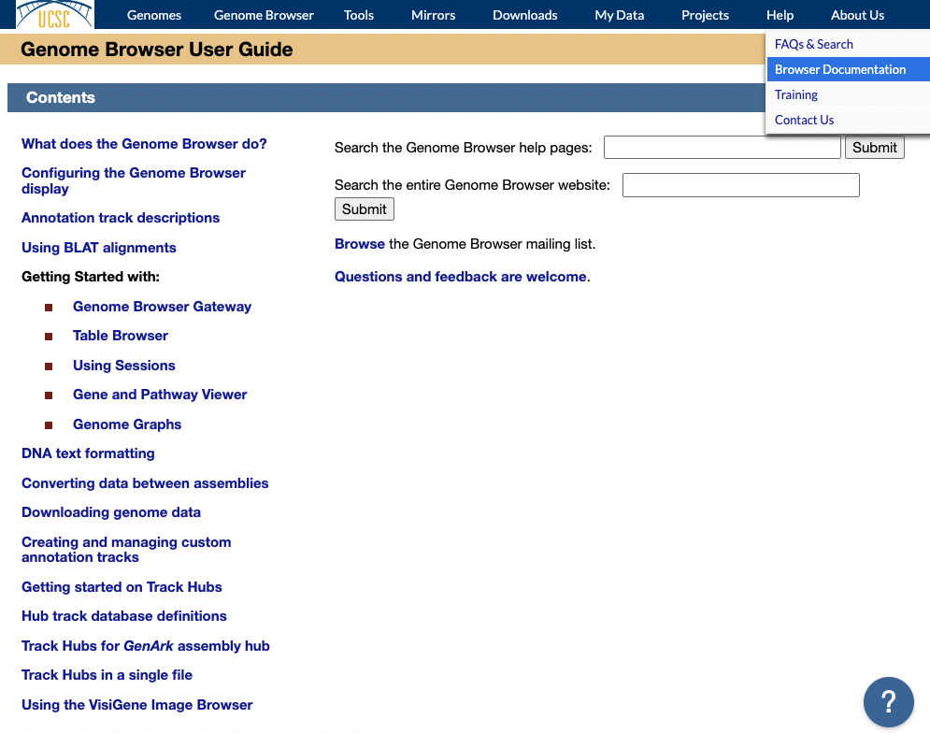

Slide 15
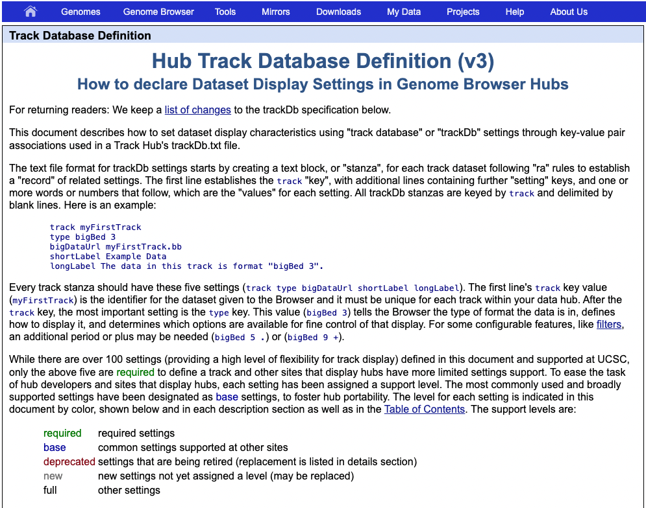

Slide 16
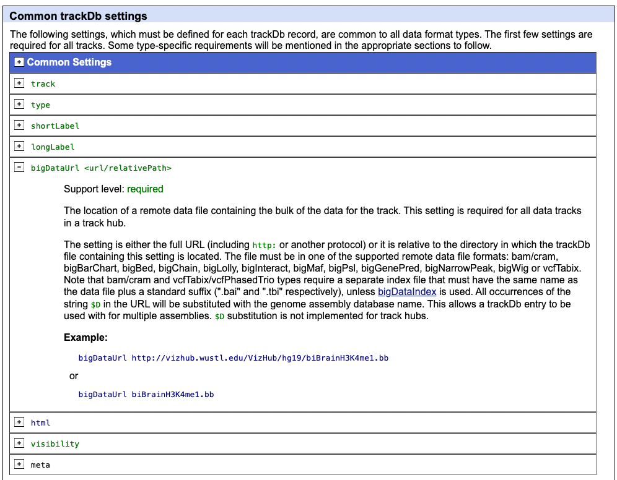

Slide 17




Where to Host the Data Remotely
-- Maximum size limit is 50 GB (uncompressed).
Server must accept byte-range request
  Difficult for most free hosting services (piracy)
Your institution may be able to provide webspace
Free hosting options for researchers are available
5 GB of space for free, but can be relatively
-- slow to display. Offers a paid subscription
service to expand space.
-- Files limited to 100MB, but very fast.
Not limited and fast, but every file needs to be
-- uploaded individually and cannot be changed.
Optimal for very stable links, e.g. in publications.

Slide 18
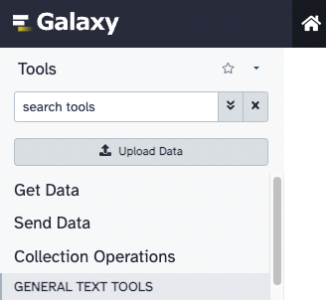
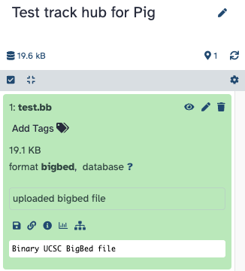
Step 1: Upload the data to a remote server
Depending on the hosting service, steps may vary.

Slide 19
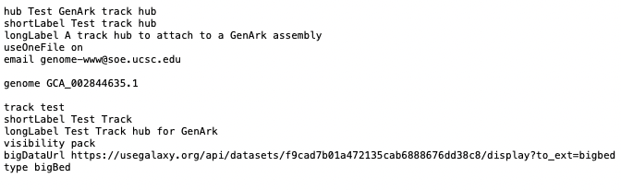
Step 2: Create the Track Hub files
useOneFile on
  Use a single file instead of the required three files but limited to one genome
hub.txt
genomes.txt
trackDb.txt

Slide 20
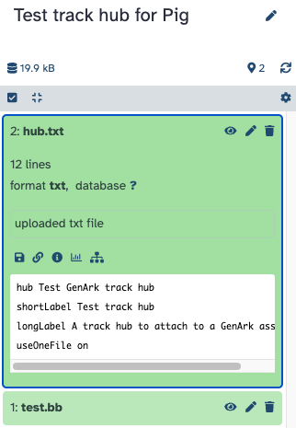
Step 3: Load the hub files to the remote server
Upload the track hub files with all your hub settings to the remote server

Slide 21
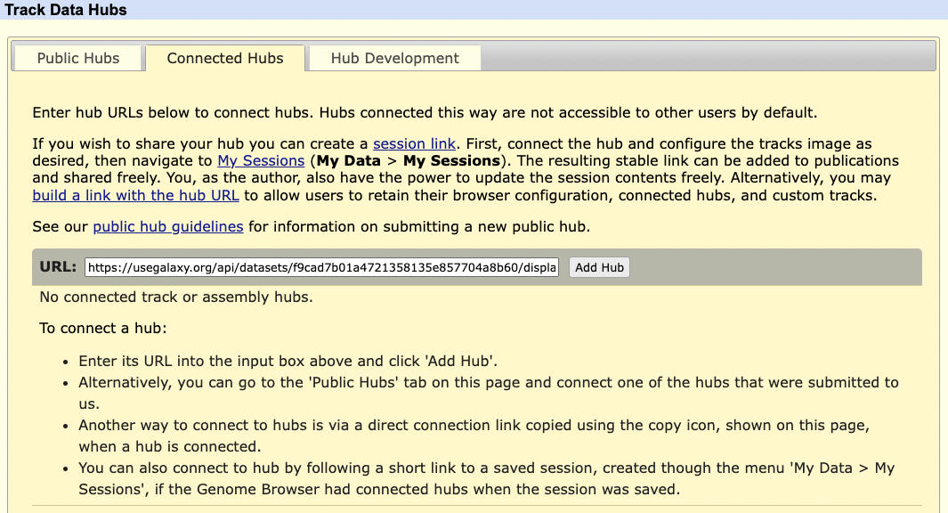
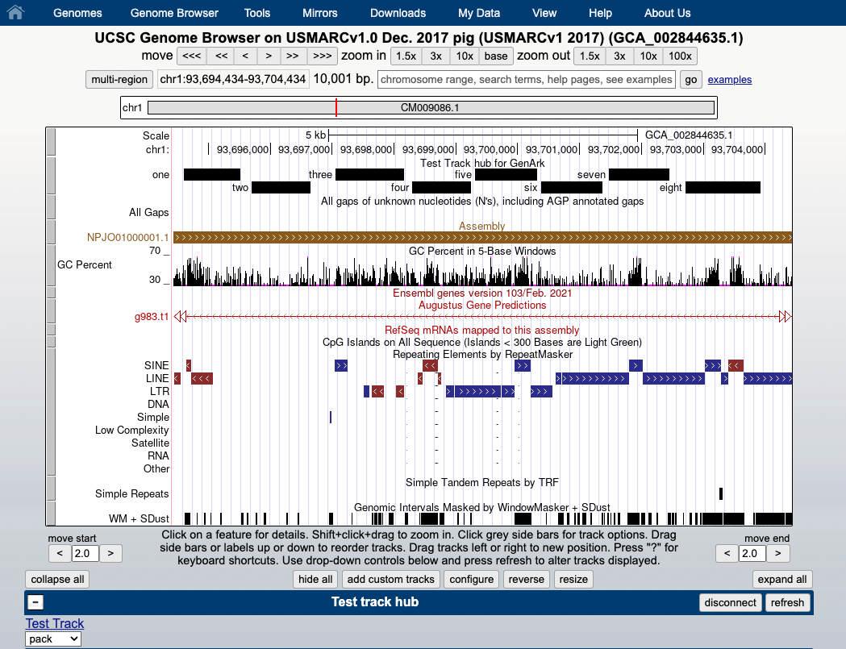
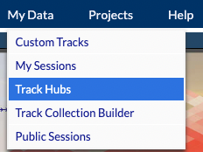
Step 4:
View the Hub
Upload the hub.txt URL via the Track Hub Tracks page:
https://genome.ucsc.edu/cgi-bin/hgHubConnect

Slide 22
Step 5: Share the hub with others
All you need is the hub.txt URL to share with others
hub.txt URL: https://usegalaxy.org/api/datasets/f9cad7b01a4721358135e857704a8b60/display?to_ext=txt
Can construct a URL that can be shared:
https://genome.ucsc.edu/cgi-bin/hgTracks?genome=GCA_002844635.1&hubUrl=https://usegalaxy.org/api/datasets/f9cad7b01a4721358135e857704a8b60/display?to_ext=txt

Slide 23
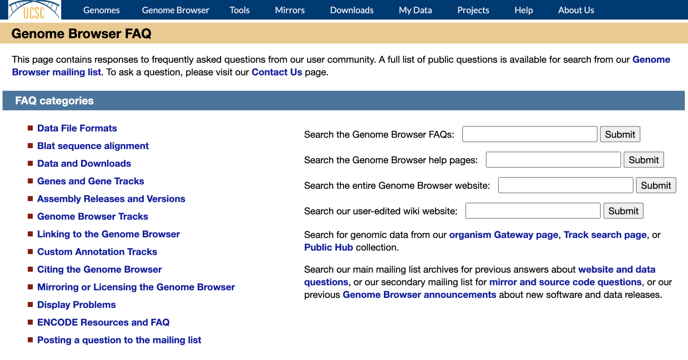
Step 5: Share the hub with others

Slide 24
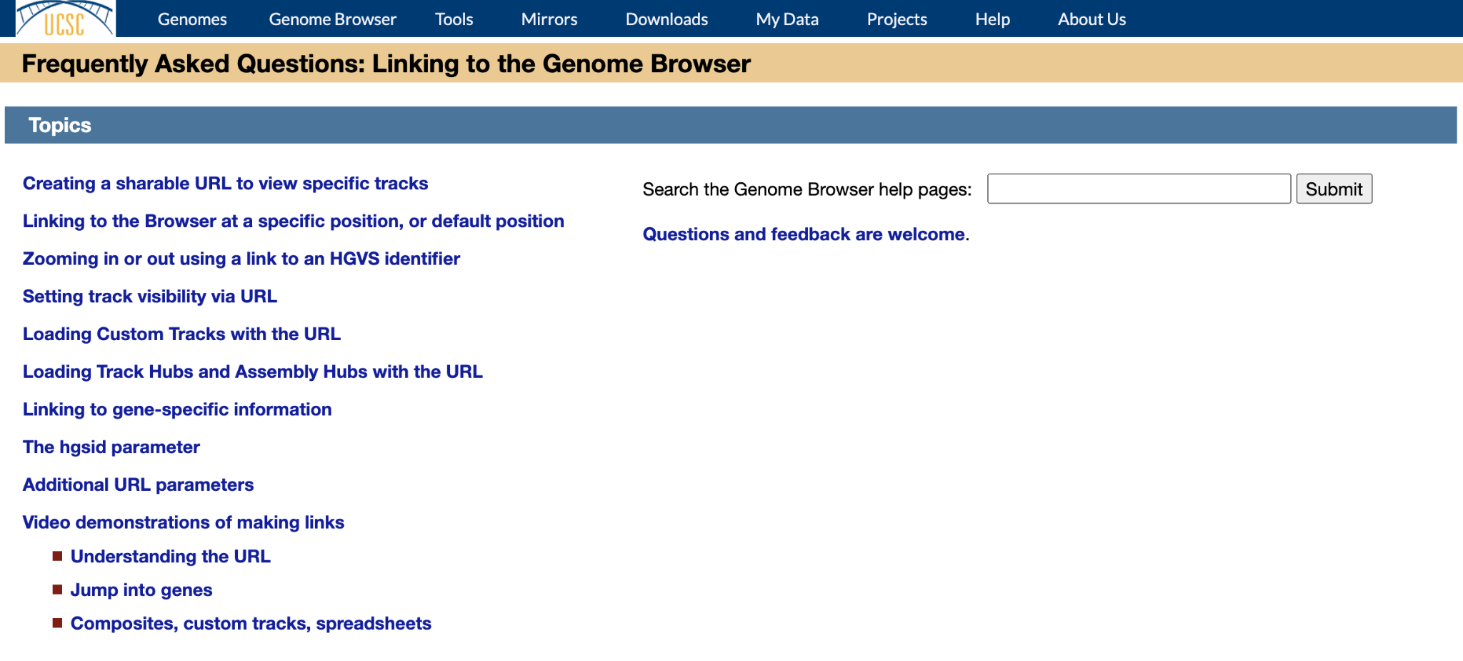
Step 5: Share the hub with others

Slide 25
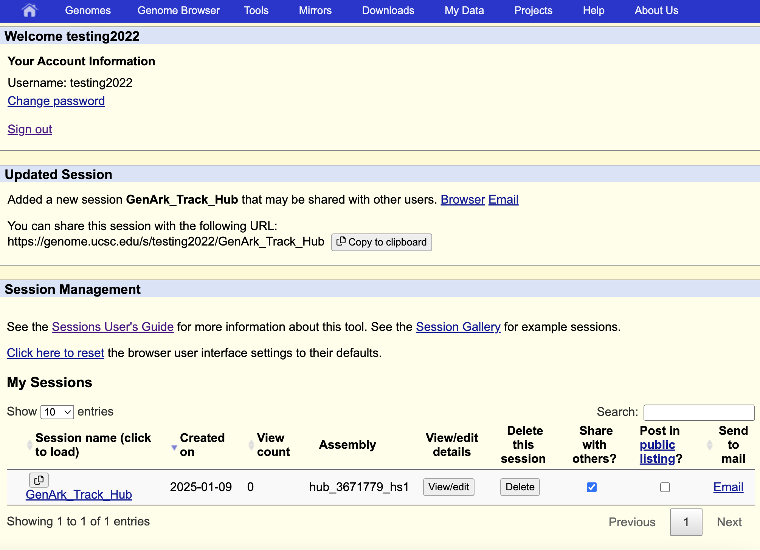
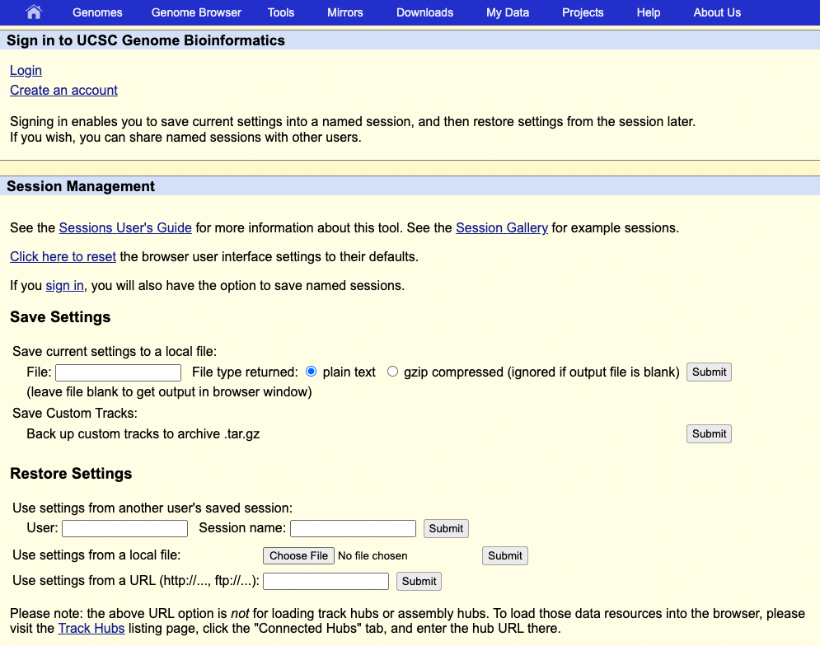
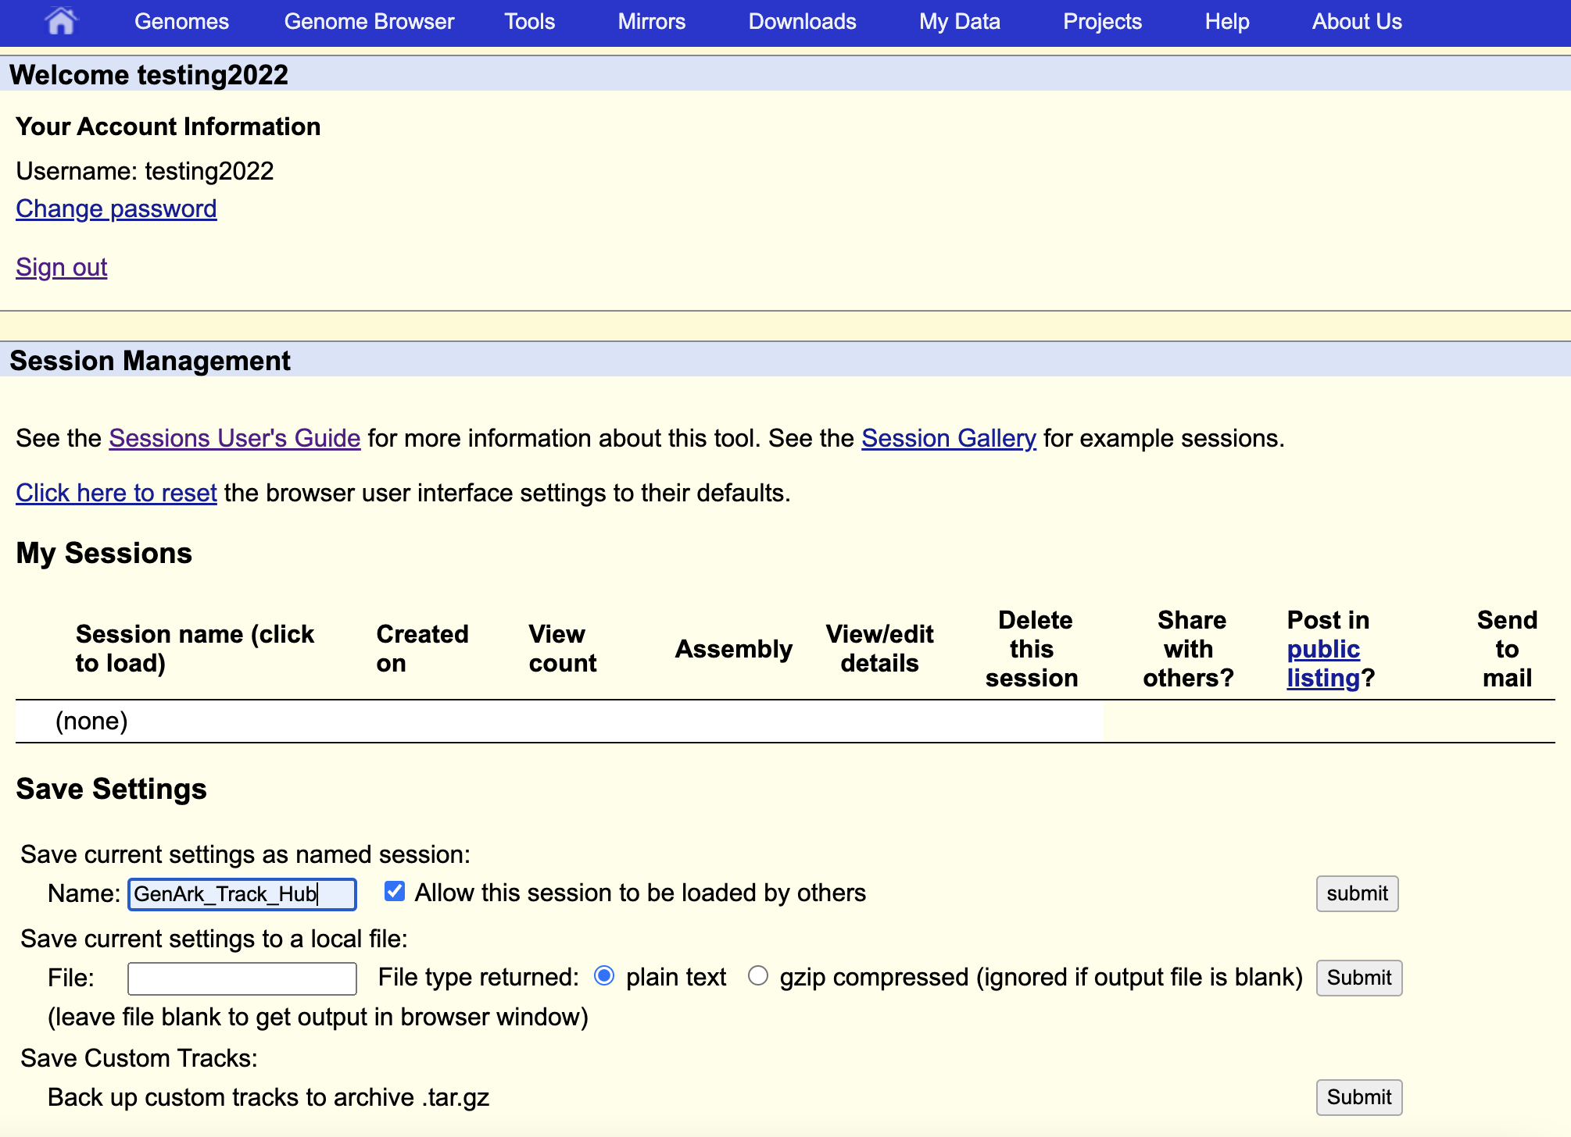
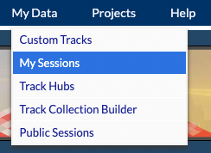
Step 5: Share the hub with others

Slide 26
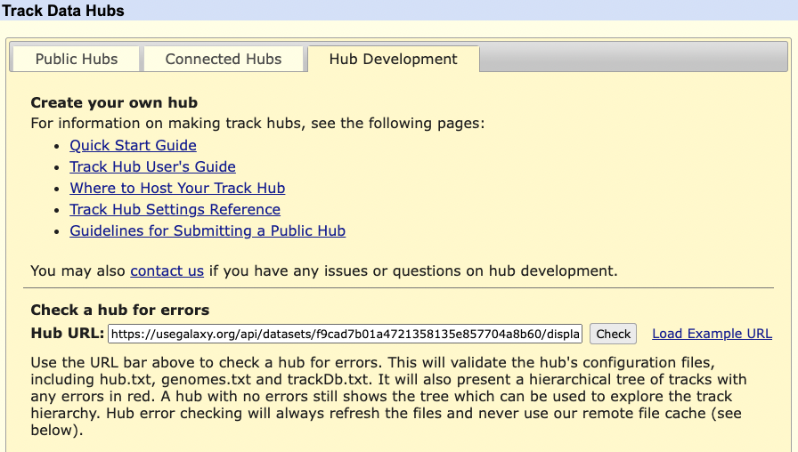
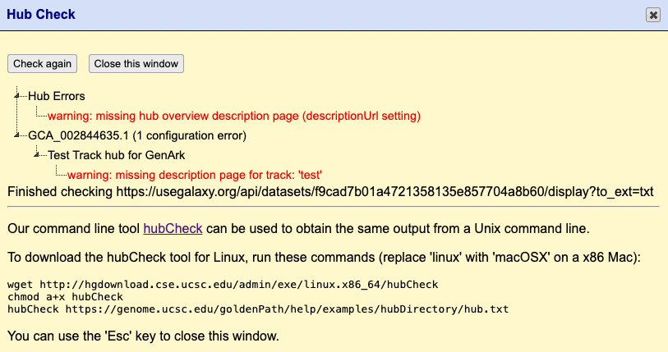
Checking the hub for errors
hubCheck utility can scan through your hub files and report any errors

Slide 27
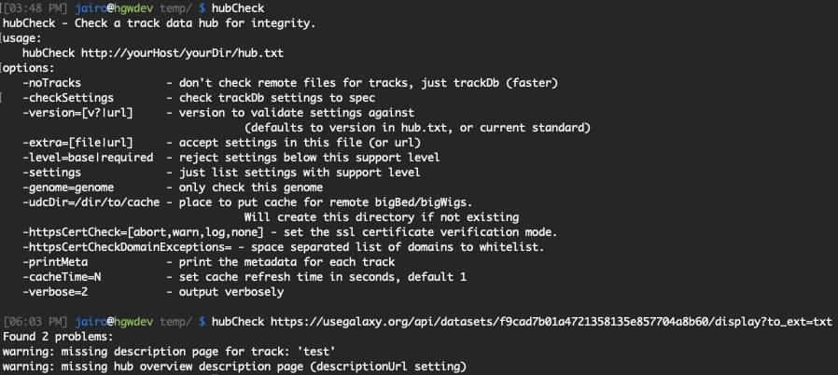
Checking the hub for errors
hubCheck utility can scan through your hub files and report any errors
Command-line utility is even more verbose

Slide 28
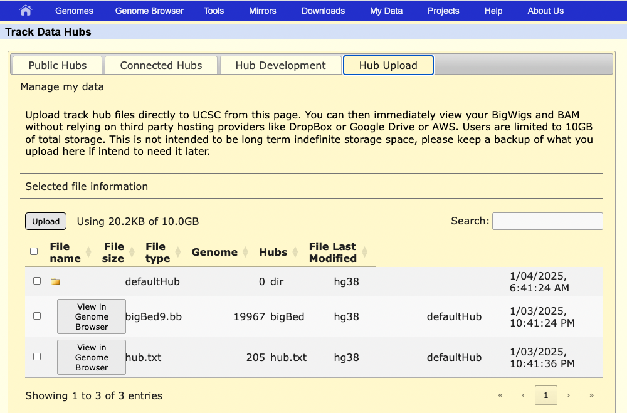
Future feature: Hub space
New feature to be released very soon
Allows you to host files on the UCSC Genome Browser
  Not meant to be permanent storage, so keep backups!

Slide 29
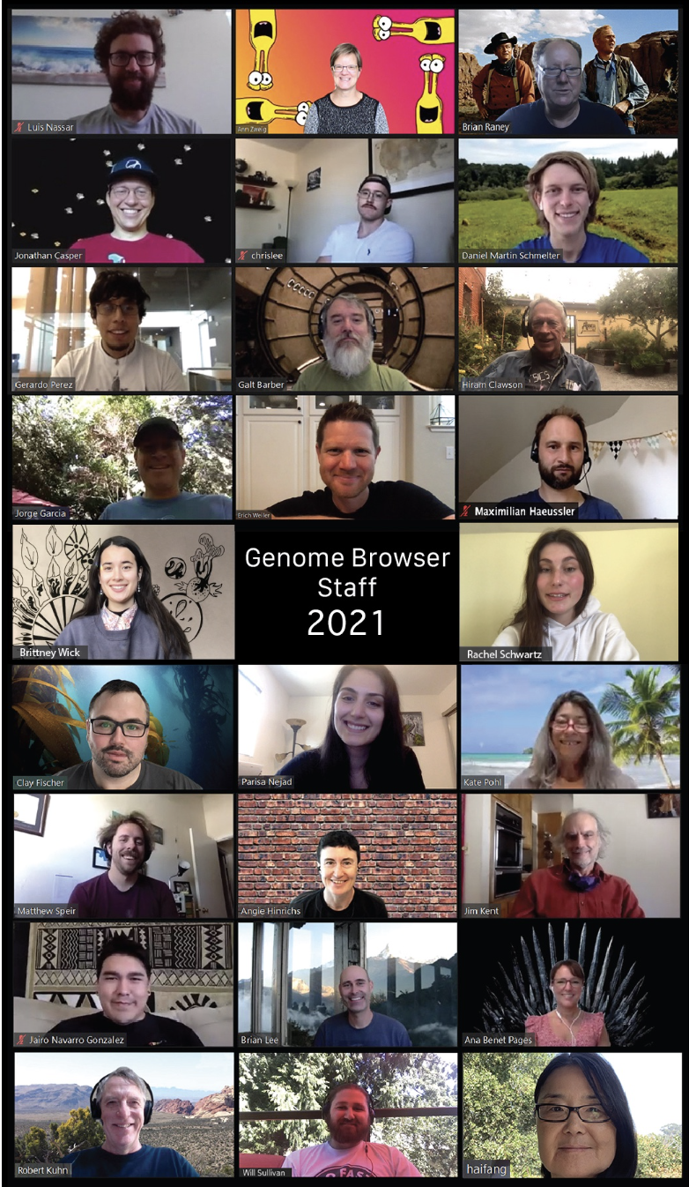
Thanks!
Contact us with your questions:
genome@soe.ucsc.edu
Sensitive data: genome-www@soe.ucsc.edu

