Slide 1
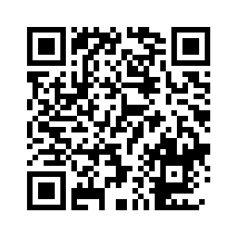
BME-18 Scientific Principals of Life
Wednesday 08 November 2023 – Thimann 1
Hiram Clawson – U.C. Santa Cruz Genomics Institute
software engineer on the genome browser project:
https://genome.ucsc.edu/
Private email to the browser staff: genome-www@soe.ucsc.edu
Public email list: genome@soe.ucsc.edu
Latest updated copy of this presentation:
https://genomewiki.ucsc.edu/index.php?title=File:BME-18.2023-11-08.pptx
Notes:
Hiram Clawson – hclawson@ucsc.edu - https://www.linkedin.com/in/hiram-clawson-46448b/ - browser staff private email: genome-www@soe.ucsc.edu – public email list: genome@soe.ucsc.edu

Slide 2
Today’s topics
my definition of ”science”
The genome browser: https://genome.ucsc.edu/ brief introduction
Browser educational resources: https://genome.ucsc.edu/training/education/
interactive browser sessions demonstrating biology topics
4. Leave you with a puzzle: what is CODIS ?
Some fun links for your entertainment:
1. https://youtu.be/0fKBhvDjuy0/ - Powers of 10 (1977) Eames office
2. https://youtu.be/7Hk9jct2ozY/ - DNA animation (2002-2014) by Drew Berry and Etsuko Uno
3. https://youtu.be/ydqReeTV_vk/ - Evo Devo (biology) – Acapella Science
4. https://youtu.be/f8FAJXPBdOg/ - The Molecular Shape of You (quantum atomic theory) – Acapella Science
5. https://youtu.be/SKhcan8pk2/ - Homochirality (all natural sugar is ‘right’ handed) – Steve Mould
6. https://youtu.be/b34al8YmQSA/ - All coal is the same age (really ?) – Steve Mould
Notes:
Overview of presentation. 1. My definition of “science” 2. The UCSC Genome Browser 3. Educational resources in the Genome Browser. Fun links: 1. https://youtu.be/0fKBhvDjuy0 2. https://youtu.be/7Hk9jct2ozY 3, https://youtu.be/ydqReeTV_vk 4. https://youtu.be/f8FAJXPBdOg 5. https://youtu.be/SKhcan8pk2w 6. https://youtu.be/b34al8YmQSA

Slide 3
‘Science’ is what we do to understand how the natural world
works by looking at physical evidence.
'what we do' - it is an activity performed by people
'to understand' - answering questions, endless numbers of questions
'natural world' - the only one we can know by direct evidence
'how ... works' - 'how' are natural processes functioning, not necessarily 'why'
'looking at' - making observations, recording evidence
'physical evidence' - objective real stuff, no hand waving allowed
Notes:
The ‘Philosophy of Science’ can be a contentious subject. https://en.wikipedia.org/wiki/Philosophy_of_science

Slide 4
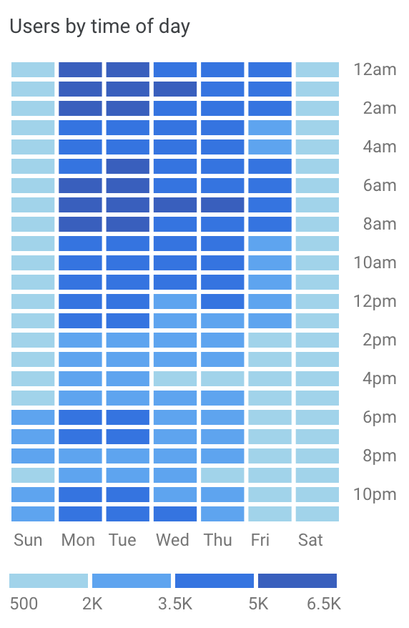
The UCSC Genome Browser
2002 - https://pubmed.ncbi.nlm.nih.gov/19957273/
Providing a web browser view of the human genome since 2001, added mouse genome in 2002, today serving up a view of over 3,600 genome assemblies for over 2,500 species
15,000 users per day, web site 300,000+ data files == 23 Tb of data, 59,000+ MySQL tables == 7 Tb of data, 90 Tb data available for download (over 2 Tb per day is sent out)
Live demonstration: https://genome.ucsc.edu/
Notes:
Original paper describing the genome browser: https://pubmed.ncbi.nlm.nih.giv/19957273/

Slide 5
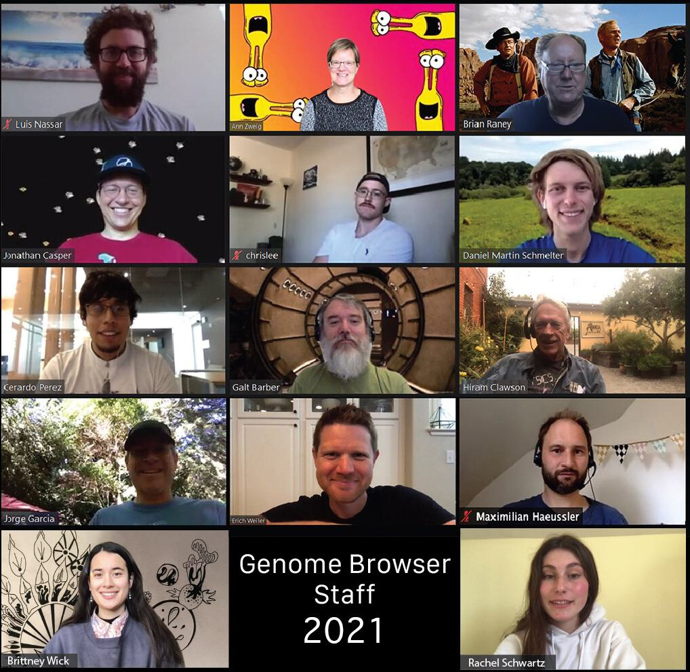
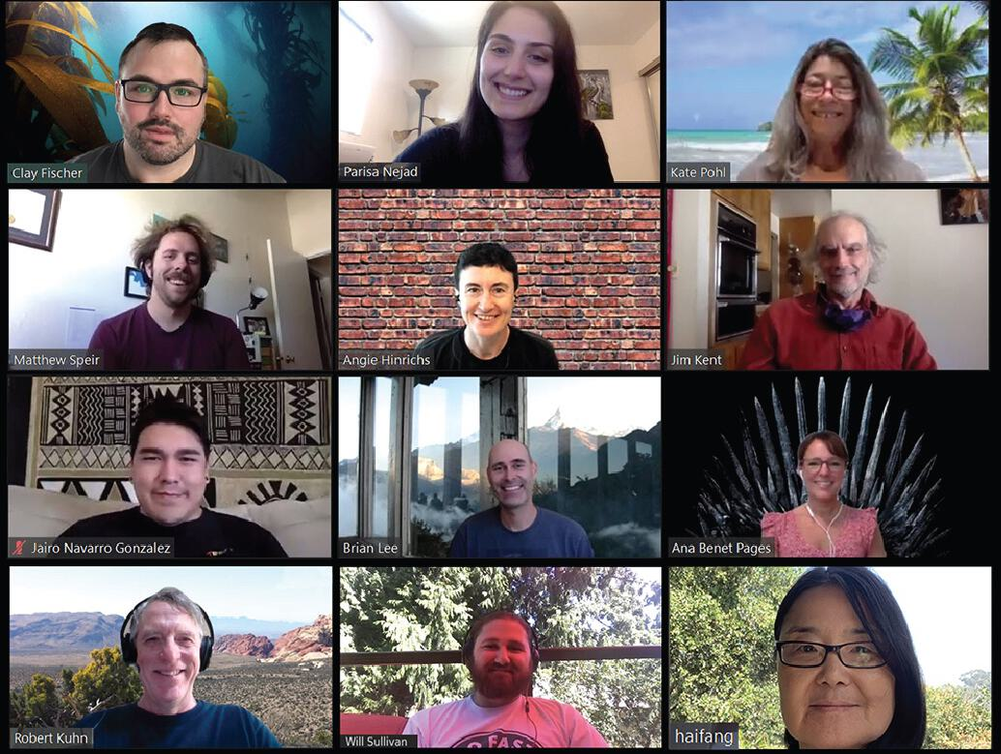
The UCSC Genome Browser Staff

Slide 6
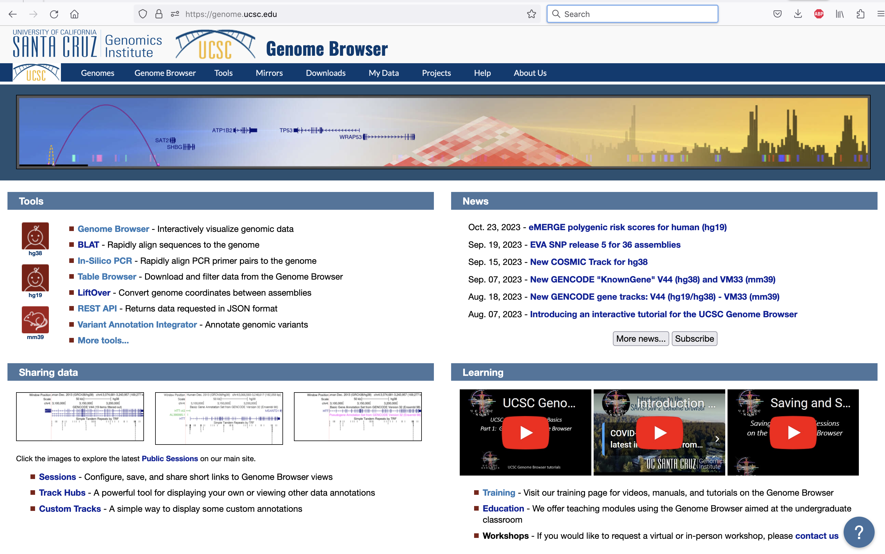
https://genome.ucsc.edu/ browser ‘home’ page
Notes:
The Genome Browser ‘home’ page – https://genome.ucsc.edu/

Slide 7
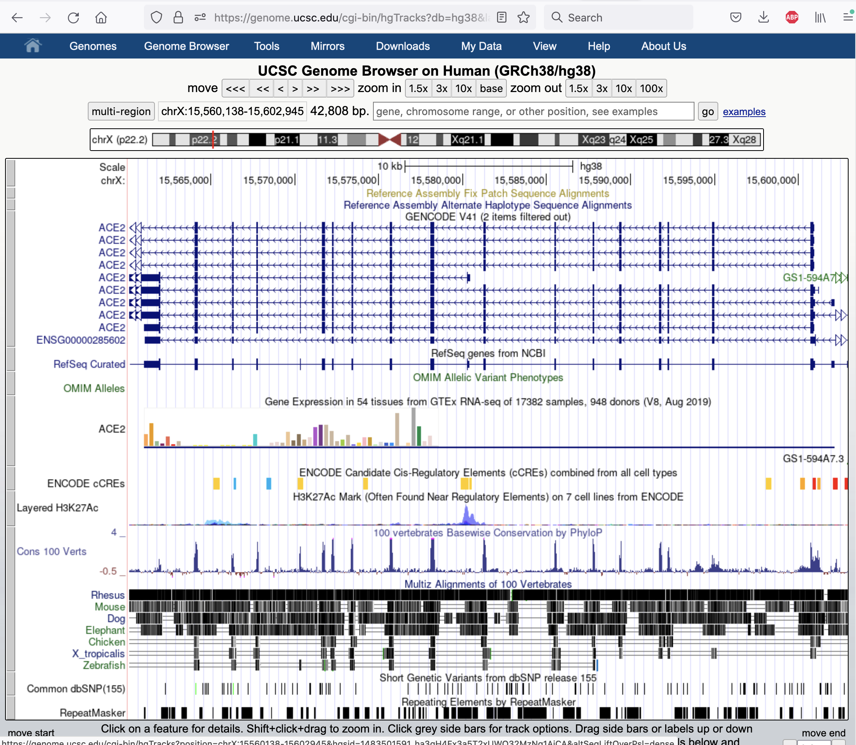
cgi-bin/hgTracks
default view
Notes:
The default view of a genome assembly and the annotations on that genome

Slide 8
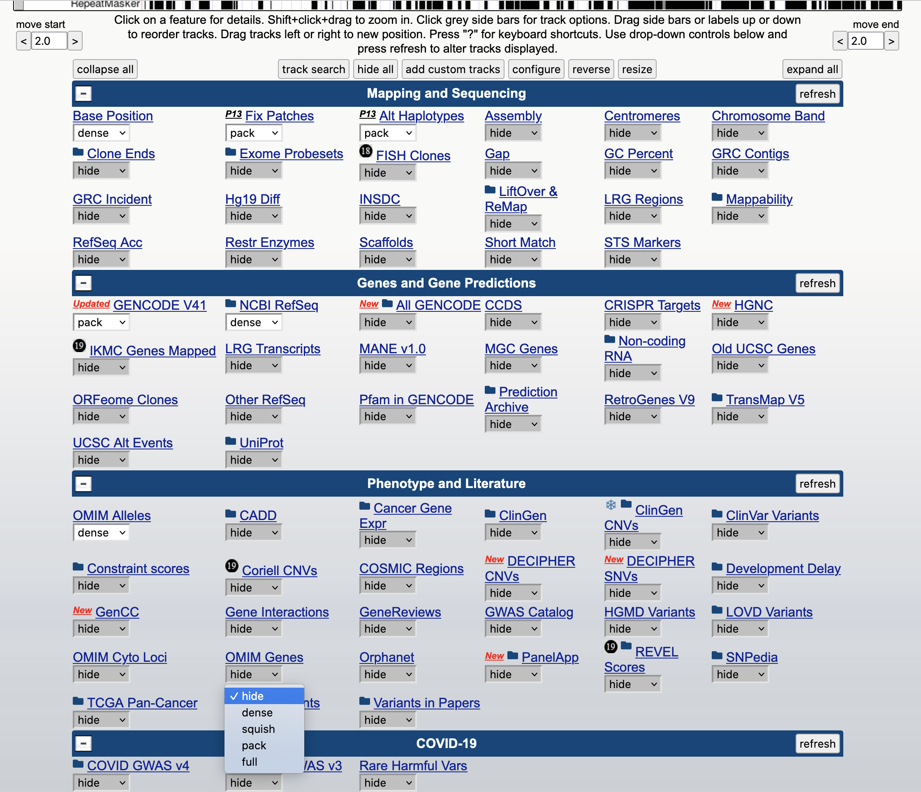
‘track’ controls
Notes:
The track controls below the main graphic image determine what is shown in the genome browser. There are thousands of annotations that can be shown.

Slide 9
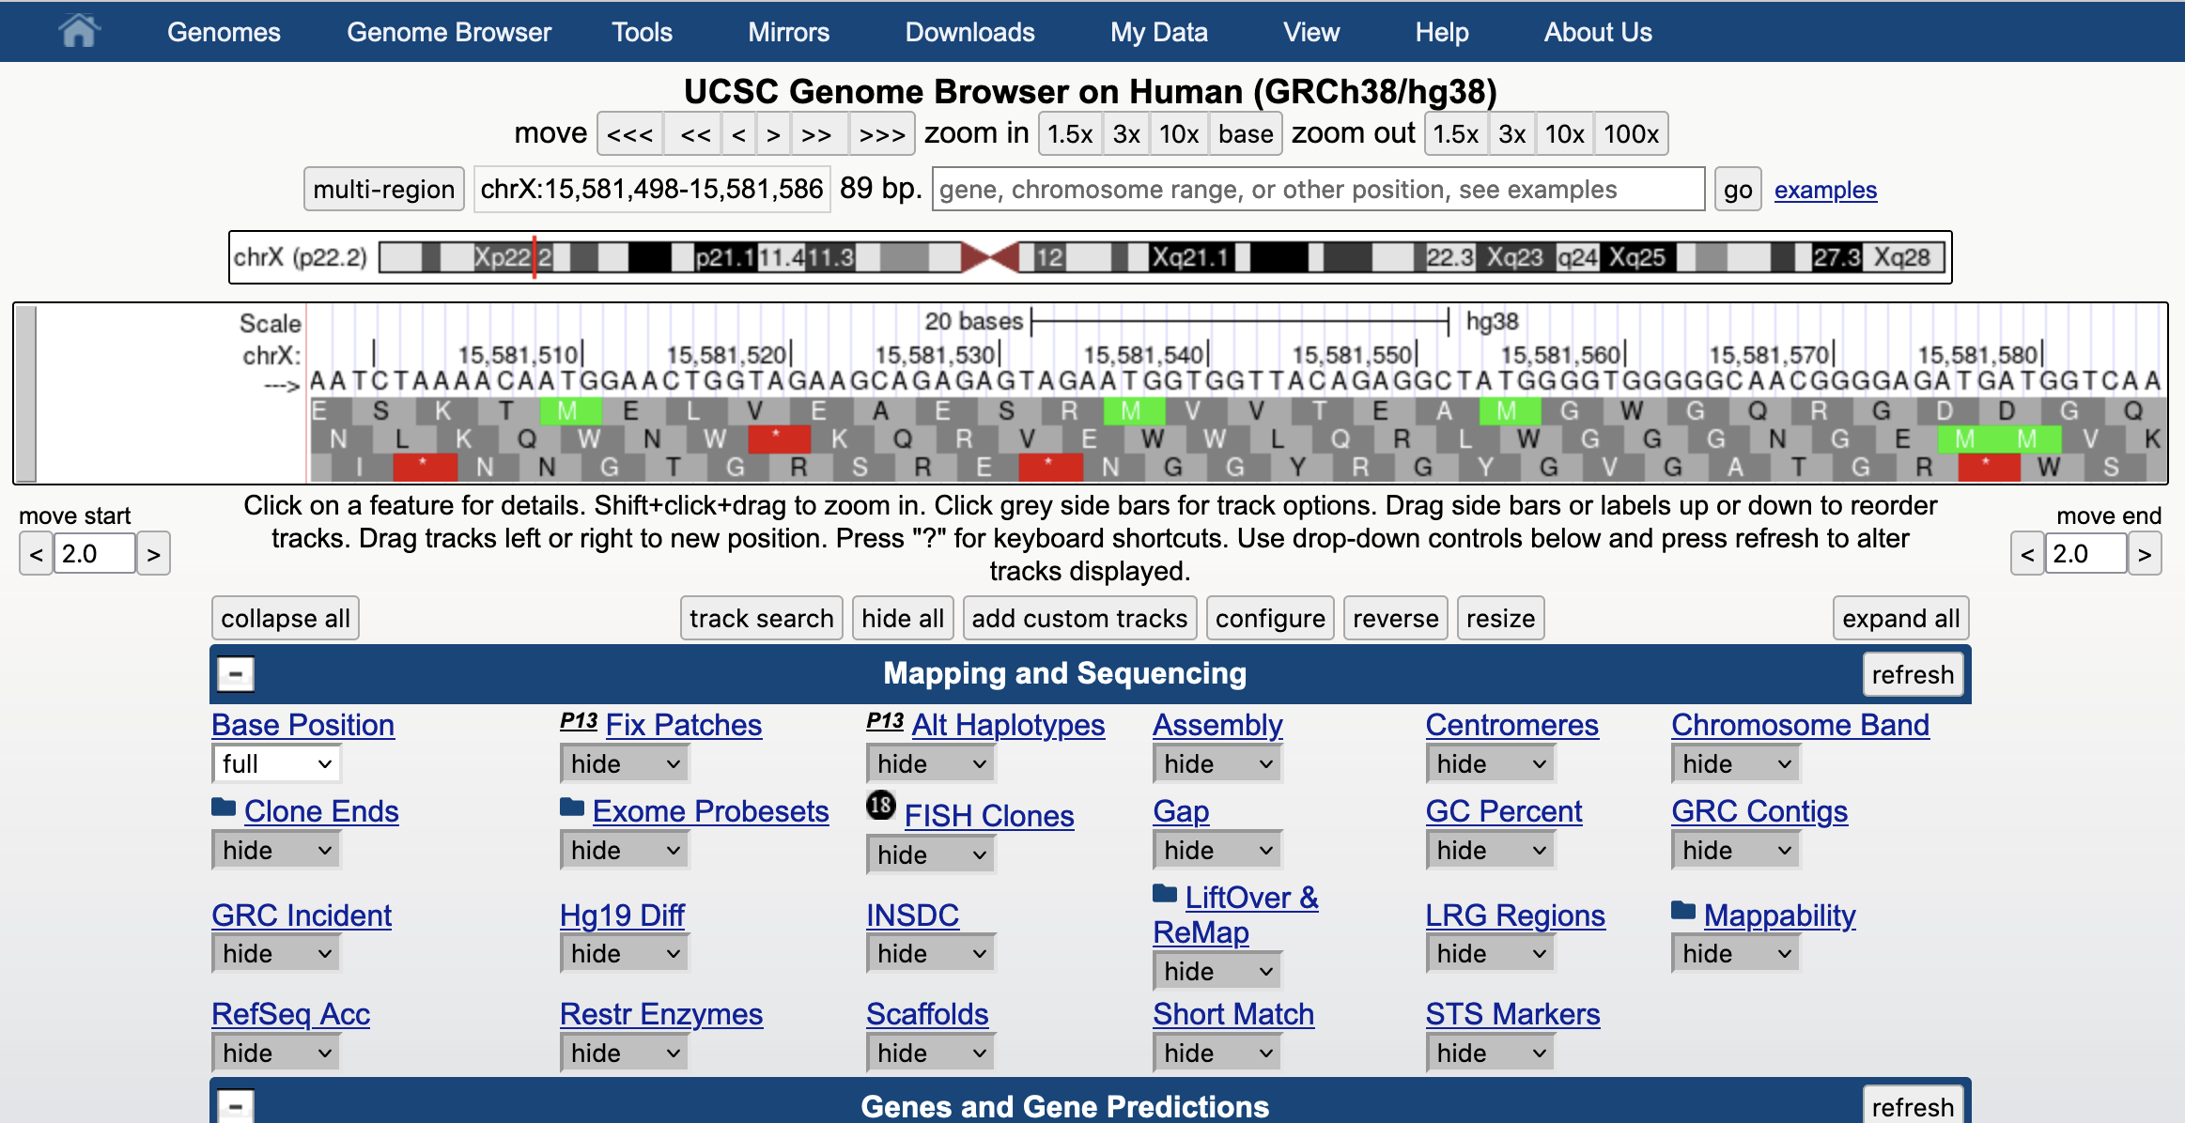
all tracks set to ‘hide’, ‘base’ track set to ‘full’, zoom in to ‘base’
Notes:
All tracks set to ‘hide’. The ‘base’ track set to ‘full’. ‘zoom in’ to ‘base’ view to see the actual nucleotides of the genome sequence.

Slide 10
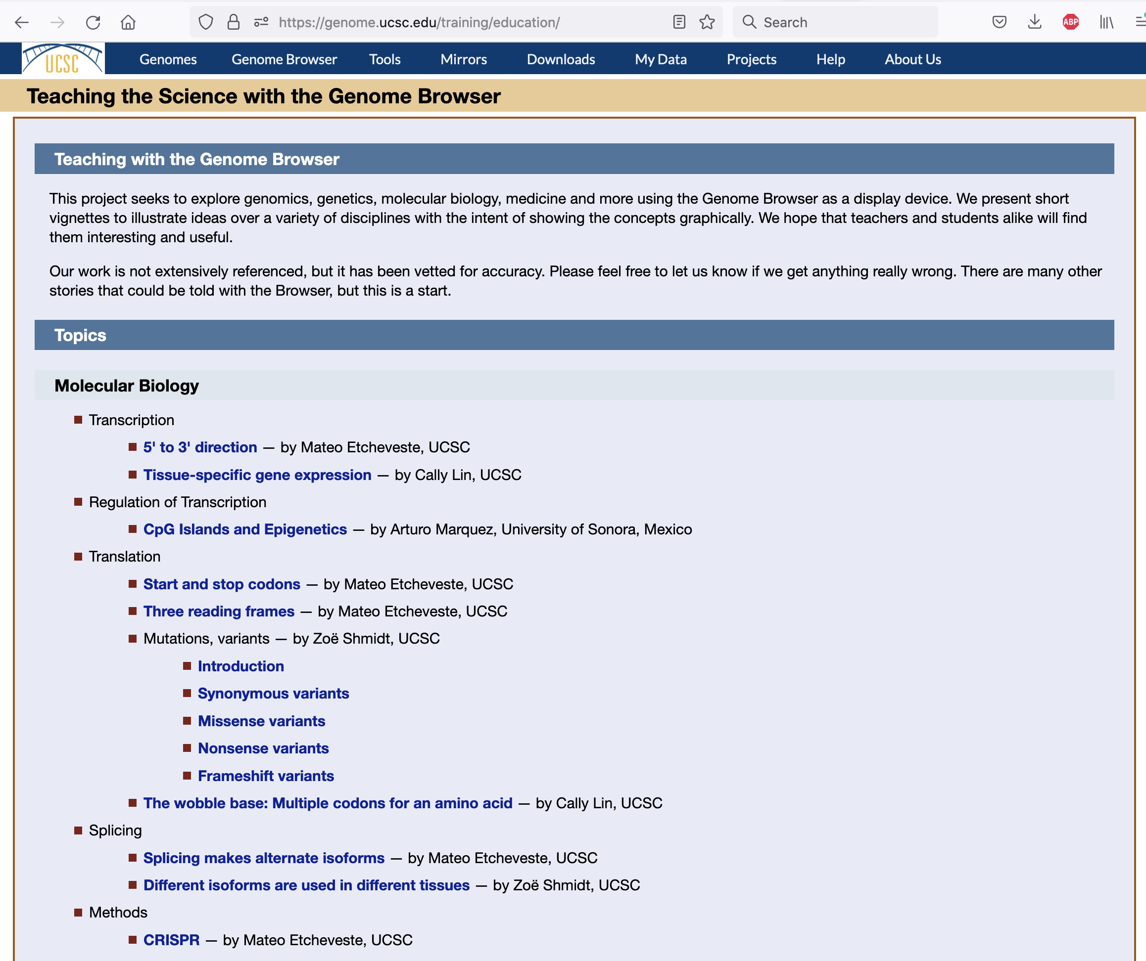
https://genome.ucsc.edu/training/education/
Notes:
Useful scenarios demonstrating biology topics using the genome browser. Leads to sessions in the browser where the demonstration can be use interactively.

Slide 11
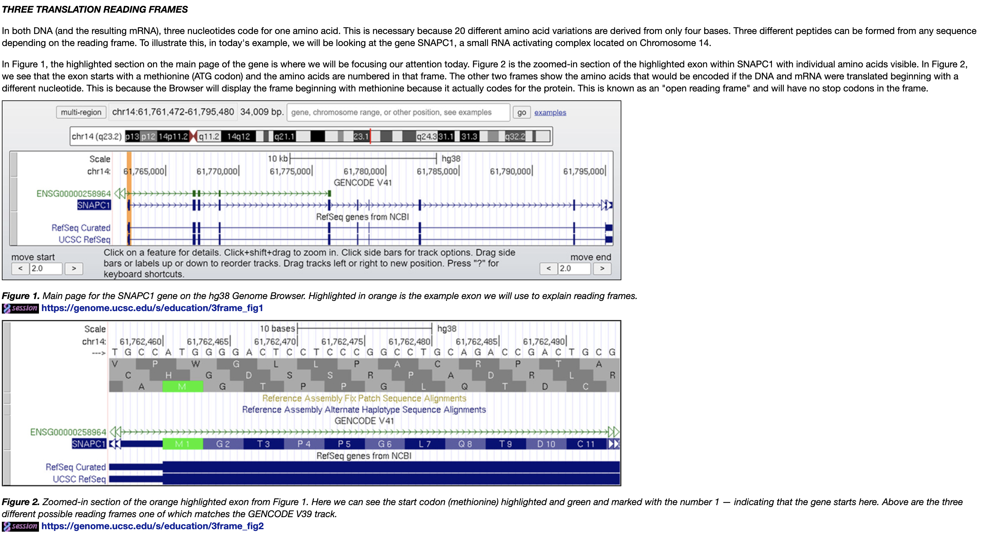
Three ‘Reading’ frames
Notes:
Sample lesson, what are ‘reading’ frames, why are there three. What about the ‘other’ three ?

Slide 12
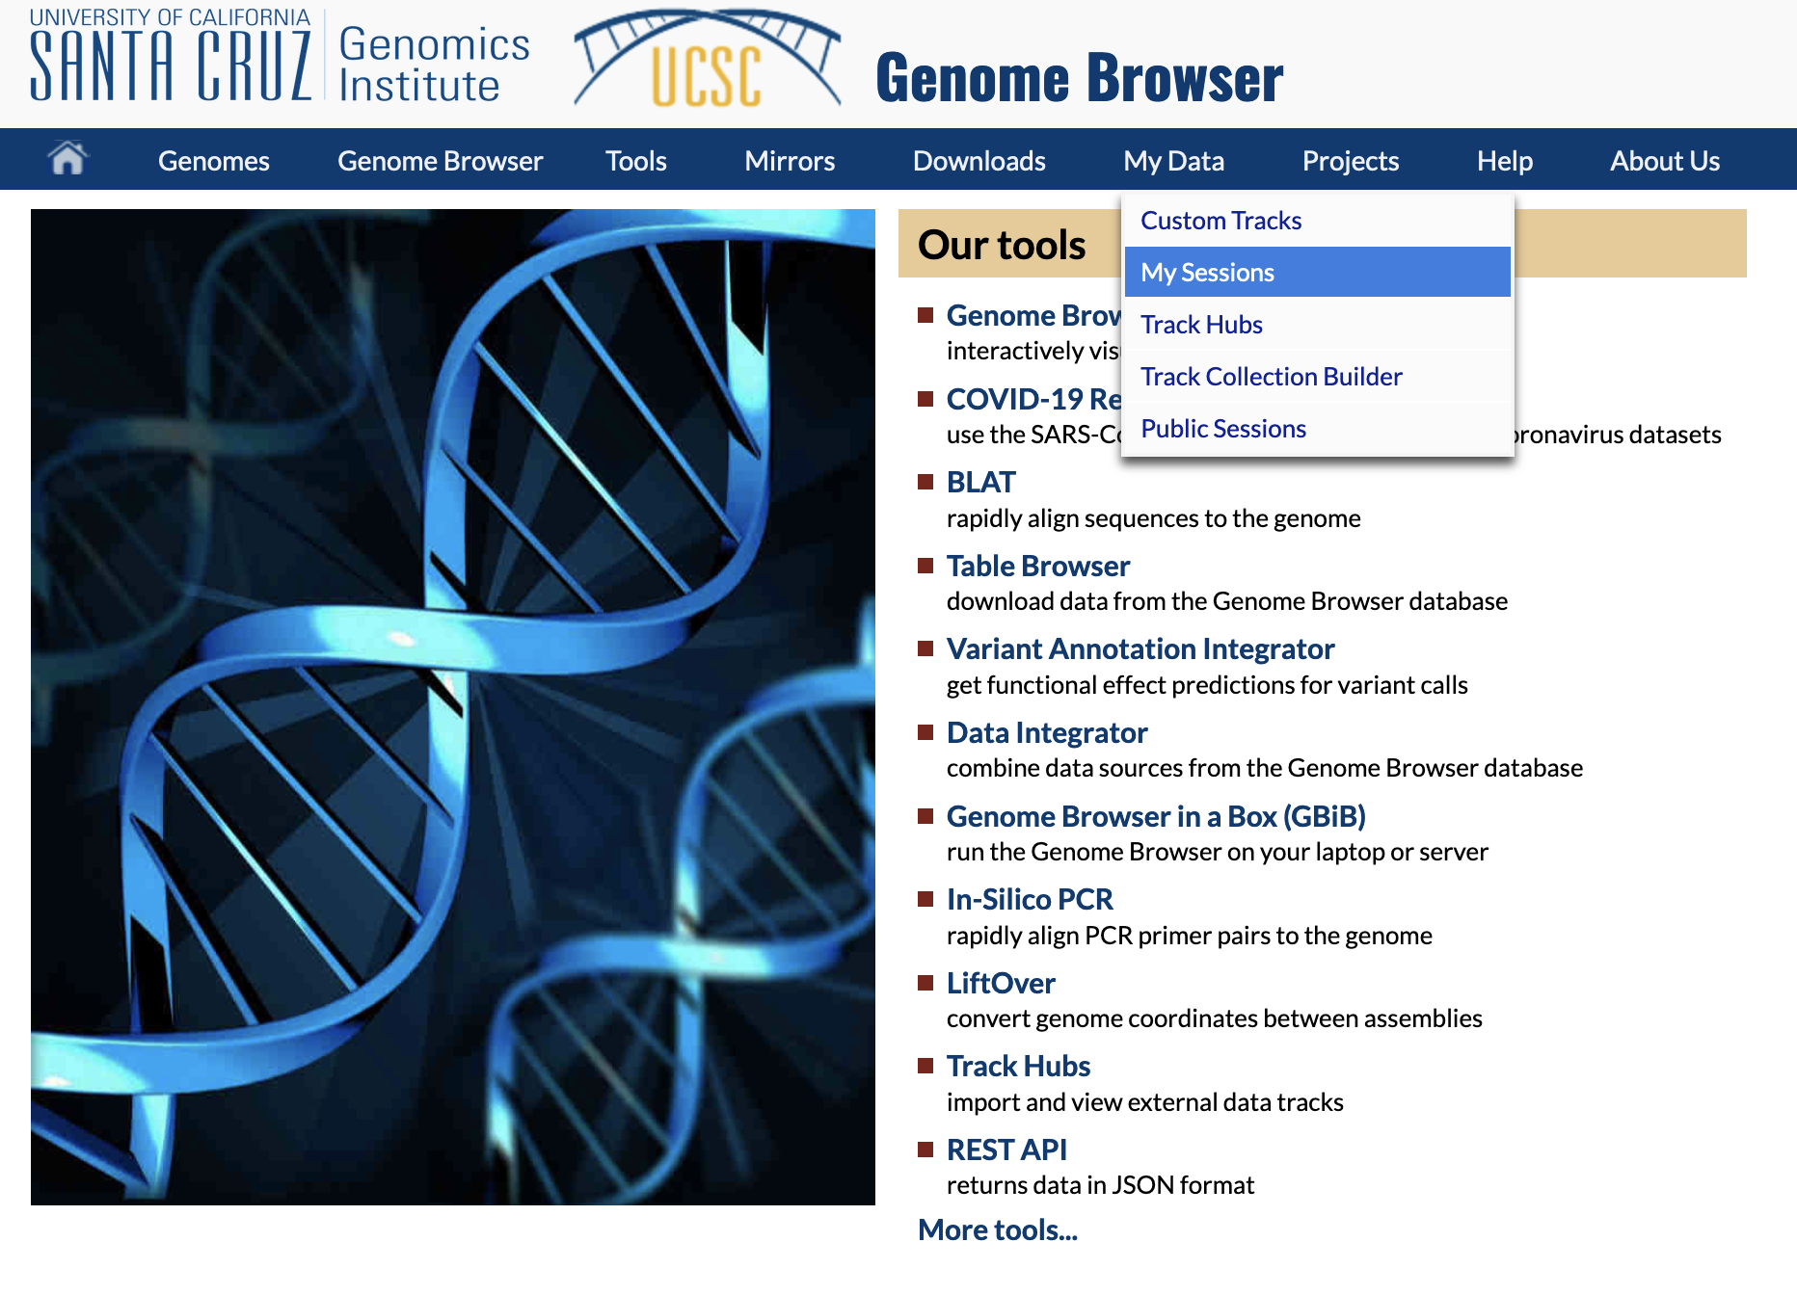
Create your own ‘sessions’ – views in the browser
See also: http://genome.ucsc.edu/goldenPath/help/sessions.html
Notes:
You can establish a login ‘account’ with the genome browser. With that account you can save ‘sessions’ – specific views of the genome browser configured to demonstrate something of interest. You can place your session in the ‘public’ list of sessions, or write to us private email at: genome-www@soe.ucsc.edu to suggest your session be used in the educational resources page.

Slide 13
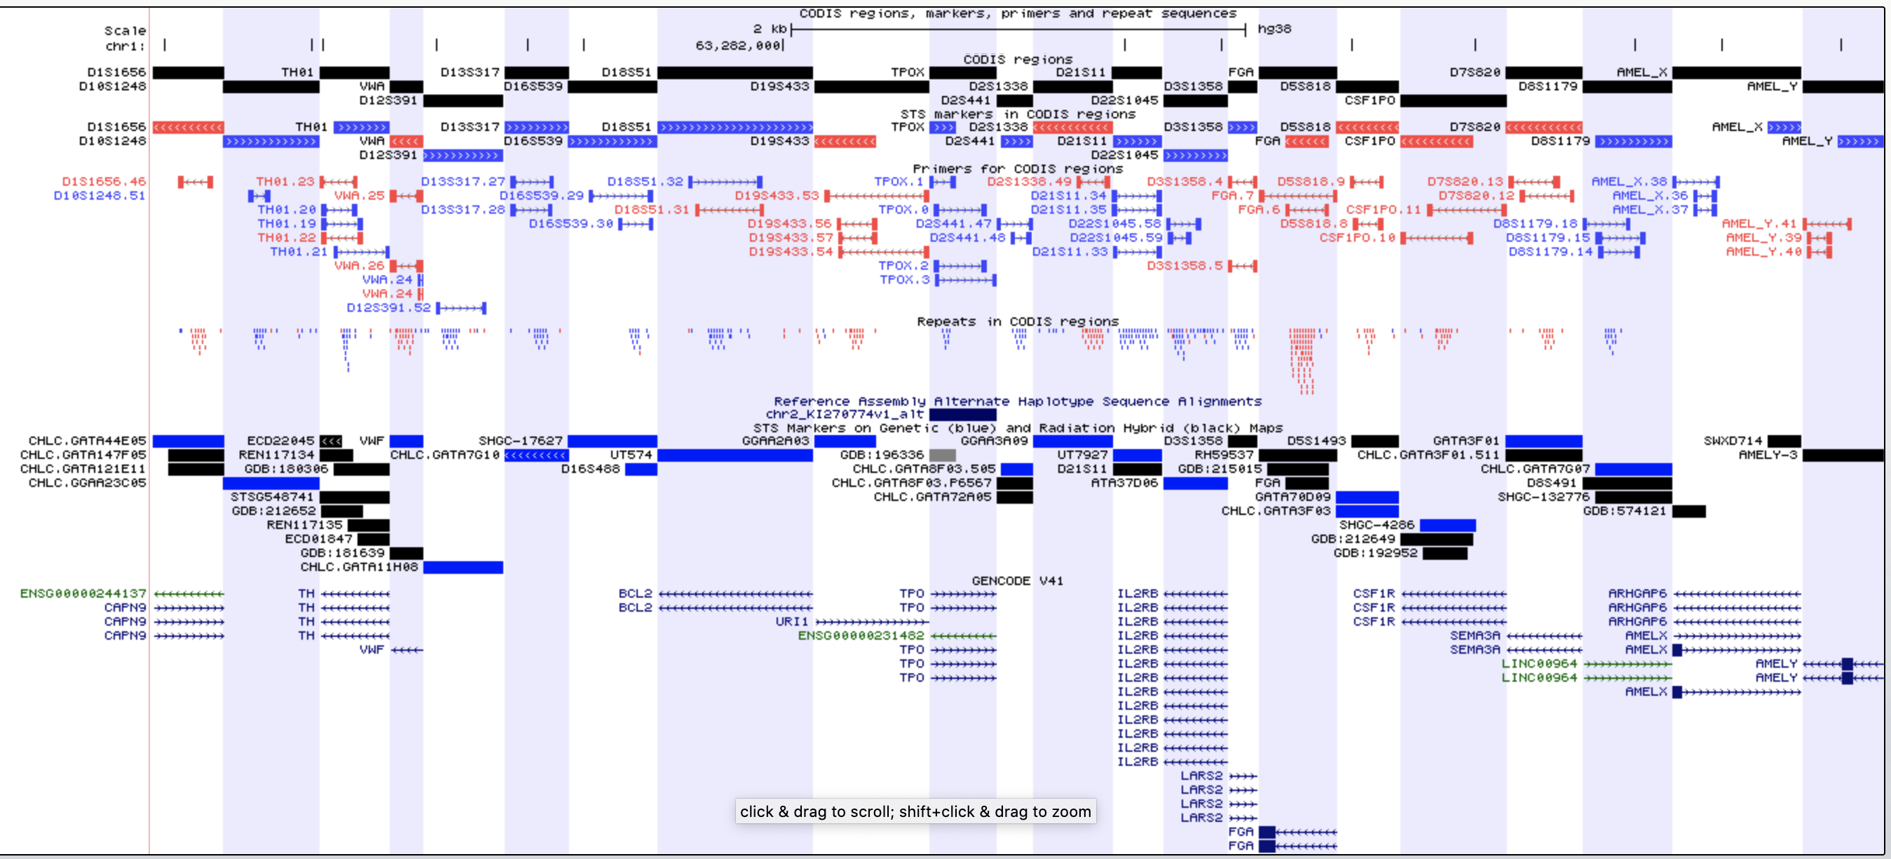
Leave you with a puzzle: how does DNA forensic identification work ?
https://genome.ucsc.edu/s/Hiram/hg38.codis
Notes:
What is CODIS ? What are DNA short tandem repeats ? What are the ethical considerations in such identification schemes ?

