Slide 1
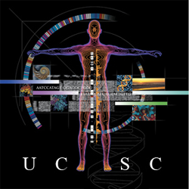
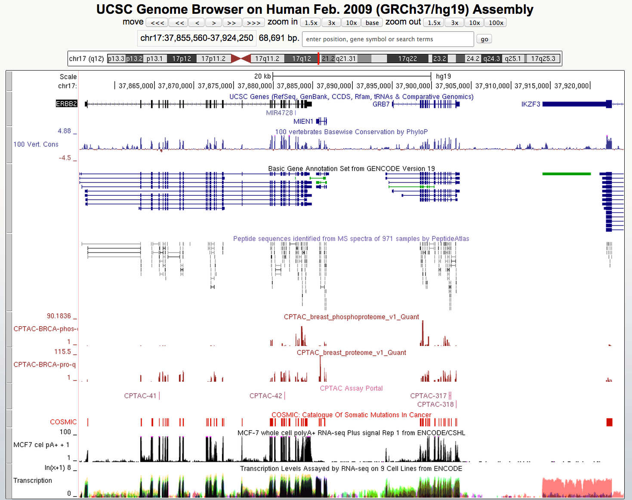

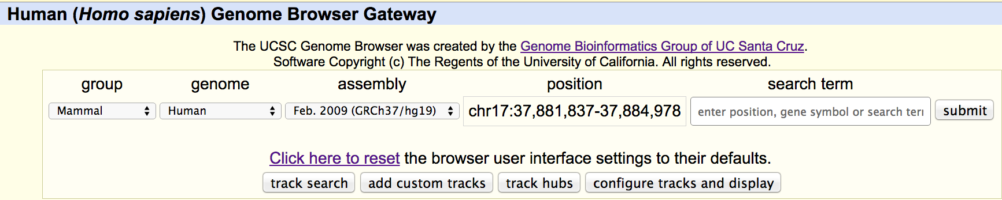
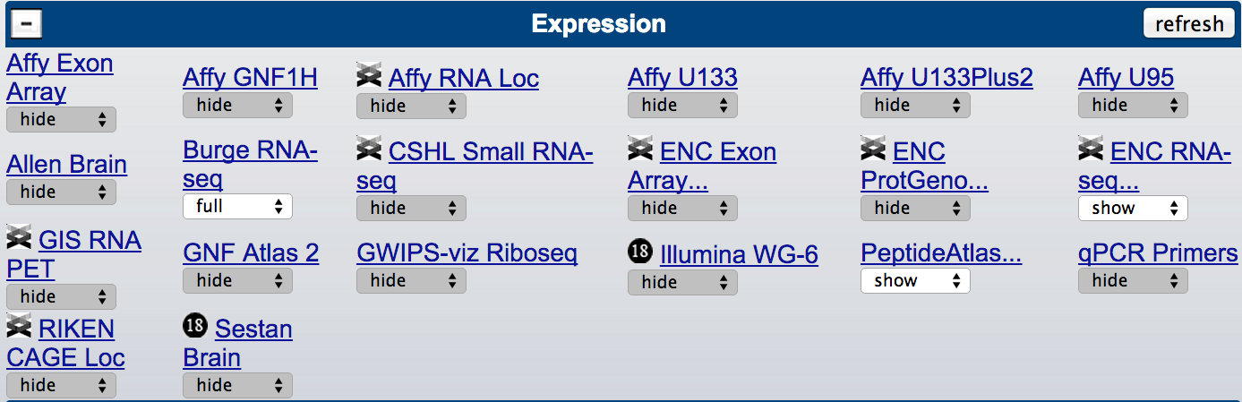
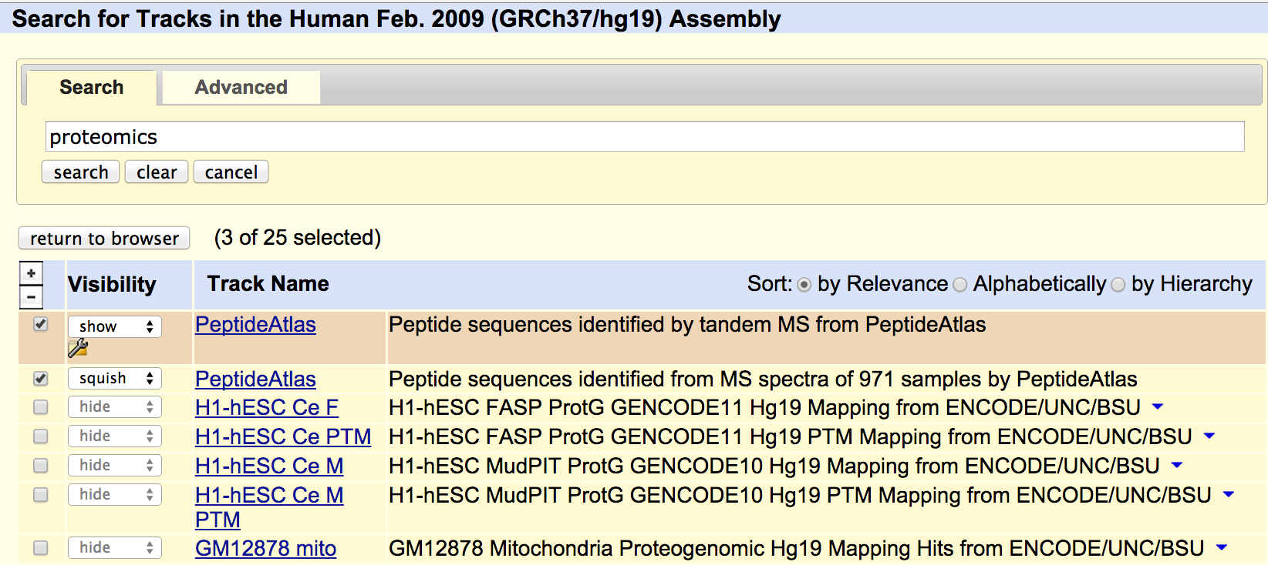
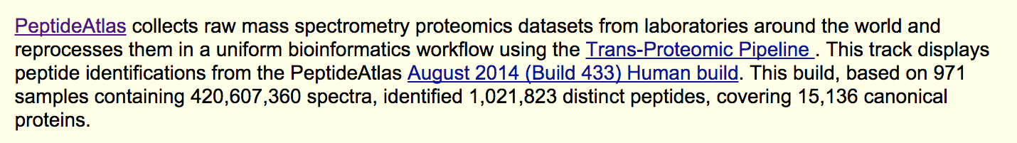
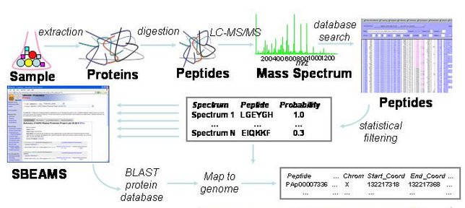
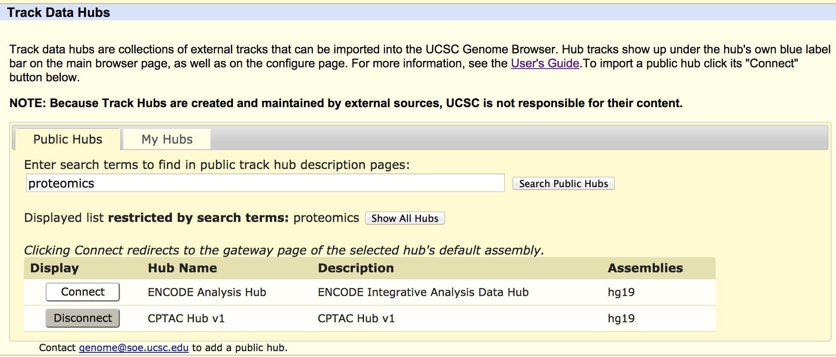
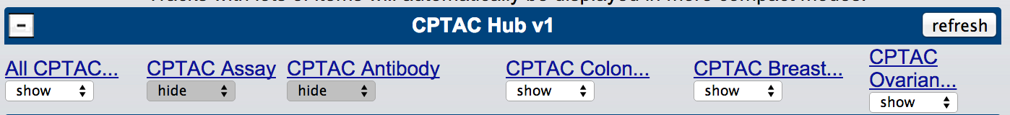
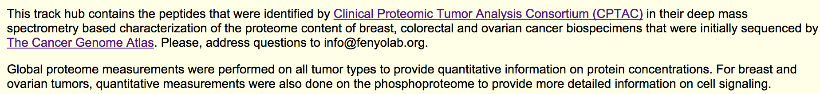
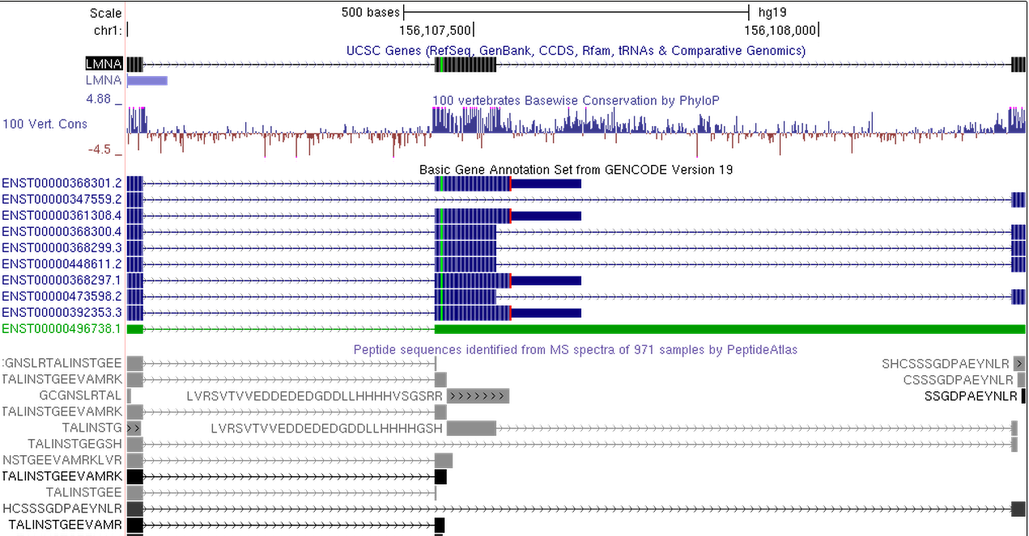
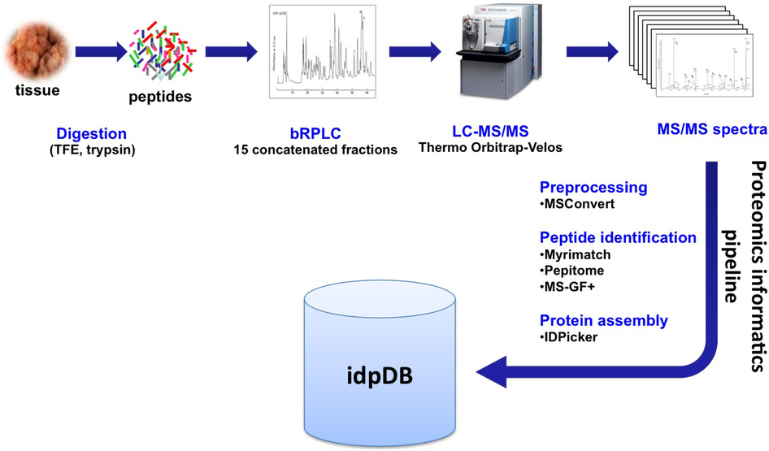


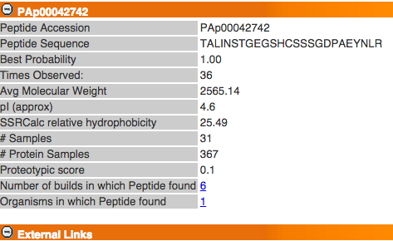







Visualizing proteomics data in genomic context using the UCSC Genome Browser
Kate R. Rosenbloom, Hiram Clawson, Mark Diekhans, Luvina Guruvadoo, Rachel A. Harte^{1,2}, Donna Karolchik, Brian T. Lee, Brian J. Raney, Ann S. Zweig, David Haussler^{1,3}, Robert M. Kuhn, W. James Kent
¹ UC Santa Cruz Genomics Institute, and ³Howard Hughes Medical Institute, University of California Santa Cruz, SC, CA, USA
² Invitae, San Francisco, CA, USA
Zhi Sun, Eric W. Deutsch Institute for Systems Biology, Seattle, WA, USA
Christopher R. Kinsinger, Henry Rodriguez National Cancer Institute, National Institutes of Health, Bethesda, MD, USA
David Fenyo Center for Health Informatics and Bioinformatics, NYU School of Medicine, New York, NY, USA
genome.ucsc.edu
Overview
Locate proteomics data
As the comprehensiveness and quality of mass spectrometry peptide identifications improve, there is increasing interest from researchers outside of the proteomics community in accessing, visualizing, and analyzing proteomic datasets in genomic context with gene annotations, epigenetic profiles, genetic variation and clinical data anchored to the genome. Similarly, researchers with proteomics data seeking to integrate with other ‘omics datasets can benefit from existing tools and databases that proide access to well-curated genome annotations. The UCSC Genome Browser and database provides a comprehensive resource of genome assemblies and annotations together with visualization and analysis tools. It has been in continuous use by scientists and students worldwide since its launch in the year 2001 to showcase the draft human genome assembly.
Two recent developments in the browser relevant to the proteomics community are the incorporation of the PeptideAtlas 2014 human build into the browser database and track display, and the CPTAC cancer proteomics data hub. These datasets are now publicly available for visualization, download, and data mining using UCSC tools at the UCSC Genome Browser website, http://genome.ucsc.edu.
1. At genome.ucsc.edu, navigate to the genome selection page:
2. Select the human hg19 genome assembly:
3. Select tracks from the menu, or use the search features
PeptideAtlas browser track
Genome browser view of a 68kbp genomic region on human chromosome 17 where 3 cancer-associated genes (ERBB2, MIEN1, and GRB7) are colocated, along with a 4th gene (IKZF3; a tissue-specific (lymphocyte differentiation) transcription factor). Exons are denoted by tall blocks in the annotated gene tracks, with confirmatory evidence in the conservation signal produced using the UCSC 100-vertebrate genome sequence alignment, RNA-seq data from the ENCODE project, and PeptideAtlas peptide identifications. The cancer proteomics (CPTAC) tracks shown here show proteome and phosphoproteome signal in breast tumor samples from the TCGA (The Cancer Genome Atlas) project, and provide links to MRM assays. Clicking on an assay provides MS detail from CPTAC. Related tracks from the COSMIC cancer mutation database and ENCODE breast cancer cell line RNA-seq round out the view.
http://genome.ucsc.edu/cgi-bin/hgTrackUi?db=hg19&g=peptideAtlas
Cancer Proteomics (CPTAC) data hub
Learn more
* Genome Browser help pages:
http://genome.ucsc.edu/goldenPath/help
* Training information, videos, and user’s guides:
http://genome.ucsc.edu/training
* Recent reference:
M Speir, AS Zweig, KR Rosenbloom, et. al.,
The UCSC Genome Browser database: 2016 Update
Submitted: Nucleic Acids Res (2016 Database Issue)
BioRxiv preprint: http://dx.doi.org/10.1101/027037
* Find us on: GenomeBrowser
@GenomeBrowser
UCSC Genome Browser
http://openslice.fenyolab.org/tracks/CPTAC/cptac/v1/hg19/CPTAC_v1.html
Display your own data in the browser
The UCSC browser provides multiple mechanisms for visualizing your own data in genomic context alongside datasets and annotations from scientists world-wide:
Genome browser view of a 1300bp genomic region on human chromosome 1 showing alternative splicing of the nuclear lamina protein, LMNA. Multiple isoforms annotated by GENCODE/Ensembl are shown together with PeptideAtlas peptide identifications (highlighted) that provide evidence for the exon skipping in transcript ENST00000347559. Clicking on a peptide in this track produces a detail page, with a link to MS and sample detail at PeptideAtlas.
Create a track data hub, and share with your collaborators
Create a public track data hub, and share with the world
Create confidential data tracks and hubs with privacy protection using a “Genome Browser in a Box” (GBiB)
* To view a wiki page with this poster and additional
information online, scan the QR code (above) or visit:
http://genomewiki.cse.ucsc.edu/index.php/Hupo2015Poster
Acknowledgements
UCSC Genome Browser work is supported by National Human Genome Research Institute [5U41HG002371], and the Howard Hughes Medical Institute [090100]. NYU work described here was supported by National Cancer Institute (NCI) CPTAC award U24CA160035, and by CPTAC contract 13XS068 from Leidos Biomedical Research, Inc.
genomics.ucsc.edu
www.peptideatlas.org
fenyolab.org
proteomics.cancer.gov

