Slide 1
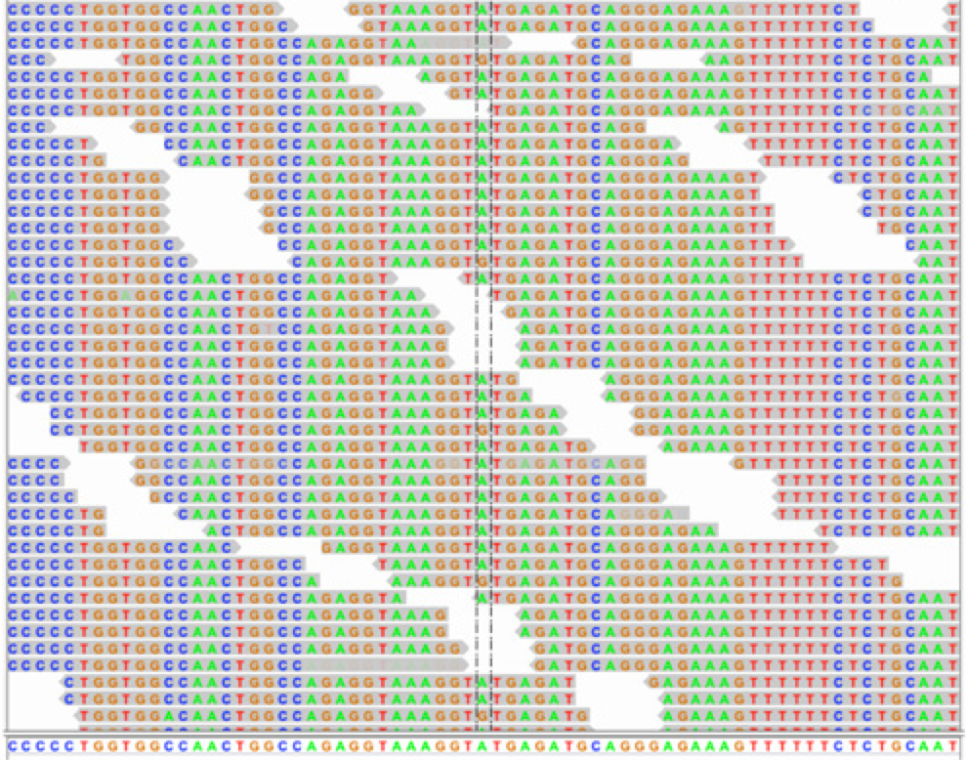
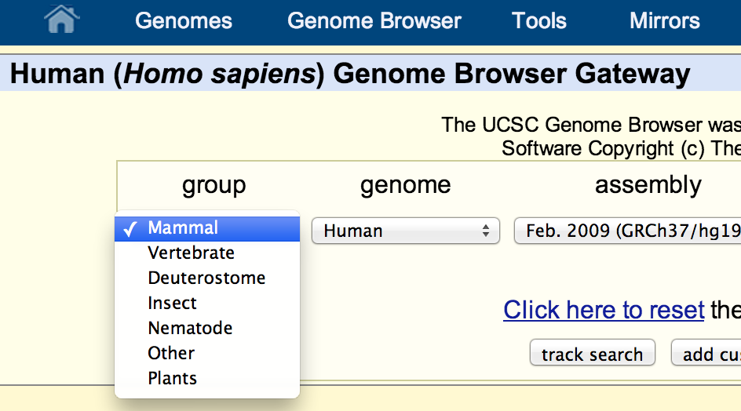
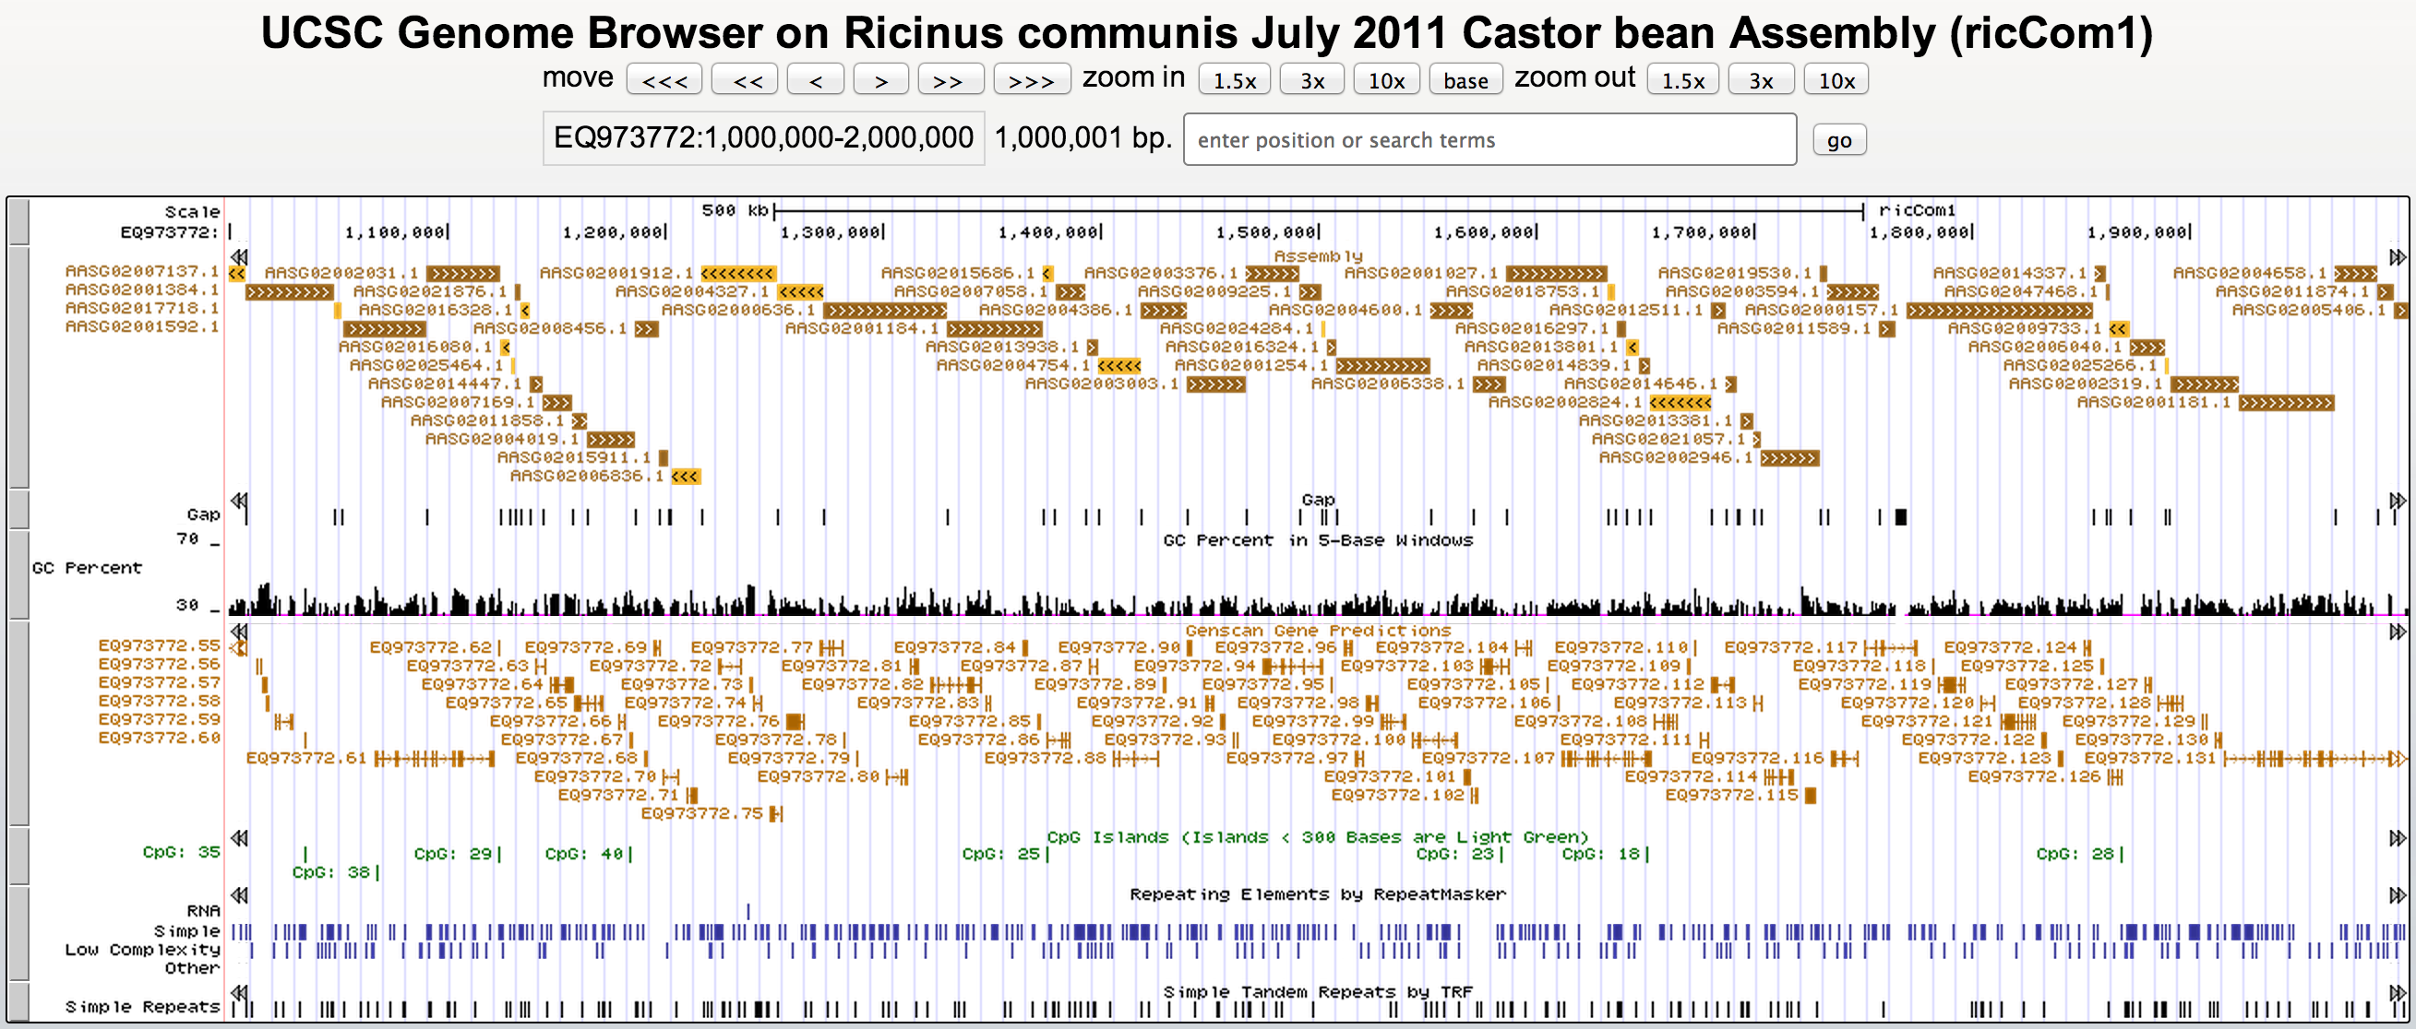
ASSEMBLY HUBS Display novel genome sequence using the UCSC Genome Browser
Assemble your sequence
Format your files
available on your web server
myHub/ - directory to organize your files on this hub
hub.txt – primary reference text file to define the hub, refers to:
genomes.txt – definitions for each genome assembly on this hub
newOrg1/ - directory of files for this specific genome assembly
newOrg1.2bit – ‘2bit’ file constructed from your fasta sequence
description.html – information about this assembly for users
trackDb.txt – definitions for tracks on this genome assembly
groups.txt – definitions for track groups on this assembly
bigWig and bigBed files – data for tracks on this assembly
external track hub data tracks can be displayed on this assembly
Display your genome
http://mylab.university.edu/myHub/hub.txt
More information:
genomewiki.ucsc.edu/index.php/Assembly_Hubs
Hiram Clawson, Brian J. Raney, Galt P. Barber, Angie S. Hinrichs, Pauline A. Fujita, Ann S. Zweig, Donna Karolchik,
W. James Kent - Center for Biomolecular Science and Engineering, University of California at Santa Cruz, California, USA
Acknowledgments
This work was funded by National Human Genome Research Institute award U41HG002371 to the UCSC Center for Genomic Science.

